Slide 1
Second Class SESE (History, Geography & Science) SHPE (Social, personal, health education)
April 27th – May 1st
You will need: A copybook/paper, pencil, colours, ruler.
Ms. N. Fox, Ms. Troy and Ms. C. Fox

Slide 2
A note from your 2nd class teachers:
Dear parents,
We hope you are well and staying safe!
In this PowerPoint you will find work for History, Geography and Science. We have also included some Sphe activities to help keep your mind and body healthy ☺
The 2nd class team have set as much work as we can that your children can do independently. However, they might need some help reading and figuring out some of the tasks / instructions. Please note that we have also included audio on each slide, all you need to do is click on the sound icon ☺
Please note that this work is planned for one week.

Slide 3
Well done to you all for getting through the first week of online work!
We are very proud of you!
If you would like any of your child’s work displayed on the school website , please send it to Ms. Healy, our HSCL: Whatsapp 0877443779 or by email hscl@shjkillinarden.ie
Here is the next week of work; take your time and do your best!

Slide 4
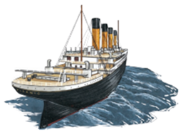
History - Titanic
Last week we started learning about Titanic:
What do you remember about Titanic?
Talk to your grown ups about what you can remember!
Here is a video to spark your memory! https://www.youtube.com/watch?v=AlXYqoRRFts

Slide 5
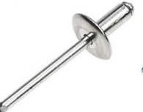
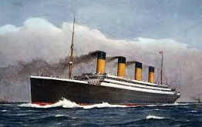
Titanic – Lets swim in deeper!
We know Titanic was a huge ship … but what was it made out of?
Titanic was made from steel plates, wrought iron rivets and equipped with the latest technology! Rivet >>>
More facts here:
https://www.natgeokids.com/ie/discover/history/general-history/would-you-have-survived-the-titanic/

Slide 6
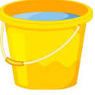
Experiment – Sink and Float
There were many reasons why people thought Titanic sank:
Some people believe that the captain didn’t listen to the warnings. Others think it wasn’t built properly and others think that it was sailing too fast and couldn’t stop.
Your task today is exploring what items will sink or float in water!
First of all, test out some fruit, pens, pencils, rubbers in a basin of water and find out which items sink or float!
Check this video out:
https://www.youtube.com/watch?v=eQuW8G2QV_Q

Slide 7
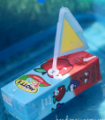
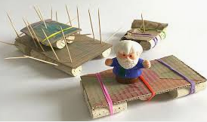
Experiment – Sink and Float
Your task is to design a raft/boat that is able to float in water!
First all of you need to think of what materials you could use to make a boat that actually floats!
This website will give you some good ideas ☺
You can even add a little captain to sail your boat! Please send in some pictures for the school website so we can see :)
https://inspirationlaboratories.com/how-to-build-a-boat/

Slide 8
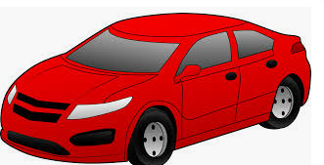
Geography: Transport
Last week we started to learn about transport… Here is a quick reminder!
What is transport?
It is the movement of people and items from one place to another!
This week we are going to look at a specific type of transport that is used all the time by people all over the world:
Cars!

Slide 9
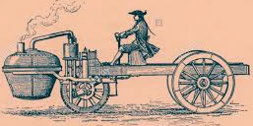
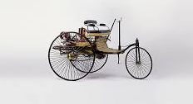
The history of cars
1769 – Nicolas-Joseph Cugnot invented a car-like vehicle. It was a steam-powered tricycle.
There were lots of developments on cars over the years but in 1886 Carl Benz was the first to make a modern car. It was called the, Benz Patent-Motorwagen.

Slide 10
Have a look at these cars!

Slide 11
Features of a car
Do you know any parts of the car on the inside or the outside?
Talk to your grown ups about the parts of the car that you know!
Inside the car there are features including the steering wheel, the gear stick, the pedals, window wipers, indicators, a radio, a heater and many more features. Have a look inside your car with your grown ups and see if they can help you find any of these things!

Slide 12
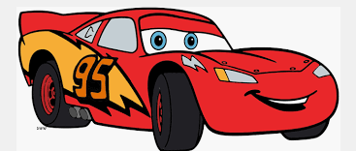
Transport - Cars
For this lesson you have two tasks to complete:
1. In your copy write a few sentences about your favourite car – what is it called? What does it look like? Why is it your favourite?
2. Design your dream car : Turn your copy sideways or use a blank sheet and draw your dream car! Make sure you label all of the parts and features and colour it in!
For example: Your dream car might have a hot chocolate machine on the inside, lazers on the outside, a mini fridge, built in tv’s or a dancefloor in the back!

Slide 13
Science - Materials
Last week we started looking at materials
There are four main materials that things are made from:
Wood
Metal
Plastic
Glass
This week we will be exploring man-made and natural materials!

Slide 14
Man-made and natural materials
Natural Vs Man-Made Materials:
Natural materials – anything that comes from plants, animals or the ground.
Man-made materials – things that humans have created like plastic.
Can you think of any man- made or natural materials in your area?
Talk to a grown up!

Slide 15
Natural Vs Man-made materials

Slide 16
Task 1 – Natural Materials
Where do these materials come from?
Write these headings in your copy and put the materials under the correct heading!

Slide 17
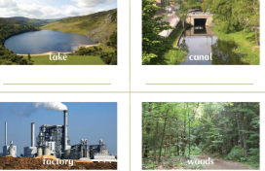
Task 2 – Answer these questions in your copy:
What natural features are in your area?
What man-made features are in your area?
Name a natural feature in a hot country?
Name a natural feature in a cold country ?
Name two natural features you could find in different parts of the world.

Slide 18
SPHE – Look after yourself!
Here are some ideas you might like to do/ use during this time to keep your mind and body healthy ☺

Slide 20
Go Noodle- some of our favourites:
Cant stop the feeling/ Trolls https://www.youtube.com/watch?v=KhfkYzUwYFk
Pop See Ko
https://www.youtube.com/watch?v=Pwn4beja1QE
Chicken Dance https://www.youtube.com/watch?v=npp1z32idrc
Run the Red Carpet https://www.youtube.com/watch?v=Shm8ByZswQ8

Slide 21
Keep being a bucket filler!
I hope everyone is remembering to check in with themselves and see who’s bucket you filled today and how you did that! Please remember to keep being a bucket filler and not a bucket dipper☺
https://www.youtube.com/watch?v=3EuemNAo6XE

Slide 22
Well done everybody! You have worked so hard ☺

