Slide 2
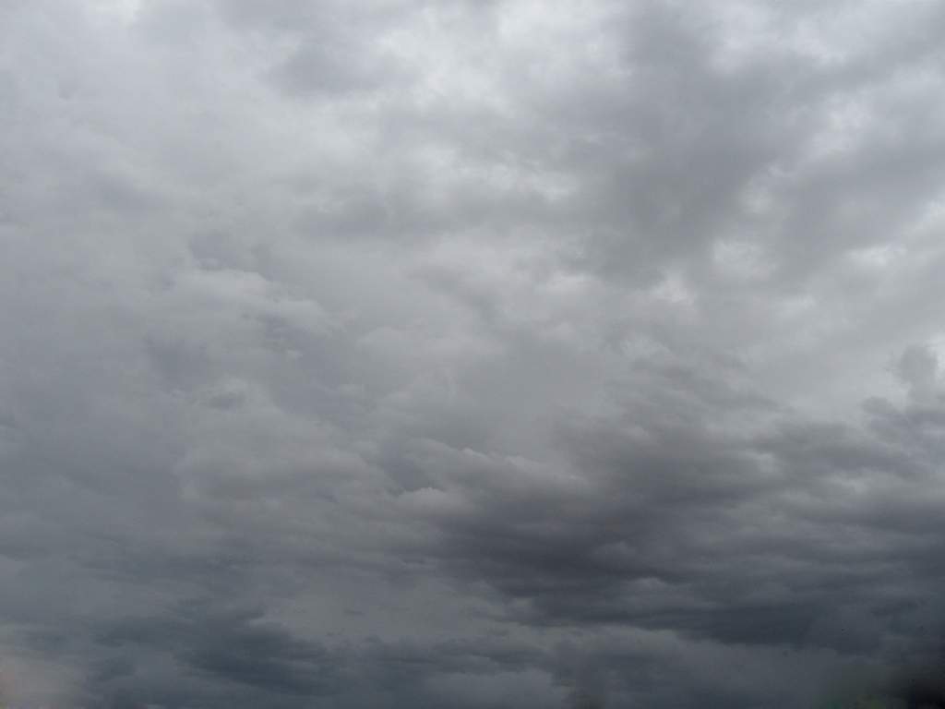
Scamall Tá sé scamallach.
Photo courtesy of second_mouse (@flickr.com) - granted under creative commons licence – attribution

Slide 3
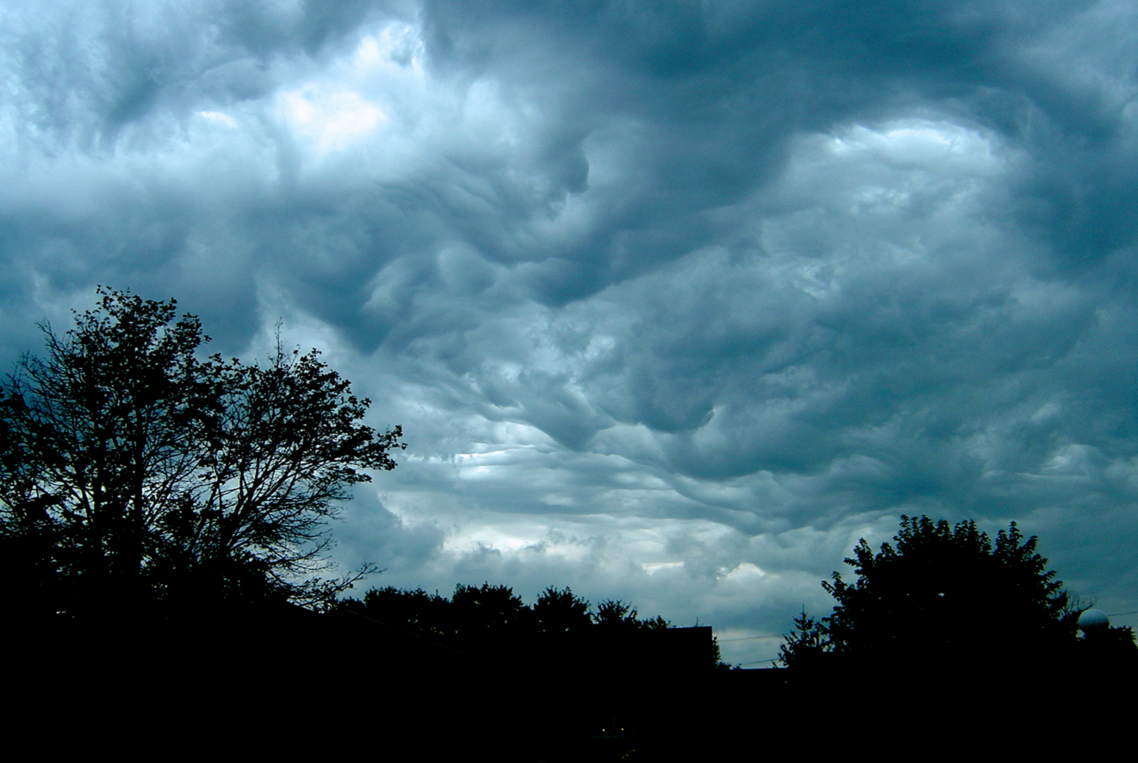
Stoirm Tá sé stoirmiúil.
Photo courtesy of laffy4k (@flickr.com) - granted under creative commons licence – attribution

Slide 4
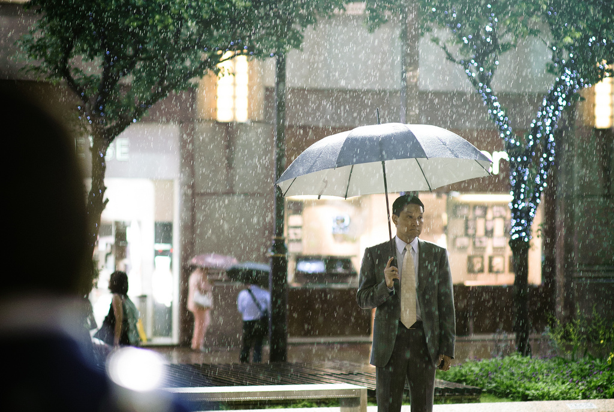
Fliuch Tá sé ag cur báistí.
Photo courtesy ofルーク.チャン.チャン (@flickr.com) - granted under creative commons licence – attribution

Slide 5
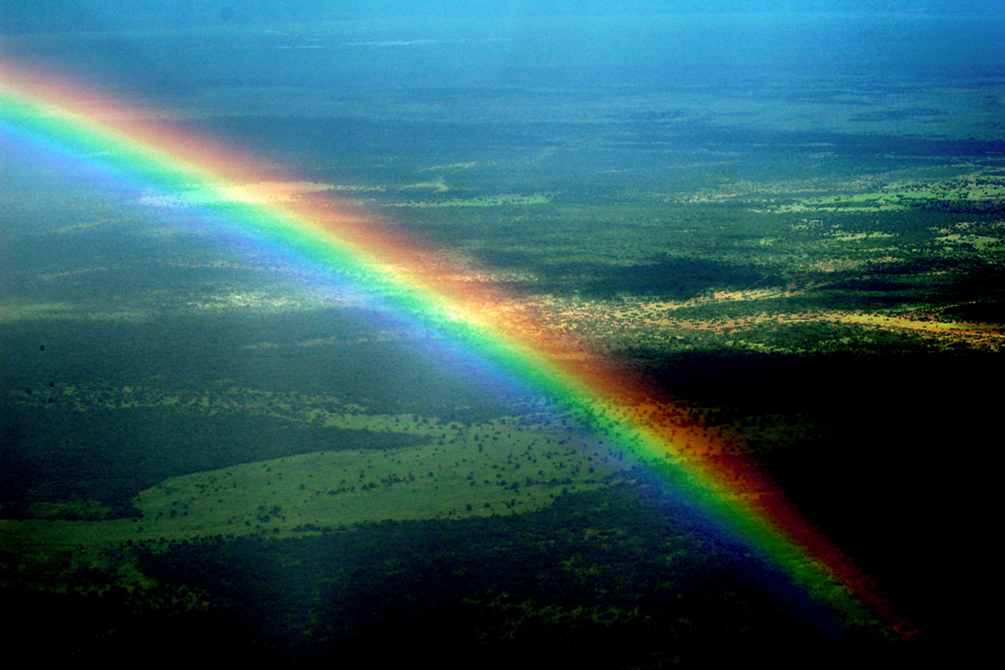
Bogha báistí Tá bogha báistí sa spéir.
Photo courtesy of Cessna 206 (@flickr.com) - granted under creative commons licence – attribution

Slide 6
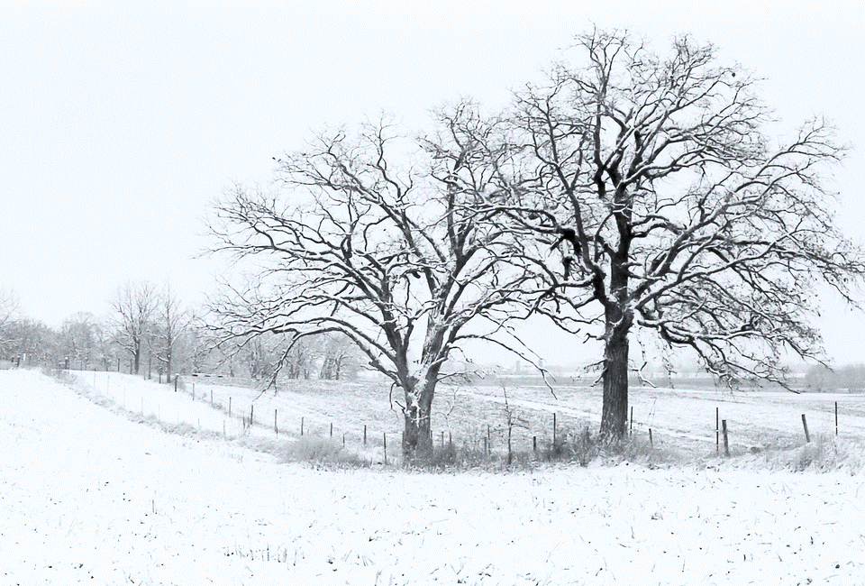
Sneachta Tá sé ag cur sneachta.
Photo courtesy of oliworx (@flickr.com) - granted under creative commons licence – attribution

Slide 7
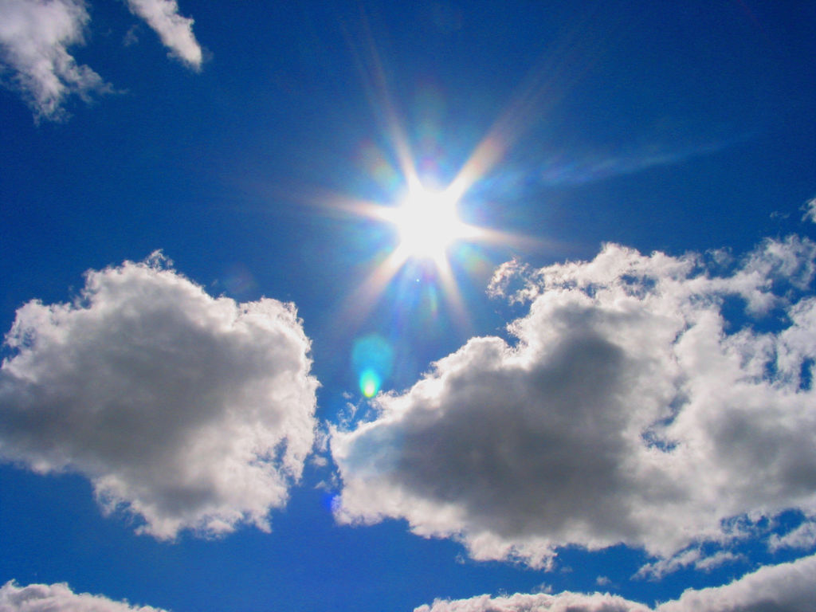
An ghrian Tá an ghrian ag taitneamh.
Photo courtesy of **Mary** (@flickr.com) - granted under creative commons licence – attribution

Slide 8
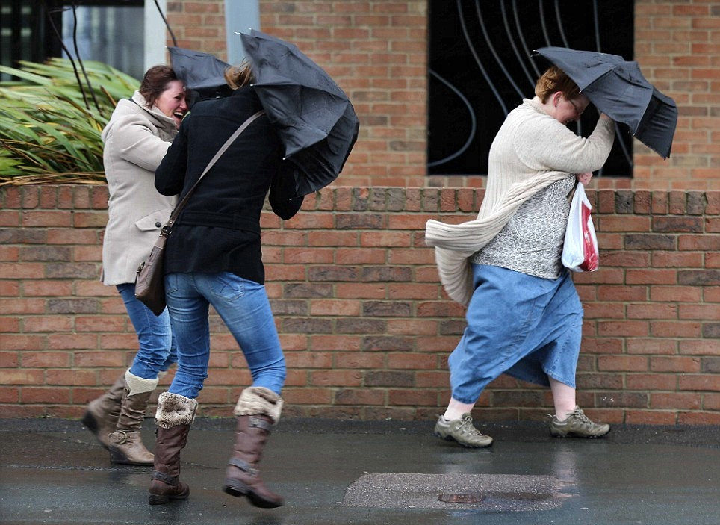
Gaoth Tá sé gaofar!
Photo courtesy of brizlzle born and bred (@flickr.com) - granted under creative commons licence – attribution

