Slide 1
Second Class SESE (History, Geography & Science) SHPE (Social, personal, health education)
May 5th – May 8th
You will need: A copybook/paper, pencil, colours, ruler.
Ms. N. Fox, Ms. Troy and Ms. C. Fox

Slide 2
Don’t forget:
If you would like any of your child’s work displayed on the school website , please send it to Ms. Healy, our HSCL: Whatsapp 0877443779 or by email hscl@shjkillinarden.ie
Here is the next week of work; take your time and do your best!

Slide 3
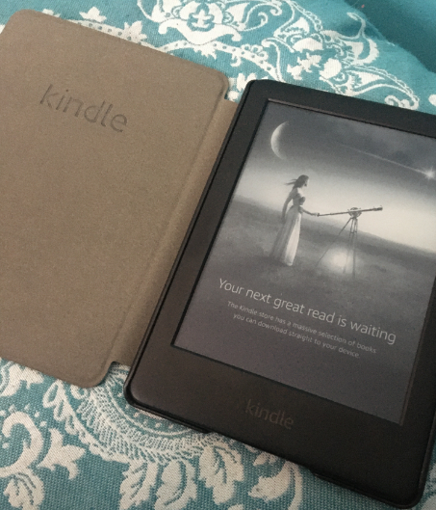
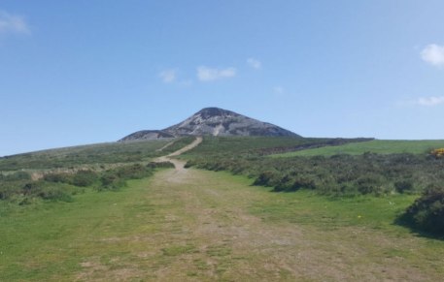
A quick message from Ms. Fox
Hi everyone ☺ I hope you are all well and keeping safe!
Over the last week I have been walking each day to keep healthy and get some fresh air!
I have also been doing a lot of reading and watching Disney + !
Well done on all your hard work, I am very impressed with all the work I have seen on the school website!
I hope to see you soon,
Ms. C. Fox

Slide 4
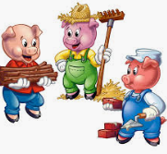
History – ‘A house is a house for me’
This week we are going to be looking at houses and homes.
We are going to start by looking at stories about homes:
Can you think of any stories that involve peoples houses or homes?

Slide 5
“A house is a house for me” by Mary Ann Hoberman
This week we are going to read:
“A house is a house for me” by Mary Ann Hoberman.
Make a prediction: What do you think this story might be about?
Click the link for the story: https://www.youtube.com/watch?v=s4cGB0-7R-0

Slide 6
Task one – Answer the questions in your copy
Answer these questions based on “A house is a house for me” :
Name five animals mentioned in the story.
What house is a house for a bee?
Where do sheep gather to sleep?
“A castle’s a house for a duchess” …who else do you think would live in a castle?
What is the house for a plane?

Slide 7
Task two – Draw a picture
Your second task is to find your favourite part in the story “A house is a house for me” and draw it in your copy!
Make sure you write a title so it is clear what your picture is ☺

Slide 8
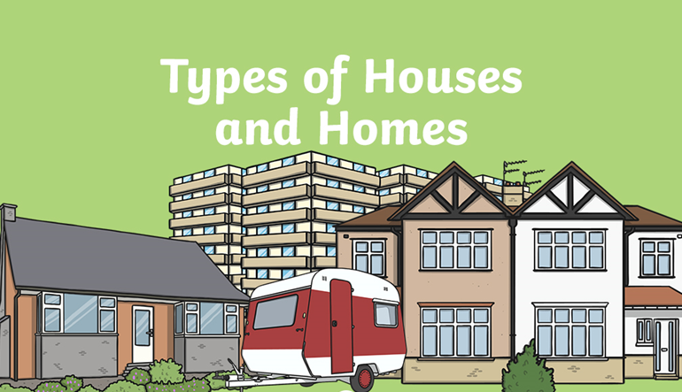
Geography

Slide 9
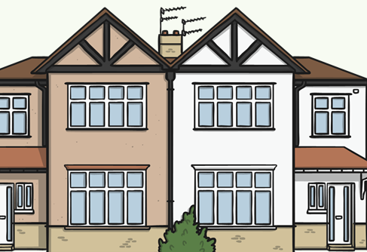
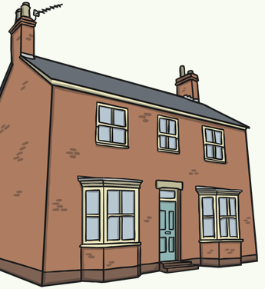
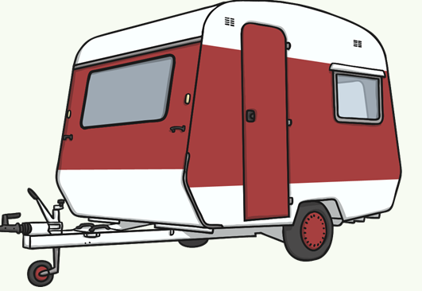
A bungalow - It doesn’t have any stairs and is all on one level.
A Detached House - This house stands on its own and isn’t joined to any other buildings.
A Semi Detached House - It has another house joined onto it on one side.
Caravan - This home is on wheels and can be moved around.

Slide 10
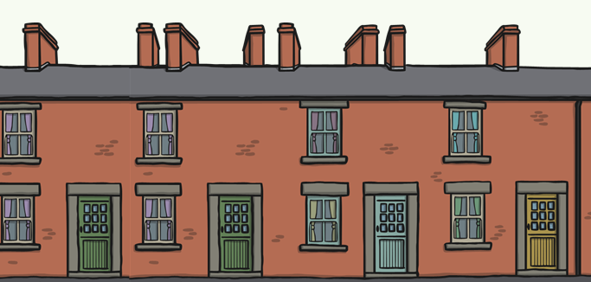
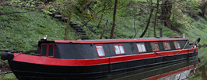
Terraced Houses - These houses are all joined together.
A Houseboat - This home floats on the water.
Apartment/ Flat - They are stacked on top of each other.

Slide 11
Geography : Task of the week
Your task this week is very simple:
Discuss with your grown ups what kind of house you live in.
Find your house on Google Maps!

Slide 12
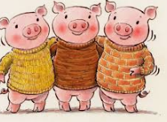
Science : What is used to build our homes?
It is important that our homes are built properly to make sure they are safe for us to live in and shelter us from harsh weather.
In ‘The Three Little Pigs’, two of their houses were built from materials that were not suitable to live in. Do you remember what they were made from?

Slide 13
Science : What is used to build our homes?
Here are some questions for you to answer out loud with your grown ups:
What is your house made from? Why do you think this was used to build your home?
Why are our school walls made out of bricks and not wood?
Why did the 3rd little pigs house work best?
Why are houses not made out of plastic or glass?

Slide 14
SPHE – Look after yourself!
Here are some ideas you might like to do/ use during this time to keep your mind and body healthy ☺

Slide 15
Time To Relaaaaaax!
Rainbow breathing
https://www.youtube.com/watch?v=O29e4rRMrV4
Be the Pond
https://www.youtube.com/watch?v=wf5K3pP2IUQ
Butterfly stretch
https://www.youtube.com/watch?v=oYI0TPJOuGk

Slide 16
Well done everybody! Have a lovely weekend ☺

