Slide 1
SENIOR INFANTS
ENGLISH AND GAEILGE
11th to 15th May

Slide 2
Dear Children,
Summer is here and we hope you’ve been able to enjoy some of the lovely sunshine we’ve had. What a busy week we had last week with Active School Week. Hopefully you got a chance to do some of the fun activities we suggested. Keeping active is very important for our bodies.
And we can see from the lovely photos that you’ve been keeping up with some schoolwork too. We are all very proud of you. We were so impressed by how talented you all are that we made a little book called ‘Our Super Senior Infants!’ Keep an eye out for it in the PowerPoint.
We know you are all trying your best. Remember only do what you can, we don’t expect you to do everything. Stay active, don’t forget to help out at home and most importantly have fun.
The Senior Infants Team

Slide 3
ENGLISH
Reading
PM Class Readers
This week you can choose between Oxford Owl or PM books. We use PM readers in school and the children will have read some of these books. Click on link above for PM Class readers and use login details below.
Username: seniorinfantsa@gmail.com
Password: May2020
On the second row try Harry and the Little Robot. For a challenge try Jet, the Little Robot on the second row at the end. Press the orange Read button at the bottom.

Slide 4
Words
what
Practice as often as possible. Choose a word and see how many times you can write it in a minute. Can you make a game with the words?
Try sounding out these words
Sound out words
sight words

Slide 5
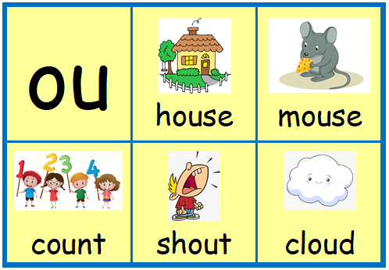
Sounds
Look at the all family. Can you think of some more words that rhyme with all?
Can you hear the ‘ou’ sound in these words? How many ‘ou’ words can you write?
I love to rhyme
ou words

Slide 6
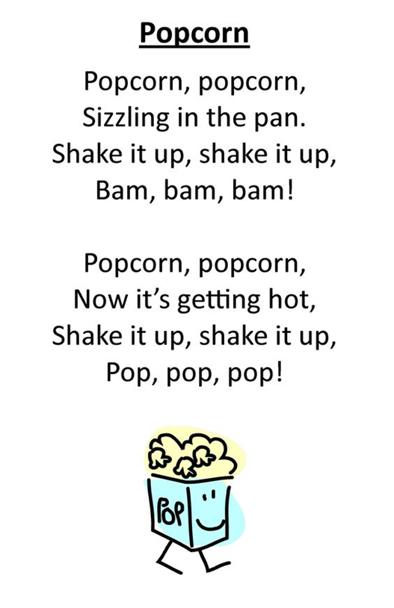
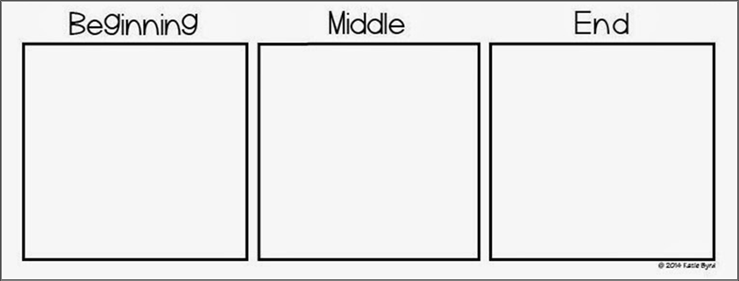
Story
Listen to the story
The Good Egg
Think about what happened at the beginning, middle and the end. What was your favourite part?
Poetry
Ask an adult to read the poem for you.
Did you like the poem?
What did it make you think of?
Have you ever made popcorn at home?
What other sounds does popcorn make?

Slide 7
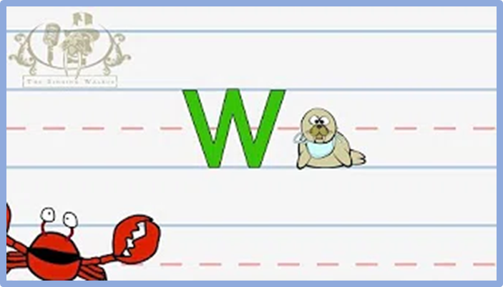
Letter Formation
My News
Capital W
Draw and write about your news. If you would like it displayed on the school website take a photo of it and send it to Gaye, our HSCL teacher, on WhatsApp 087 744 3779 email hscl@shjkillinarden.ie
Our Super Senior Infants have been very busy working at home. Have a look at what they’ve been up to.
Our Super Senior Infants

Slide 8
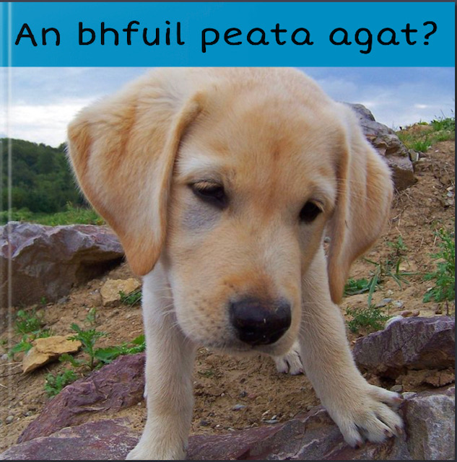
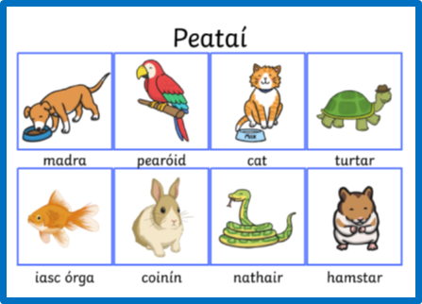
GAEILGE
Leabhar/Book
Look at the book
An bhfuil peata agat?
Peataí / Pets
An bhfuil peata agat? /Do you have a pet?
Tá ___ agam. / I have a ___.

