Slide 1
Second Class SESE (History, Geography & Science) SHPE (Social, personal, health education)
May 18th – May 22nd
You will need: A copybook/paper, pencil, colours, ruler.
Ms. N. Fox, Ms. Troy and Ms. C. Fox

Slide 2
Don’t forget:
If you would like any of your child’s work displayed on the school website , please send it to Ms. Healy, our HSCL: Whatsapp 0877443779 or by email hscl@shjkillinarden.ie
Here is the next week of work; take your time and do your best!
*Audio Included in slides*

Slide 3
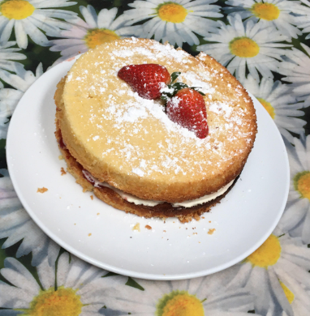
A quick message from Ms. Fox
Hi everyone ☺ I hope you are all well and keeping safe!
This week I did a lot of painting! I have been painting fences around my house and trying to make sure the dogs don’t stand in the paint tray! I also made a sponge cake, it was yummy ☺
I know last Saturday was supposed to be your Communion day and you are probably disappointed but don’t worry we will work something out ☺ For now just keep safe and enjoy each day in whatever way you can!
Please keep sending in photos for the website, they make my week ☺
Ms. C. Fox

Slide 4
History – Haunted Houses
Continuing on with our houses and homes theme, this week we will be looking at another type of home; A haunted house!
Haunted Houses are something we might talk about at Halloween!

Slide 5
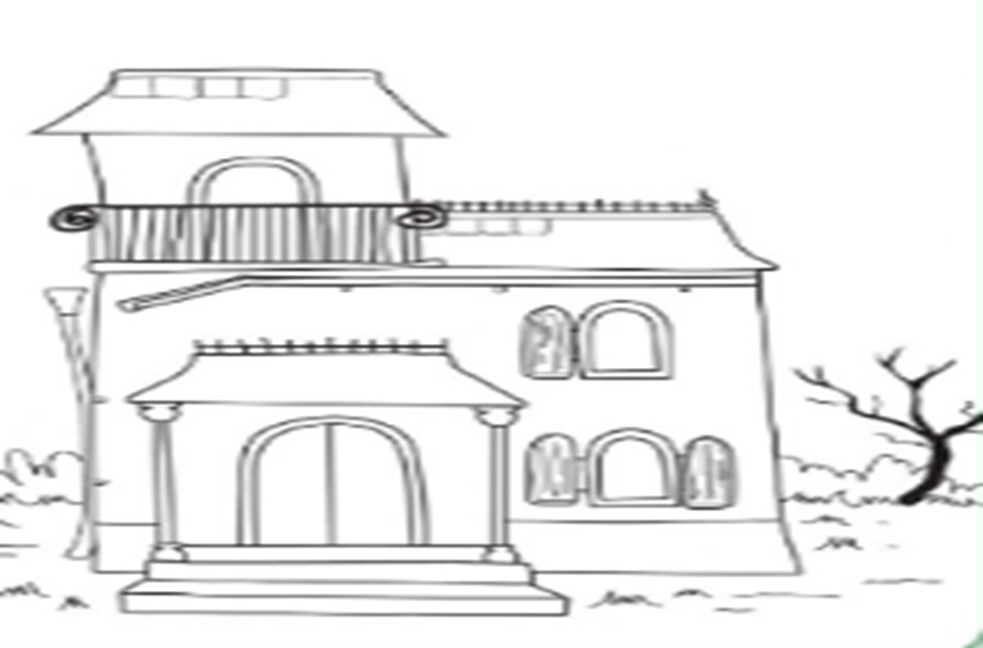
The Haunted House
Today we will look at this
Haunted House! You will
be drawing this house and
following the instructions
on the next slide!

Slide 6
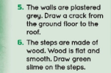
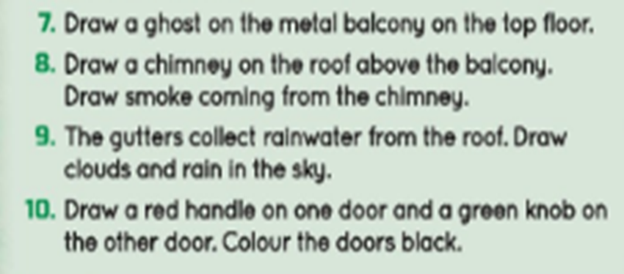
The Haunted House – Drawing instructions

Slide 7
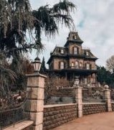
The Haunted House
I have just two questions for you about your Haunted House:
Would you live in your Haunted House? (Answer this question with a grown up and tell them why!)
Who do you think would live in your Haunted House? Draw them beside it ☺
This is a photo of the ‘Phantom Manor’ in Disneyland Paris!

Slide 8
Geography – Homes around the world
Last week we had a quick look at homes from different places around the world!
What our homes give us:
It shelters us from the weather.
It keeps us safe from danger.
It is a place for our things.
It is a place to eat, sleep and play.

Slide 9
Homes around the world
What do you think people’s homes would be like in:
Holland
Kenya
Greece
Switzerland
South Africa
Hong Kong
Peru
Australia

Slide 10
Homes around the world

Slide 11
Homes around the world

Slide 12
Homes around the world
Using the previous slides, answer these questions! Talk to your grown ups and tell them why you chose these answers!

Slide 13
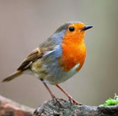
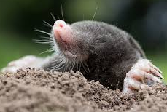
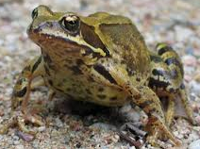
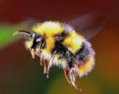
Science: Animal Homes
This week we will be taking a look at animal homes ☺
Can you name any animal homes?

Slide 14
Animal Homes
What is a habitat?
A habitat is an animals natural home / place to live in.
A birds natural habitat is a nest.
A moles natural habitat is in a tunnel that they make.
A frogs natural habitat is a pond.
A bees natural habitat is a hive.

Slide 15
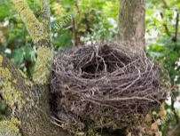
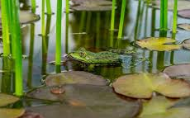
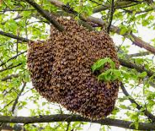
Animal Homes

Slide 16
Animal Homes: Badgers
For this lesson we will be looking at badgers and their habitats!
Have a look at these videos first ☺
https://www.youtube.com/watch?v=HFz9WQulxhE
https://www.youtube.com/watch?v=KrChYx_sFK0

Slide 18
A Badgers Home
Read the passage on the previous slide and answer these questions in your copy:
What is the name of a badgers home?
Where do they build their homes?
What do they use for their bedding?
How many badgers can live inside?
What happens if too many tunnels are dug?
What size was the biggest badger home in Ireland?

Slide 19
SPHE – Look after yourself!
Here are some ideas you might like to do/ use during this time to keep your mind and body healthy ☺

Slide 20
https://www.youtube.com/watch?v=tbCjkPlsaes

Slide 21
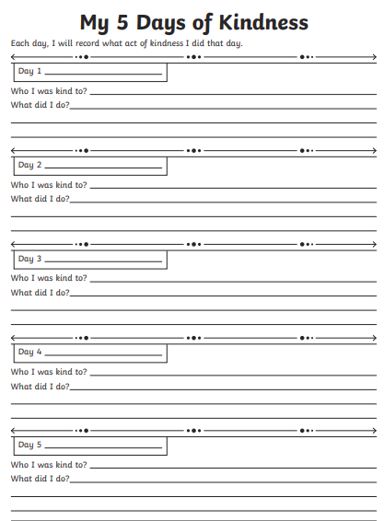
5 Days of Kindness☺
Your challenge for this week is to do ‘5 days of kindness!
Each day you write who you have been kind to and what you did to be kind to that person!

Slide 22
Well done everybody! Have a lovely weekend ☺

