Slide 1


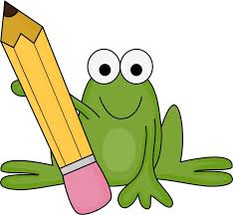
Junior Infants Literacy Online Learning
Sacred Heart JNS
April 20th – April 24th
Notes:
1

Slide 2

Children: We hope you are all staying healthy and safe at home. Your teachers are missing you and are looking forward to seeing you back in the classroom soon.
Parents/Guardians: We hope that our plans will help you. The children will need your help but should be encouraged to be as independent as possible. Keep the sessions short (2/3 tasks per day) and regular and remember that you have one week to complete the tasks. Don’t stress or panic if not completed we will revise all of this when schools re-open. Thank you.
Notes:
2

Slide 3
Students will need:
- A copy book to record their work.
- Pens, pencils, colours, rubber.
-An adult to help.
-A computer / tablet / phone for some activities.
Notes:
3

Slide 4
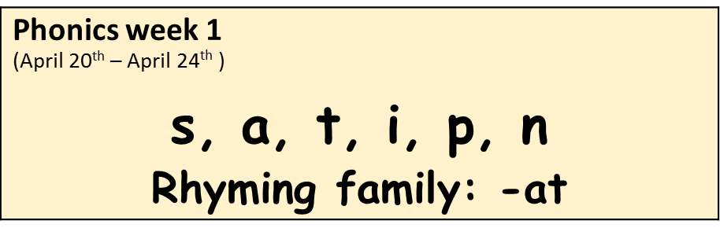
Phonics
Say each sound, do the action and sing the jolly phonics song.
List 3 words for each sound.
Here is a link to the first set of songs https://www.youtube.com/watch?v=T4IfiKiQ-3I
Notes:
4

Slide 5
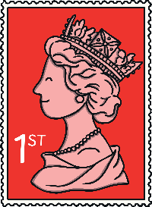


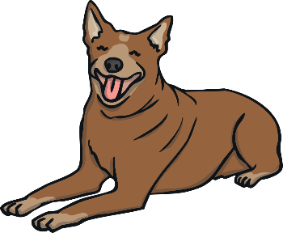
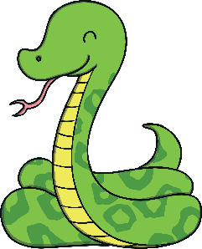
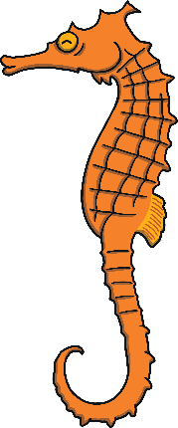

Sound Sort
Can you find which one is the odd one out?
S

Slide 6


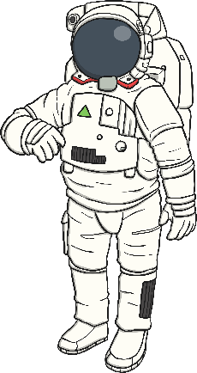
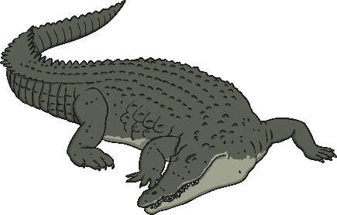
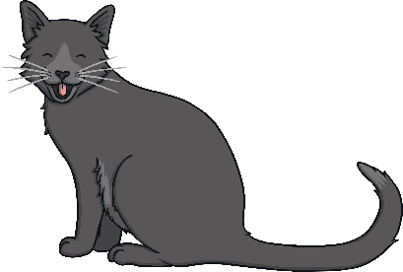

a

Slide 7
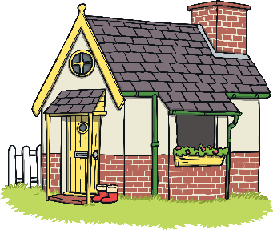
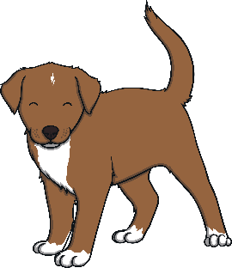
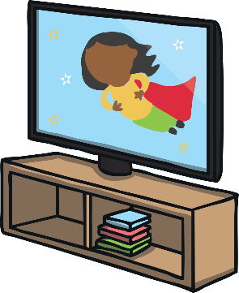



t

Slide 8



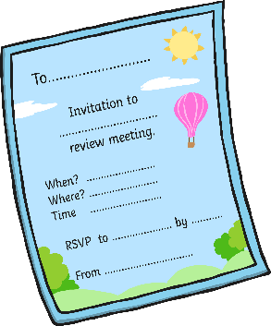


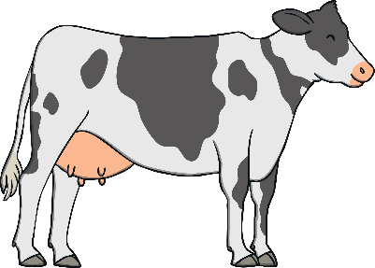
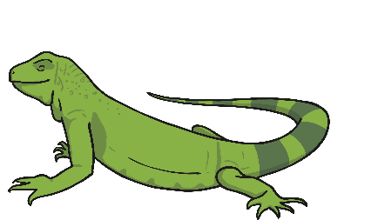
i

Slide 9
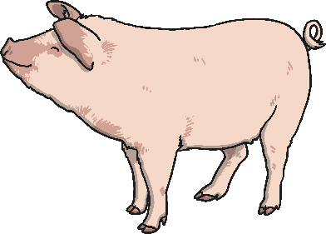



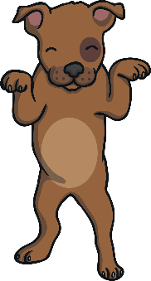
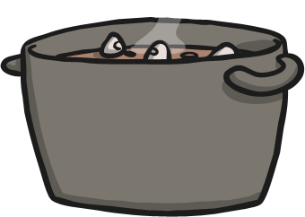
p

Slide 10


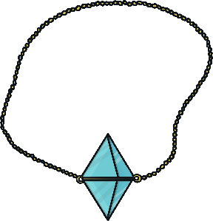
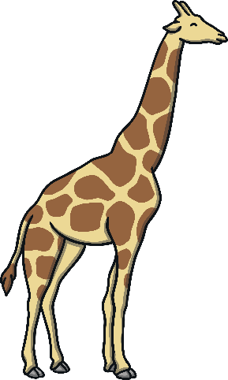


n

Slide 11
Blending: Sound out 3 words daily
https://www.youtube.com/watch?v=MQpw77l-l6M
sat sip
nap ant
pin pan
pit pat
tap tan
sap nip
nit tin
tip
Notes:
11

Slide 12
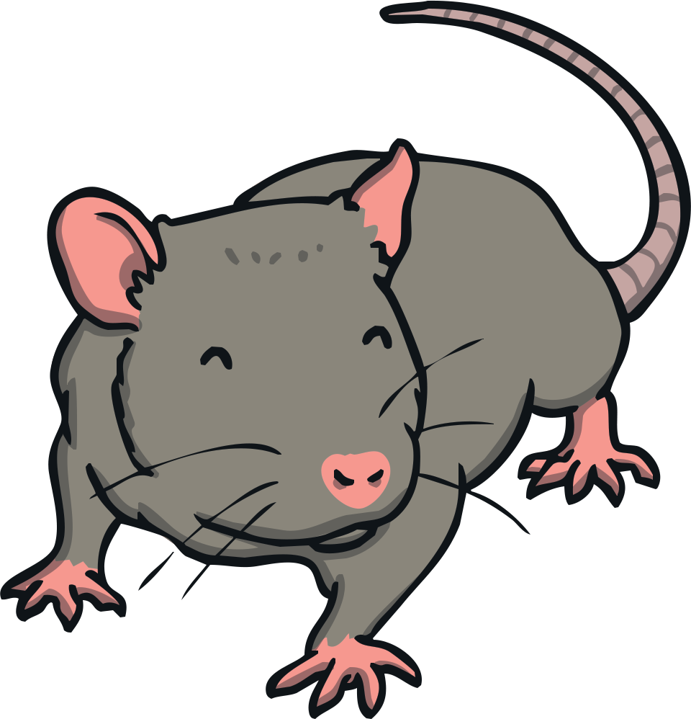

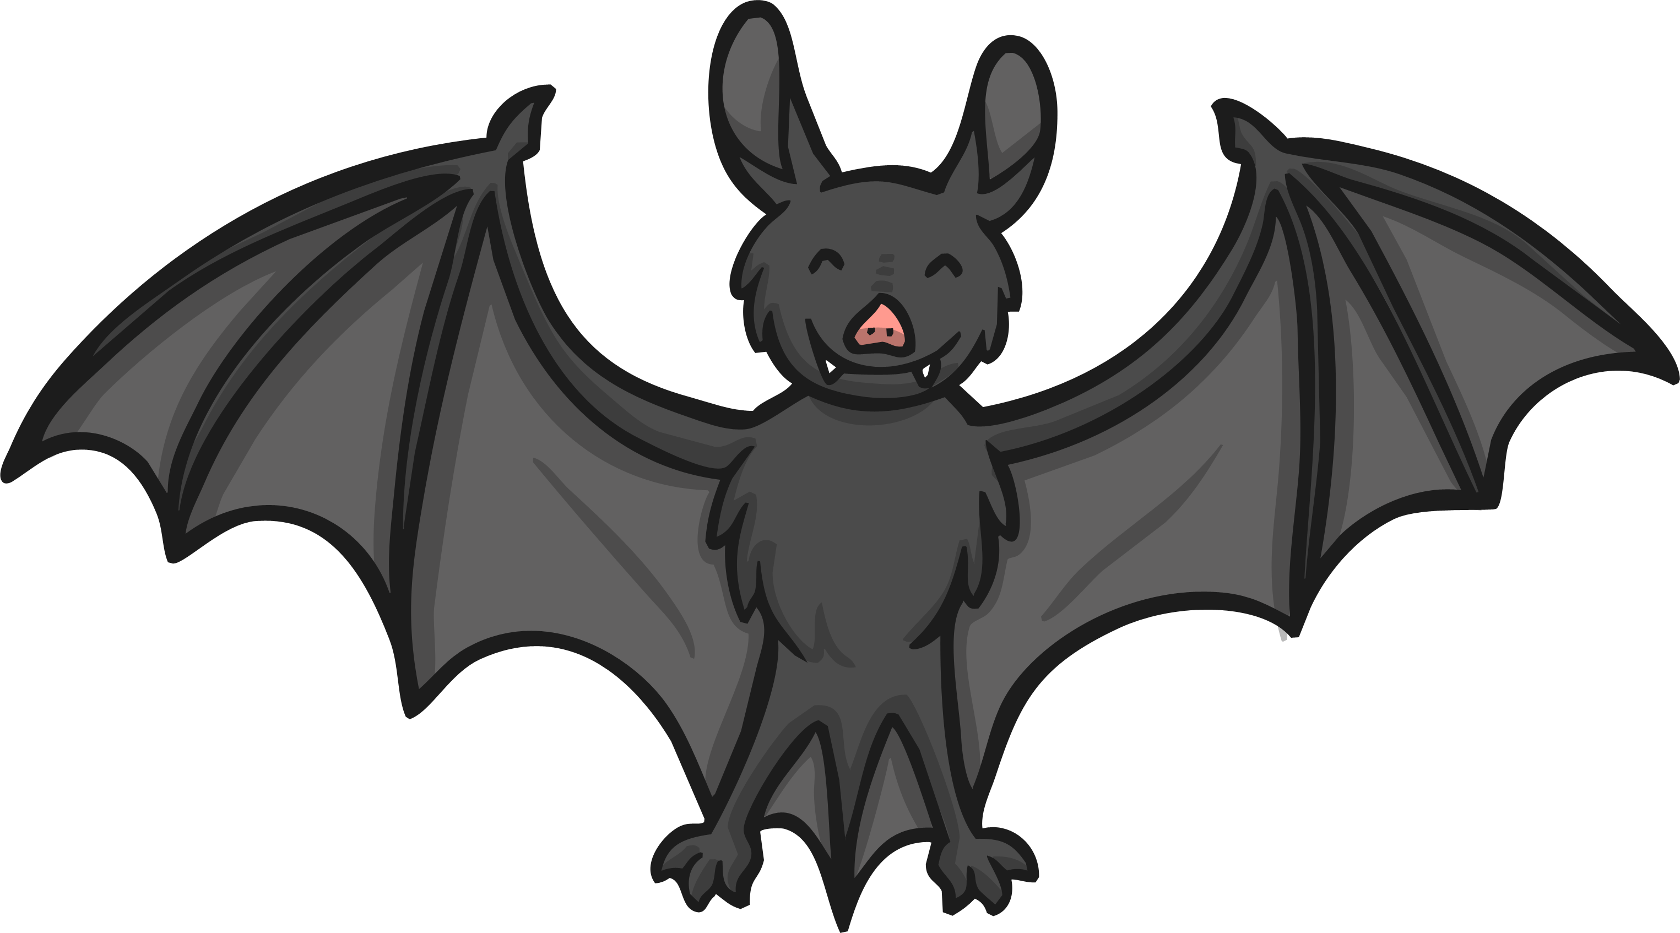

Rhyming Words: at family
Rhyme week 1: How many words can you think of that rhyme with cat?
Which of the following is not an –at word?
at
rat
pan
hat
bat

Slide 13
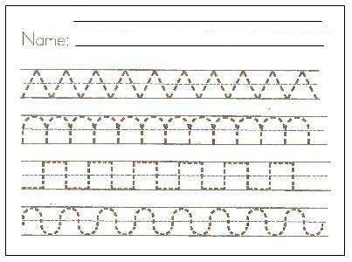
Short writing activities
Practise writing the letters c, a, d, g, o. Please watch carefully how you child writes the letter. Are they starting in the right place?
Dictation: Say each word slowly and get your child to write them down. Ask them what sound they hear at the beginning, in the middle and at the end. a, dog, god, cod.
Practise writing patterns.
Notes:
13

Slide 14
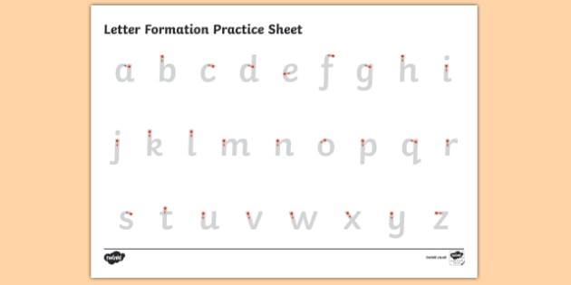
Reminder: Correct letter formation is SO important
Notes:
14

Slide 15
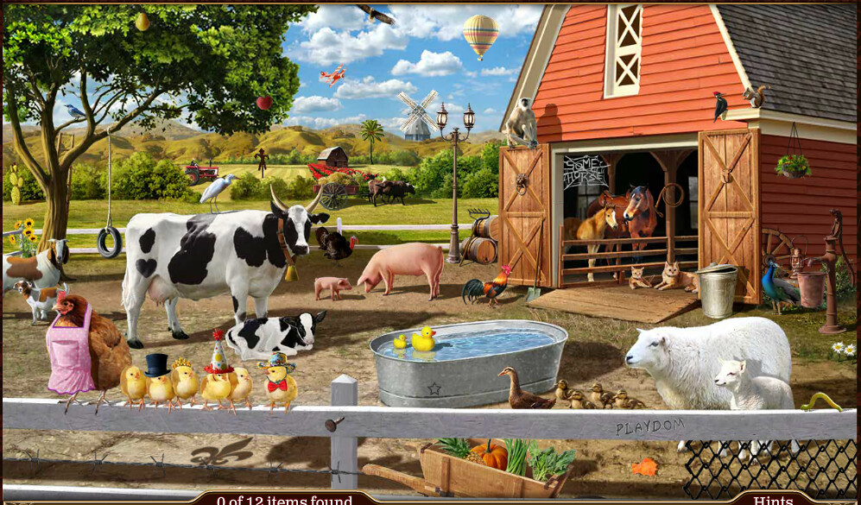
Oral language
Notes:
15

Slide 16
Questions
Name all the animals you can see.
Where are the horses?
What are the ducklings doing?
Why is the cow wearing a bell?
What might the farmer take to the mill?
How does the farmer get milk from the cow?
What do you call a baby cow, horse, pig, duck, goose, sheep, goat?
What is your favourite farm animal? Why?
Can you spot some things that don’t belong in the picture? How many did you find?
Notes:
16

Slide 17
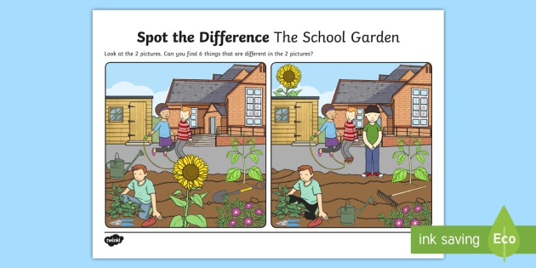
Spot the difference
Notes:
17

Slide 18
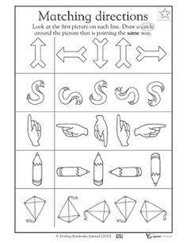
Look at the first picture in each row. Can you find the matching picture?

Slide 19
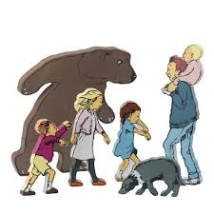
Reading
Try to set aside a little time each day to read to your child.
Encourage them to predict what they think will happen before they read it. When we make predictions we look at the front cover and title of the story.
Encourage them to look at books themselves and to identify any words they know.
Get them to retell stories in their own words and to talk about the characters.
Ask them to draw a picture of their favourite part of the story.
Sample story you can read: We're Going on a Bear Hunt - https://www.youtube.com/watch?v=0gyI6ykDwds
https://www.starfall.com
https://www.oxfordowl.co.uk
https://stories.audible.com/discovery
Notes:
19

Slide 20
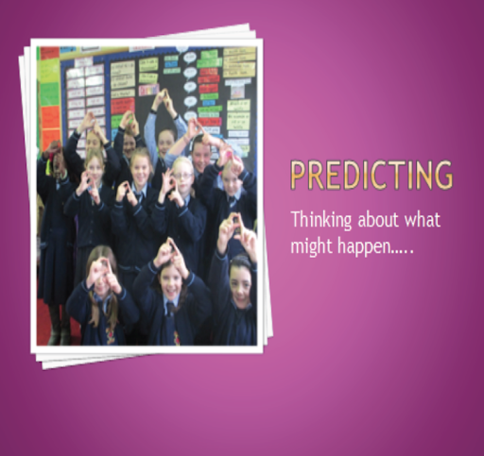
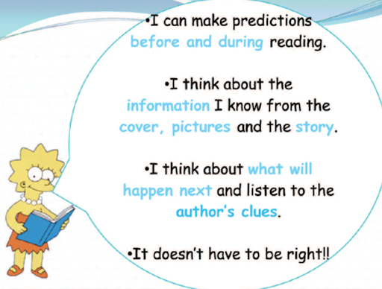
Notes:
20

Slide 21
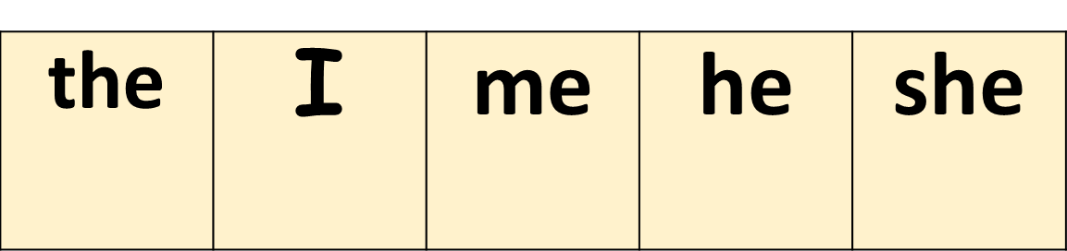
Tricky Words
Tricky words are best remembered by constant repetition. Here are some simple ways to achieve this.
Write the words individually on paper and stick them up around the house. Ask your child to say the word whenever they pass by it. Move the words around regularly.
Make two copies of each word and play Memory or Snap.
Be a tricky word detective and find a given word in a story book.
Watch the Epic Phonics ‘Tricky Word’ songs on YouTube
Notes:
21

Slide 22

Can you find the matches?
To win you have to be able to read and match all the words! Good luck!
I
he
the
me
she
she
the
me
he
I

Slide 23
Can you find the matches?
I
he
the
me
she
she
the
me
he
I

Slide 24
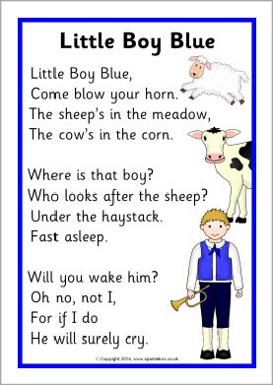
Have fun learning this poem and adding actions.
Notes:
24

Slide 25


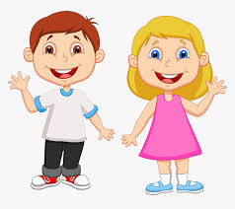
Gaeilge - Irish
Please click on the sound button to
hear the comhrá beag. Now it’s your turn!
Dia duit. Dia’s Muire duit.
Cé tusa? Is mise…
Slán. Slán leat agus go raibh maith agat.

Slide 26

carr
Please repeat the words out loud after you hear them.

Slide 27
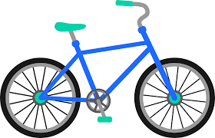
rothar

Slide 28

bád

Slide 29

liathróid

Slide 30

Taispeáin dom bád mór.
Taispeáin dom rothar mór.
Taispeáin dom liathróid mór.
Taispeáin dom carr mór.

Slide 31
Can you point to the right picture?
Press the sound button to begin.

Slide 32

Well done! You have completed all your work.
Notes:
32

