Slide 1
Home Art Ideas Junior Infants

Slide 2
Each art idea can be done over the week. It does not need to be done in one go. Take your time with your child, play some music and enjoy!
These particular lessons are great for practising cutting skills, strengthening fine motor skills and hand eye co-ordination.

Slide 3
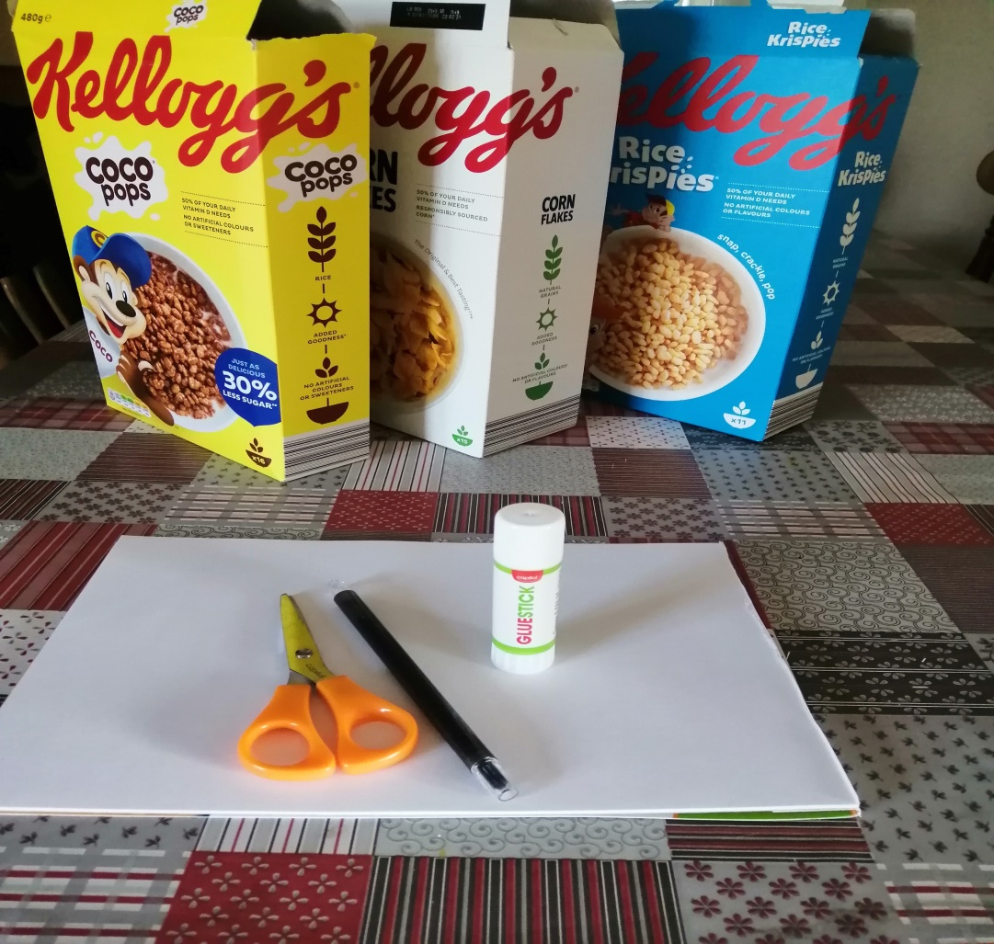
You will need;

Slide 4
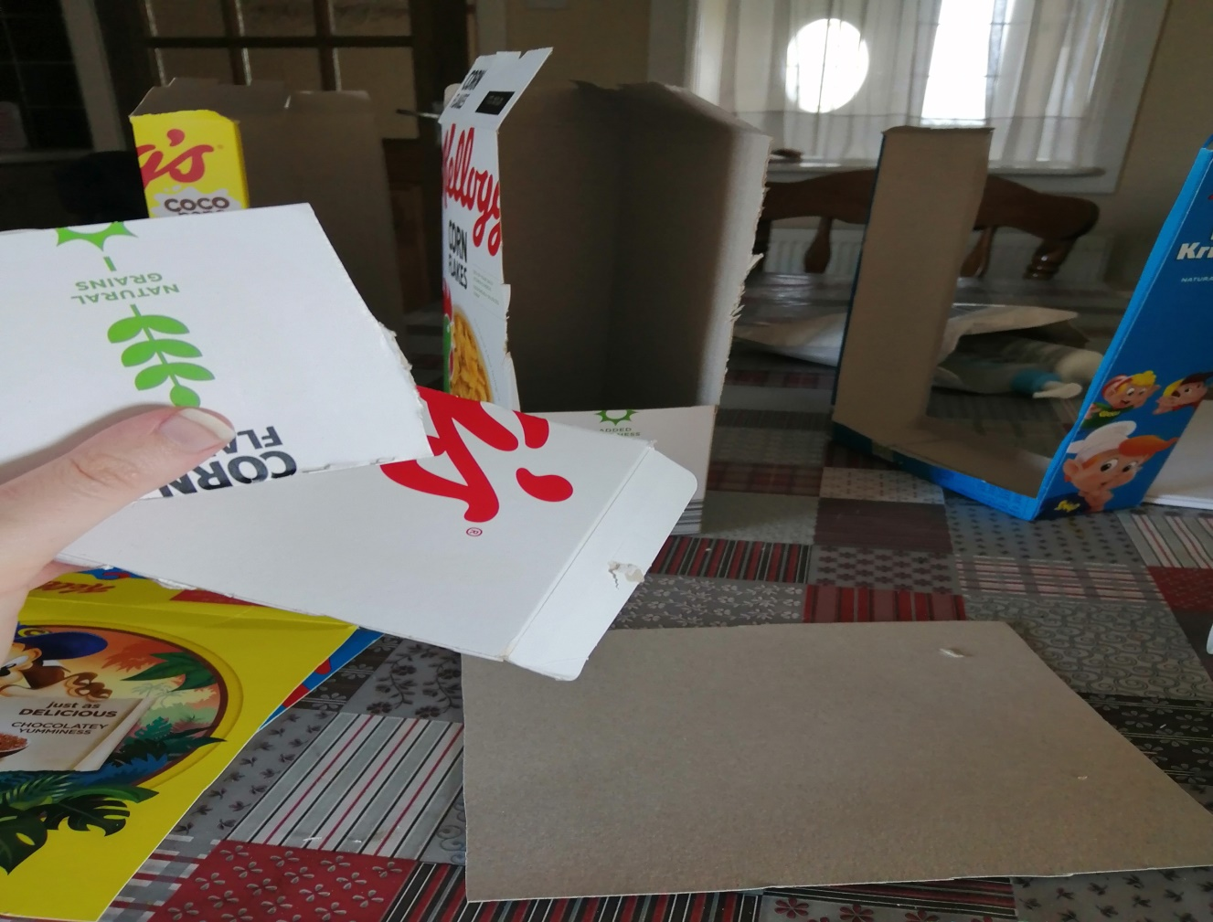

Slide 5
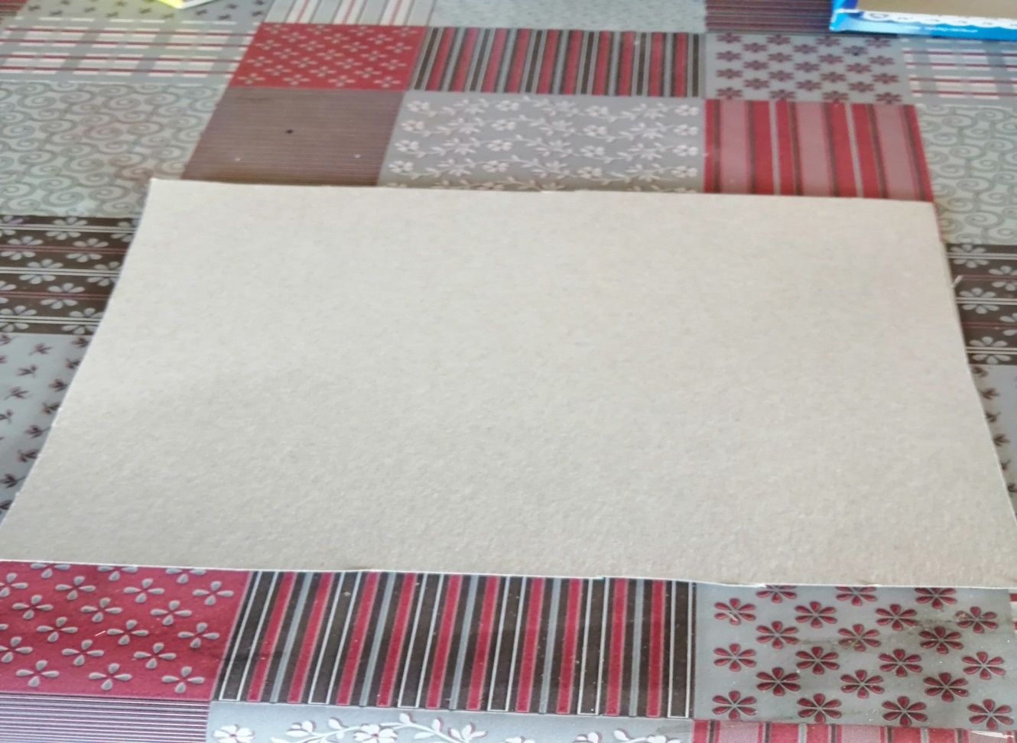
Keep one piece of card for drawing your picture on.

Slide 6
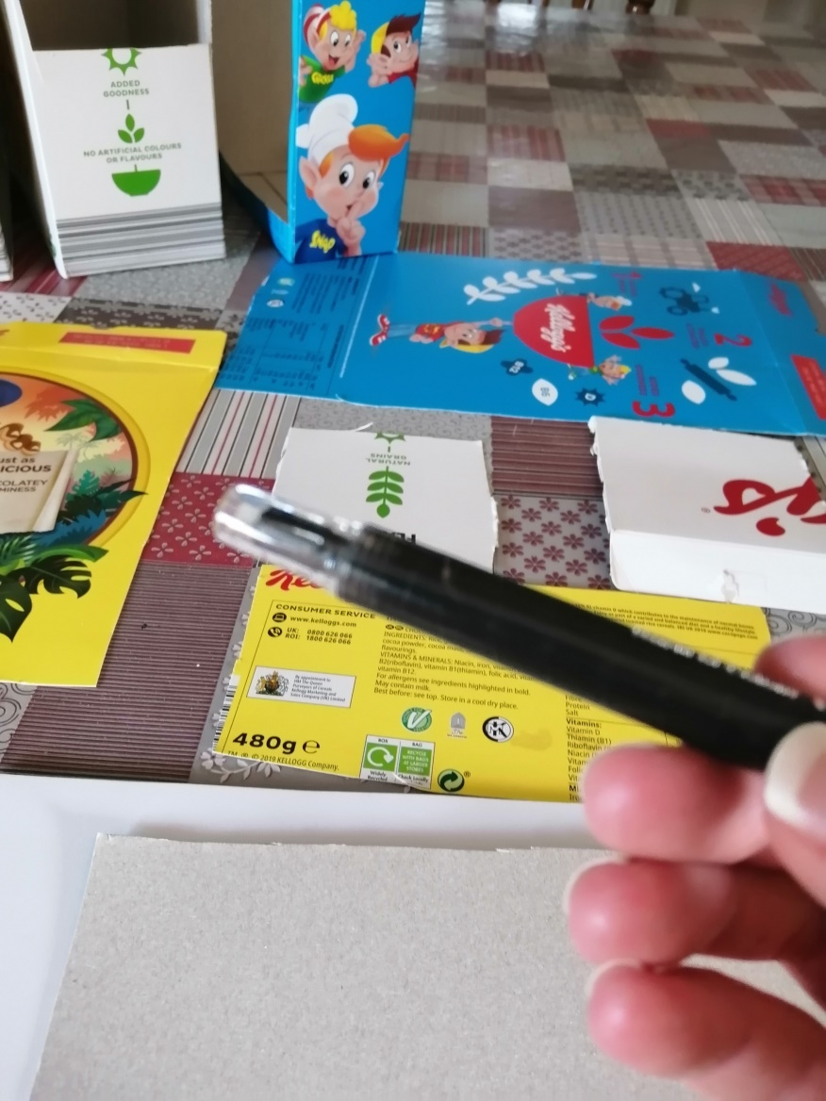
Cut out squares of various colours from the boxes.

Slide 7
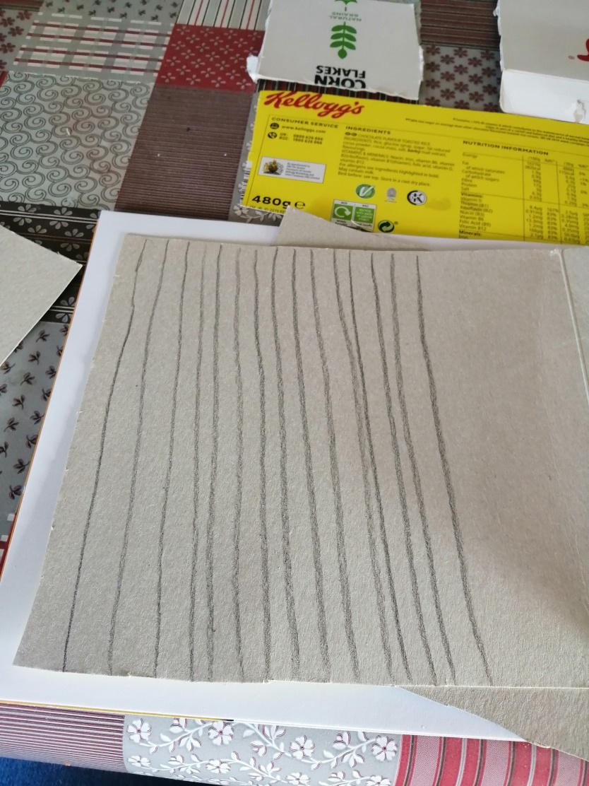
Draw lines on these cut outs and get your child to cut carefully along the black lines. Give lots of encouragement, rest and help where necessary. Ensure your child is holding the scissors correctly.

Slide 8
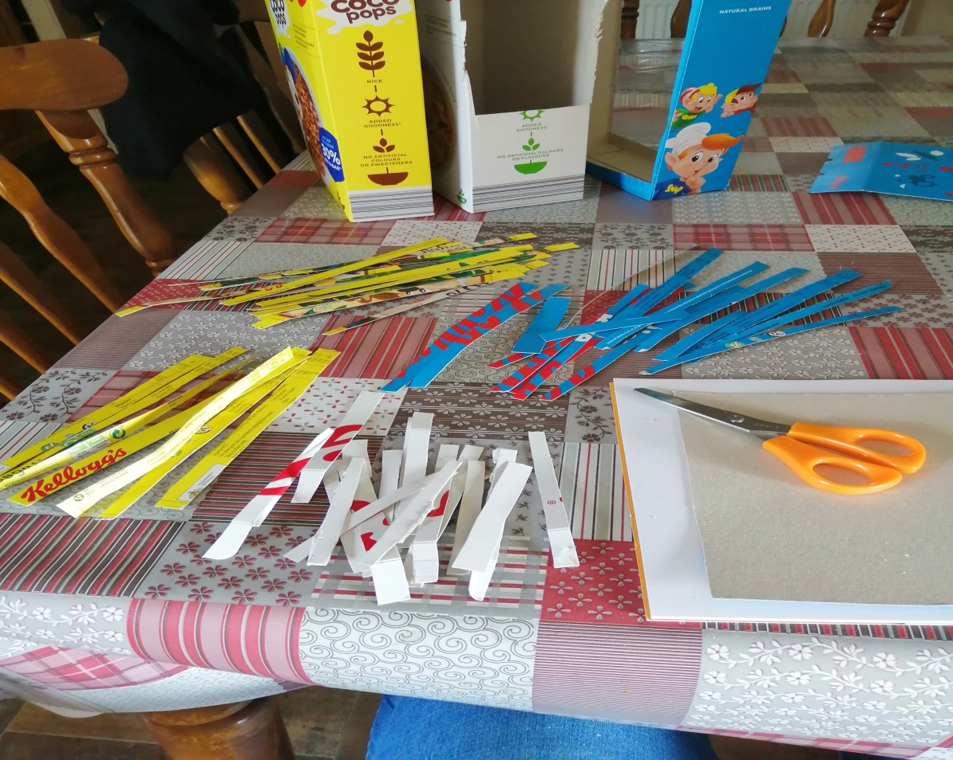
Sort out your coloured strips.

Slide 9
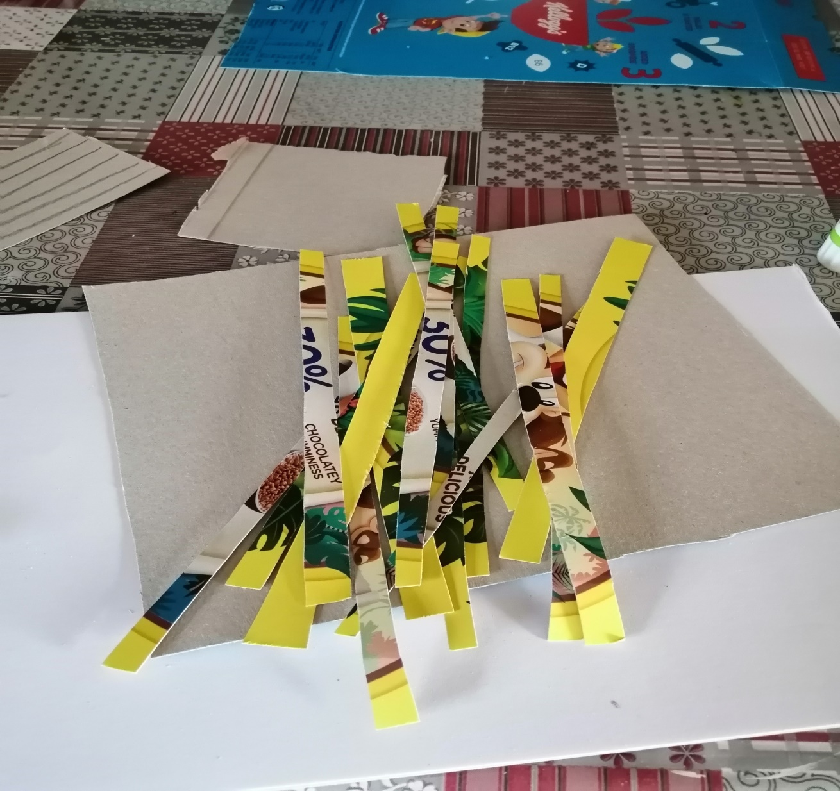

Slide 11
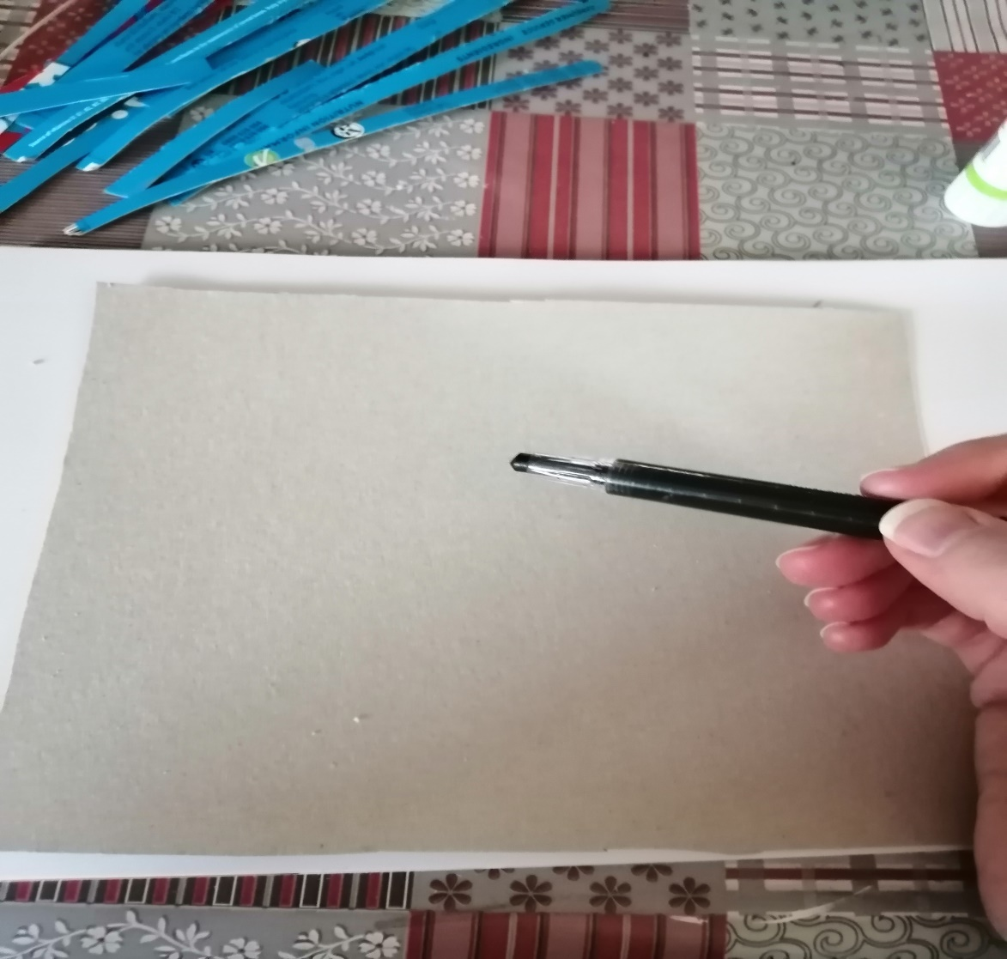
Draw or help your child to draw their picture. Keep it simple.

Slide 14
Cut the strips into little square tiles.

Slide 34
You can cut out the little characters and add them to your picture.

Slide 36
Try your own picture.
You can use this idea to make a tile art picture of flowers, animals, fish, dinosaurs, trees or even to design your own outfit.
Get creating!

Slide 37
Lesson 2
You can try this idea with any pictures lying around the place on cereal boxes, in magazines or old picture books.
You can do straight lines, zig zag and curved cutting lines to create a different effect.
Try it out!

Slide 48
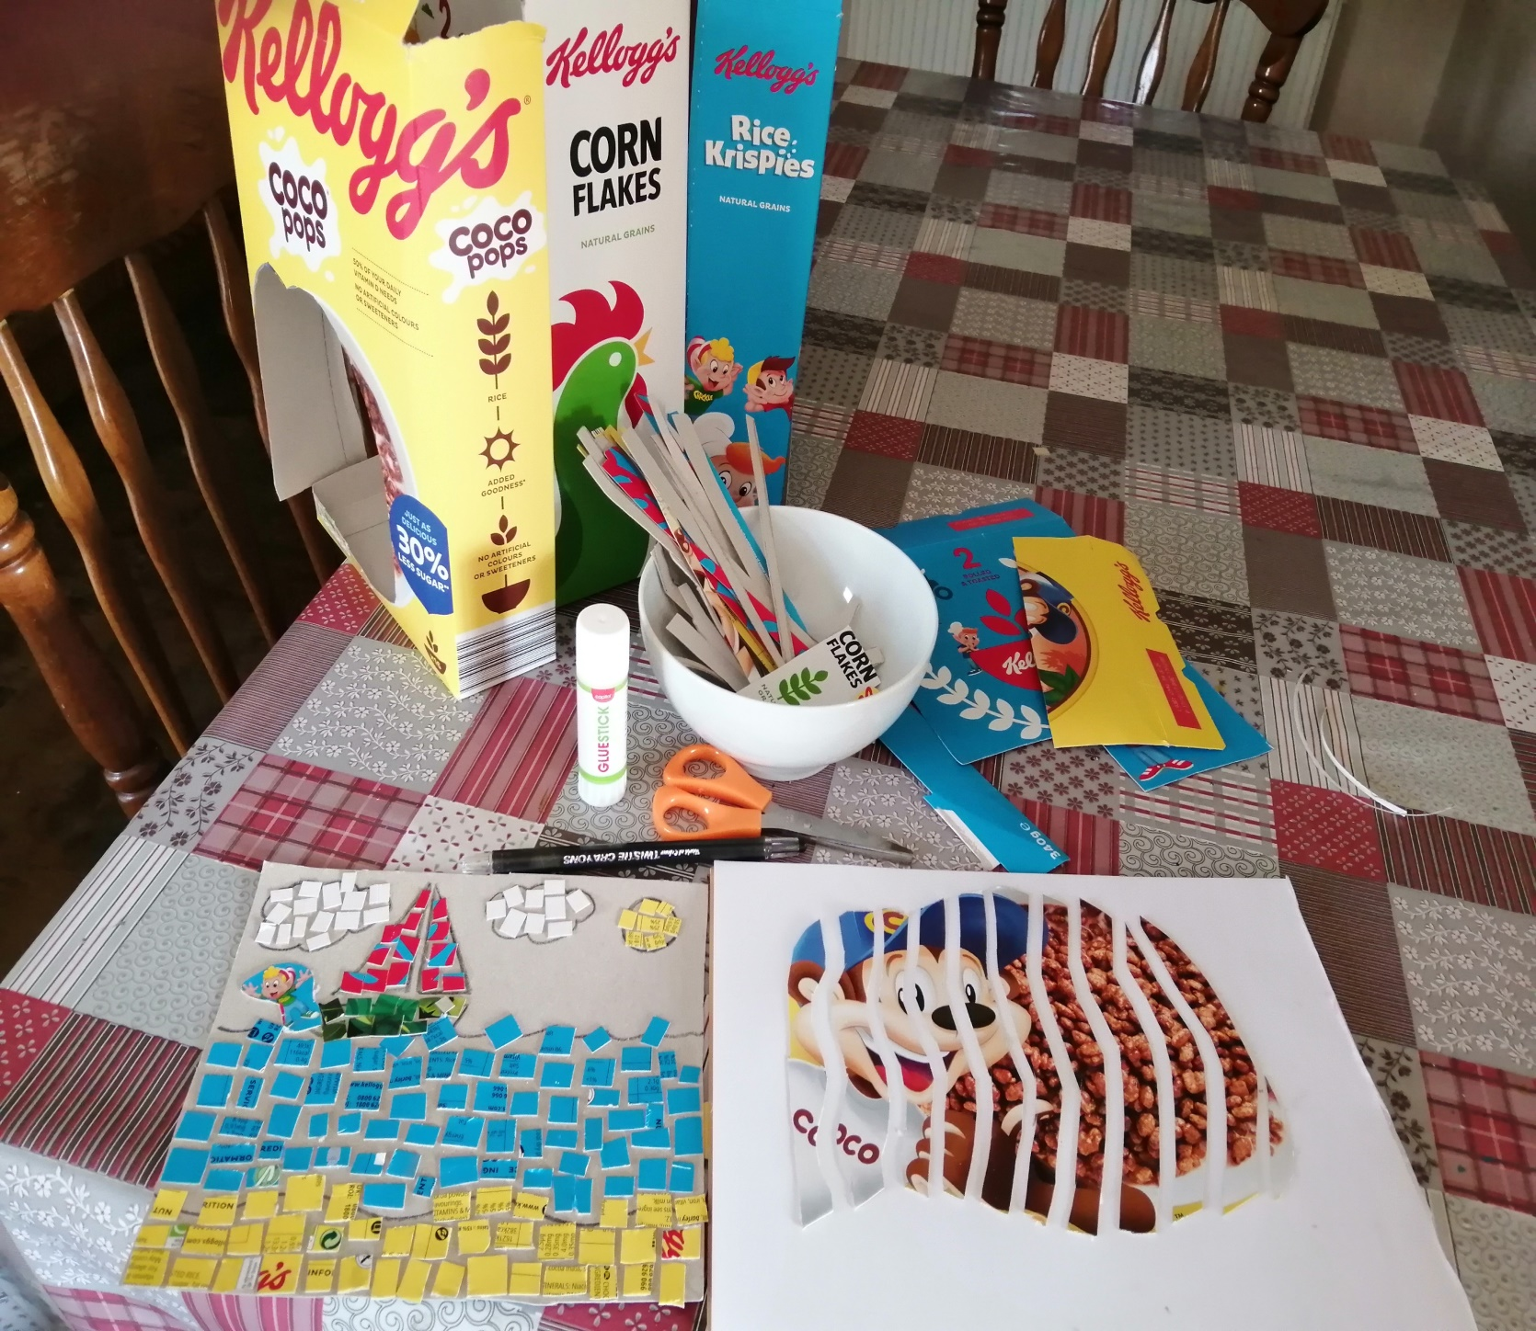

Slide 49
Keep your leftover tiles and materials for your child to do some free art another day.
Enjoy and keep safe.

