Slide 1
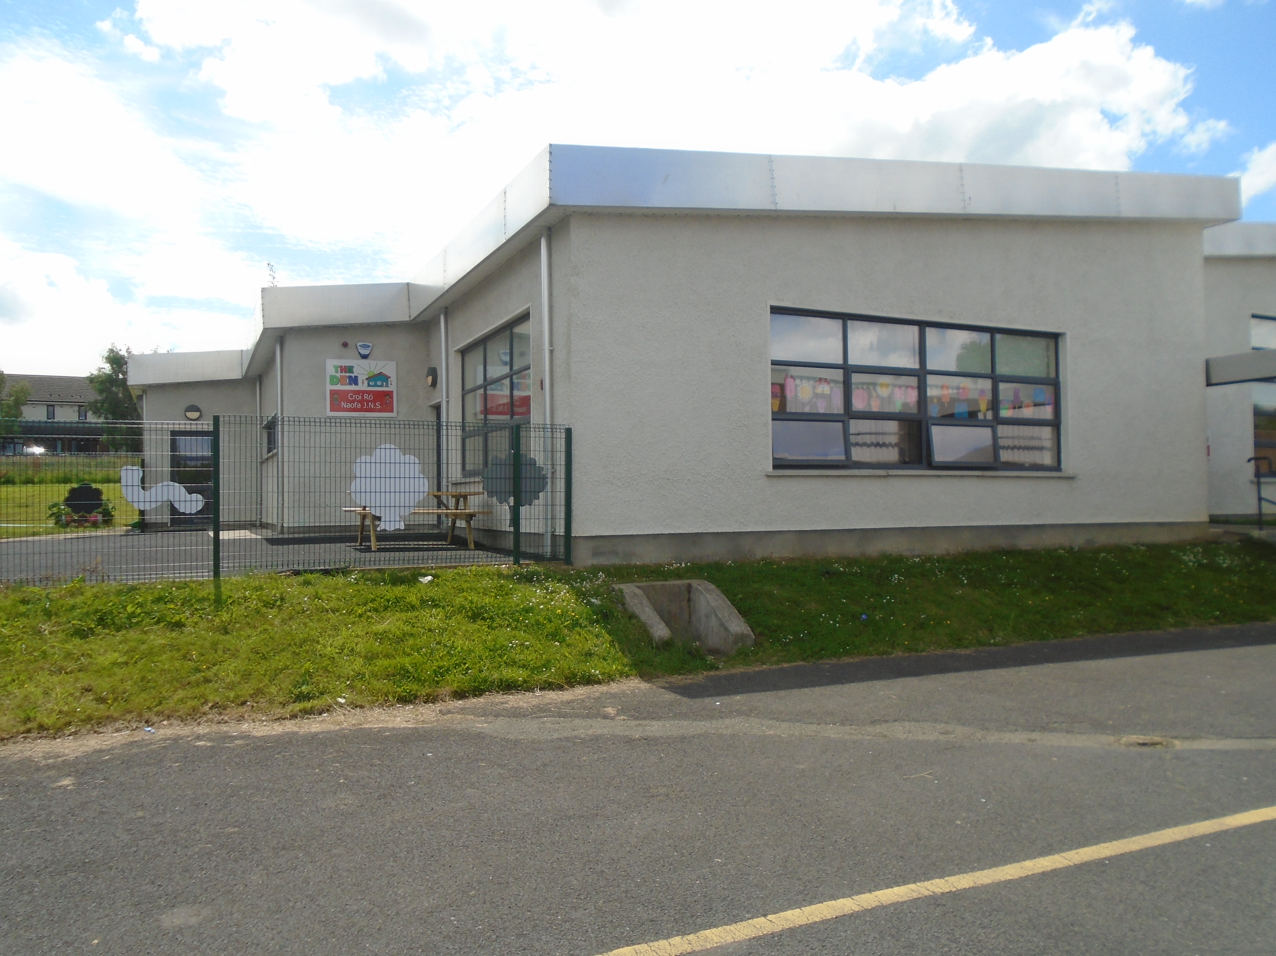
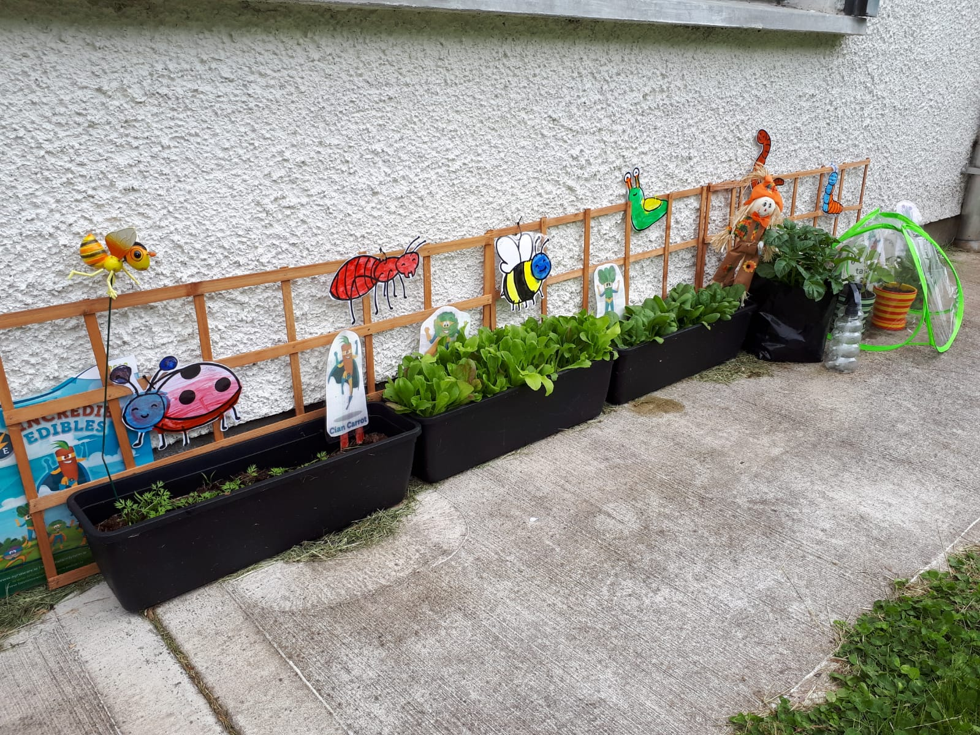
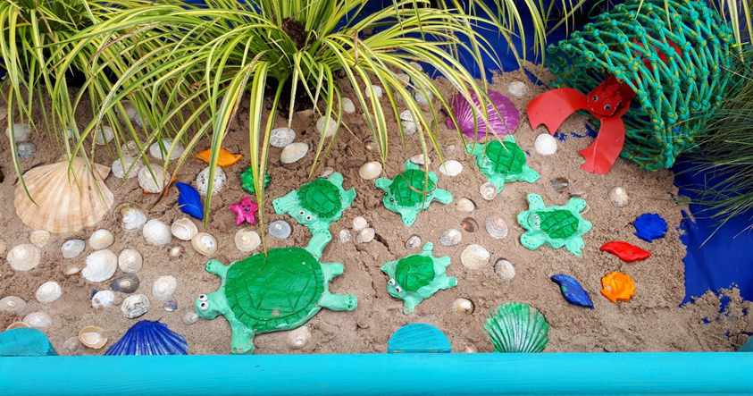
The Den.
1st – 12th June 2020
Theme - Minibeasts

Slide 2
Dear Parents/Guardians,
We hope you have been enjoying some of the activities and ideas we have suggested.
Do you have ideas for fun or creative things you have tried at home? We would love to hear about them and maybe we could share them so we can all have a try.
Usually at this time of year we are looking forward to a nice trip and also our Sports Day. We can still enjoy some fun activities or virtual tours even though it won’t be the same. Check out some links on the Useful Links slide.
If you would like to share any photos of your child’s achievements on the school website for the Friday Gallery, you can send them to Gaye, HSCL on Whatsapp 087 7443779 or email hscl@shjkillinarden.ie
We would love to see them!
Take care of yourselves and your families,

Slide 3
CONTENTS…
What have you been doing?
Literacy
Numeracy
SESE/Art
Minibeasts
Life Cycle of the Butterfly
Minibeast Art
Be Active
Be Healthy
Sports Day
SPHE-Healthy Eating
Useful Links
And finally…

Slide 4
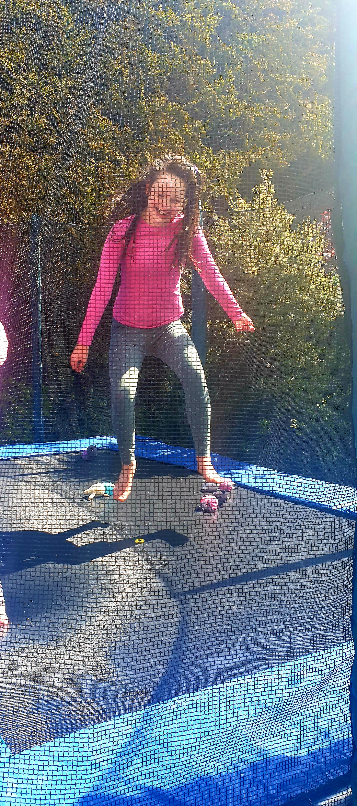
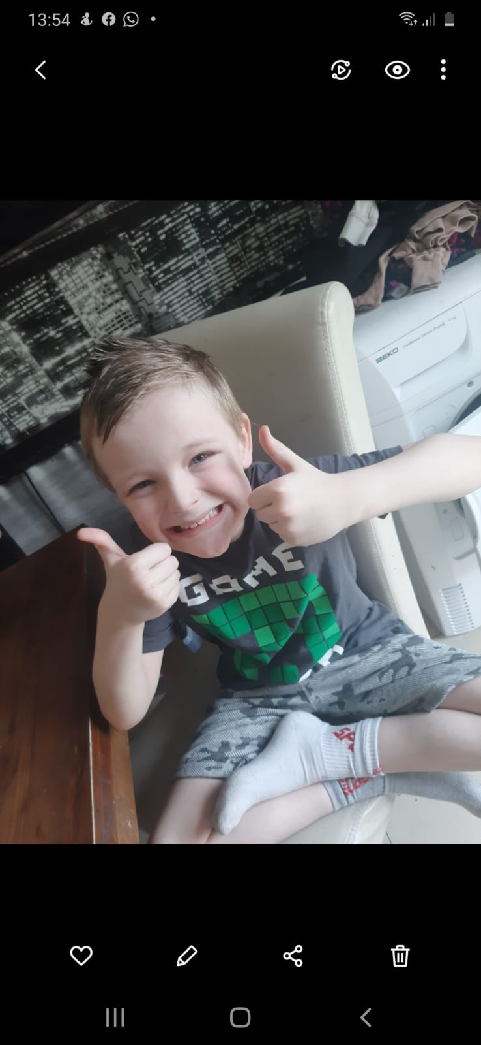
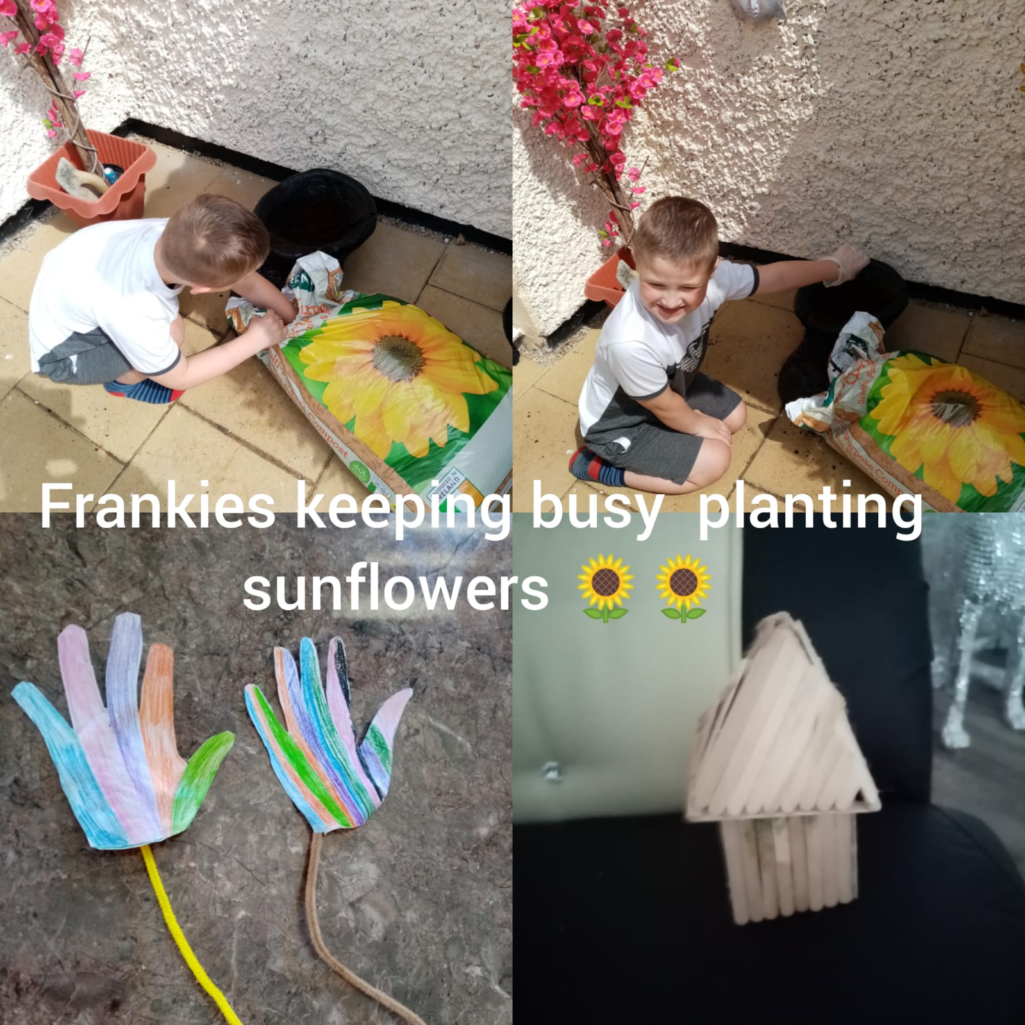
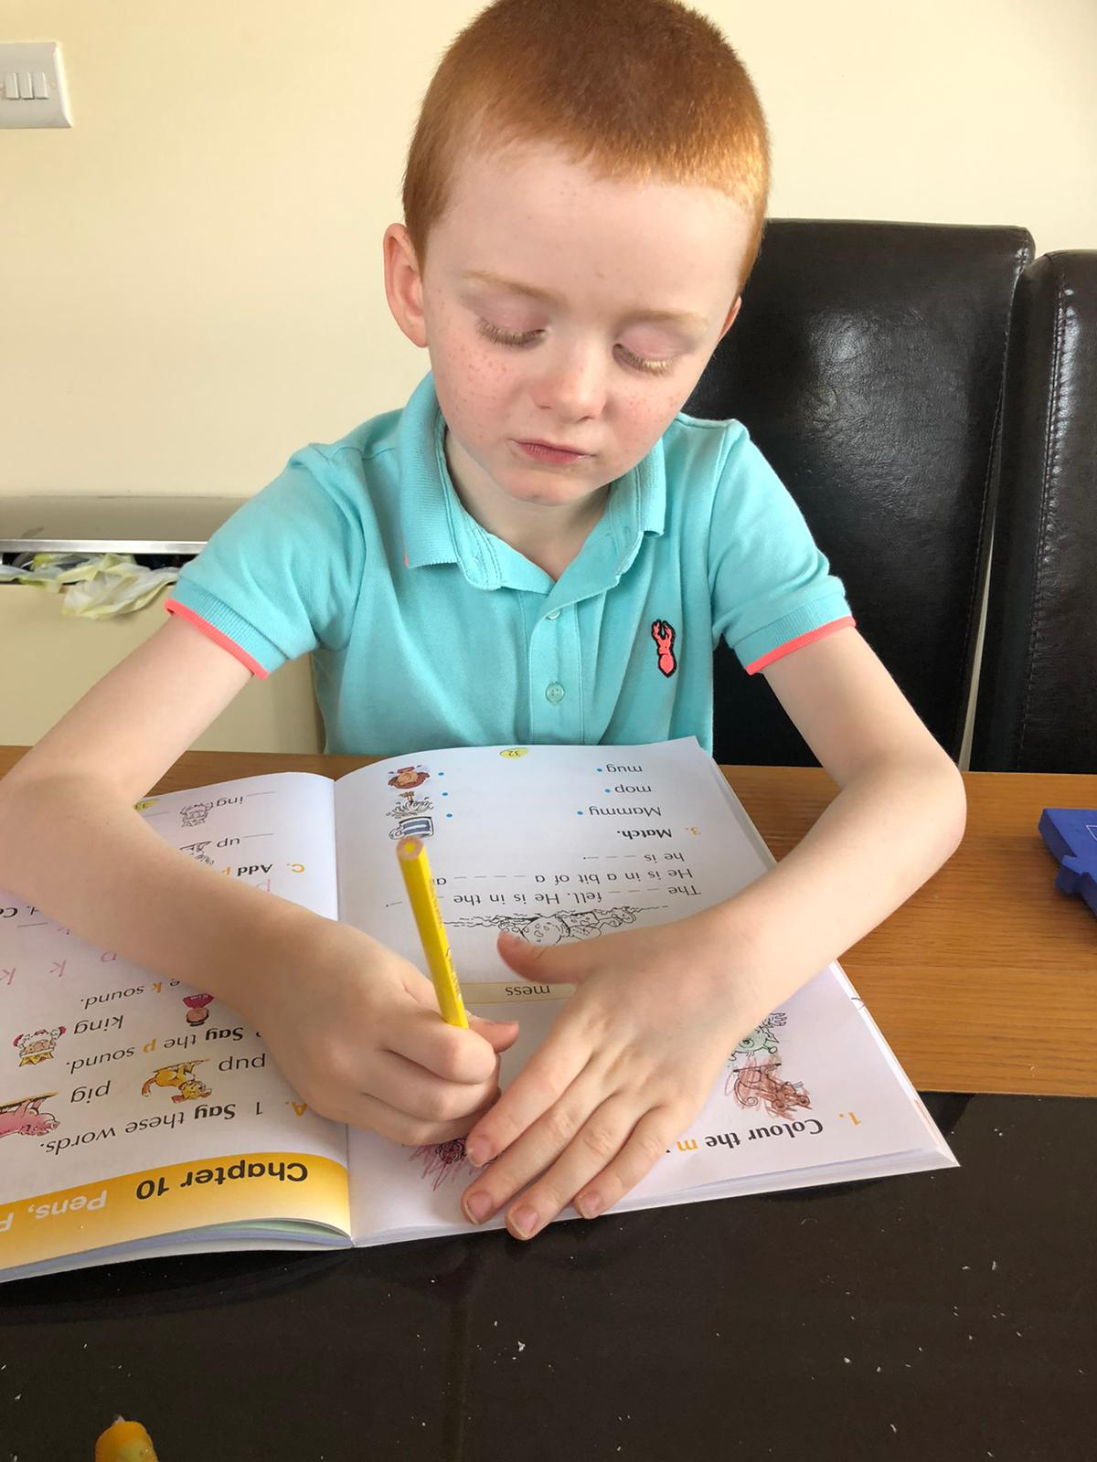
What have you been doing?
 | Category 1 | Category 2 | Category 3
Subject 1 | 2,450 | 4,223 | 1,600
Subject 2 | 3,995 | 864 | 12,042
Subject 3 | 75 | 80 | 90
Subject 4 | 5,625 | 4,805 | 541
Subject 5 | 642 | 8,511 | 75
You have all been amazing… doing great art, gardening, learning, helping, improving your writing, playing, colouring, being active and creative.
We are so proud of you all!

Slide 5
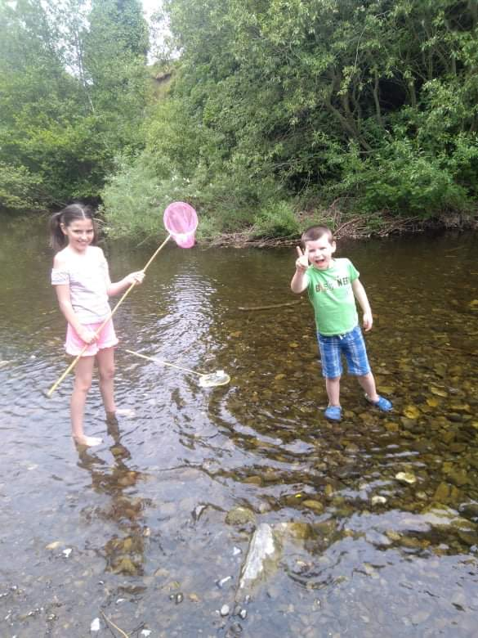
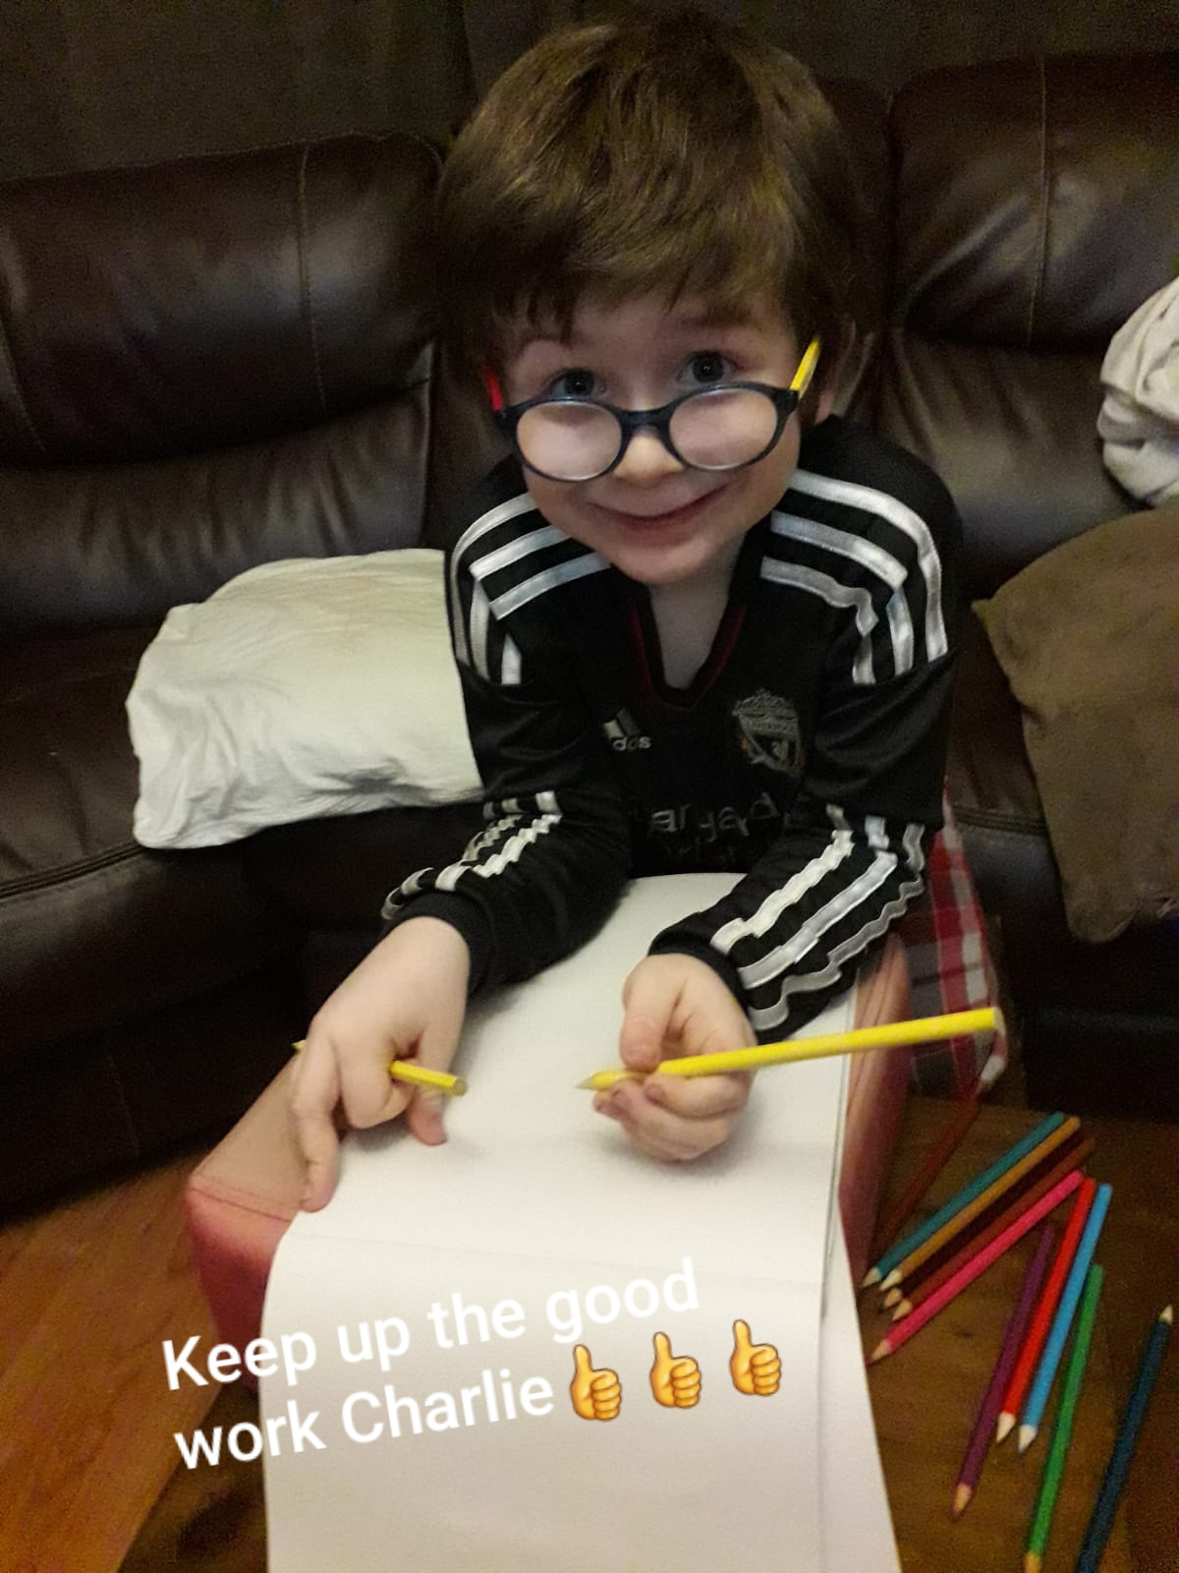
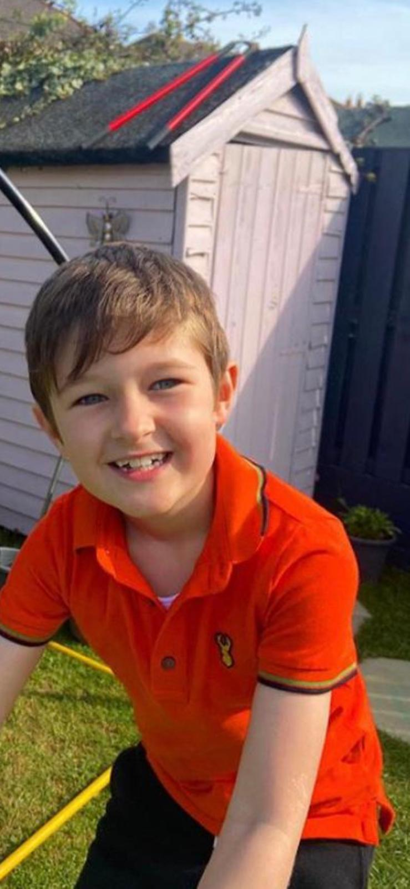
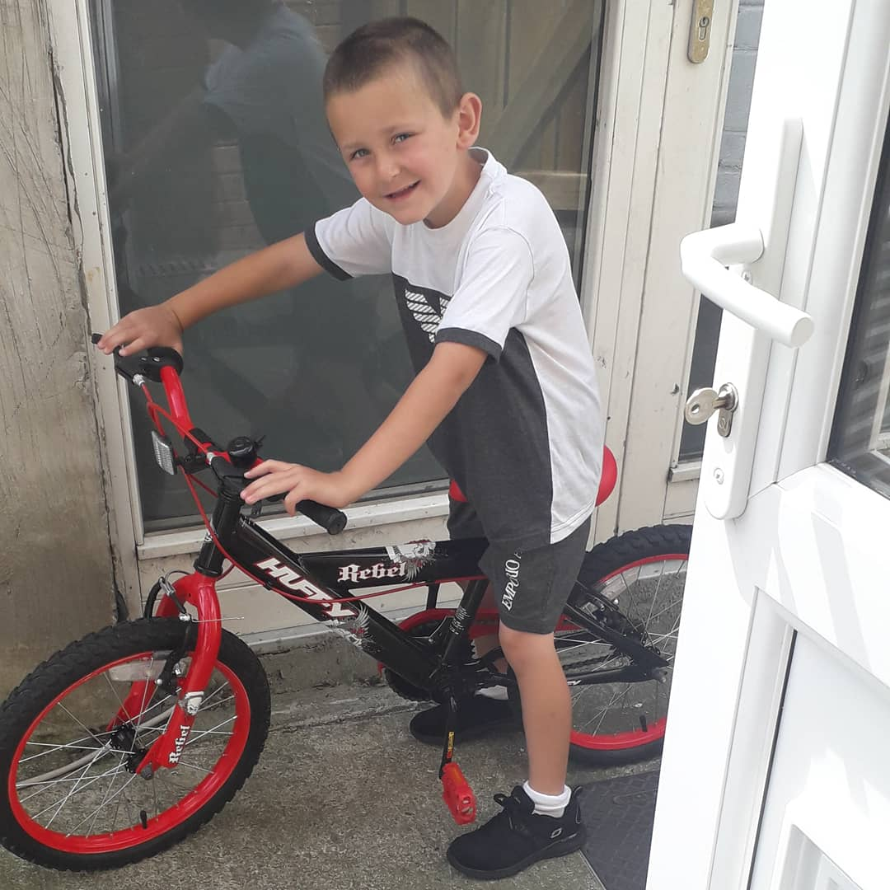
…some more pics
More pics to come next time…

Slide 6
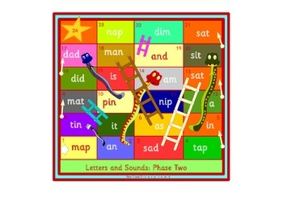
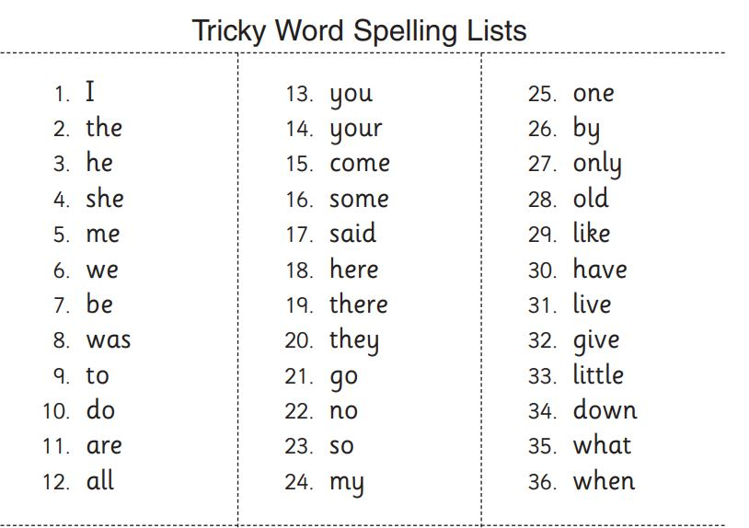
Literacy
Tricky Words
Make your own Tricky word snakes and ladders by sticking the words on the squares.
Read the words you land on. Or hide some words and go on a word hunt!
Poetry
Here is an acrostic poem about School. Can you write your own? Try one about SUMMER too!

Slide 7
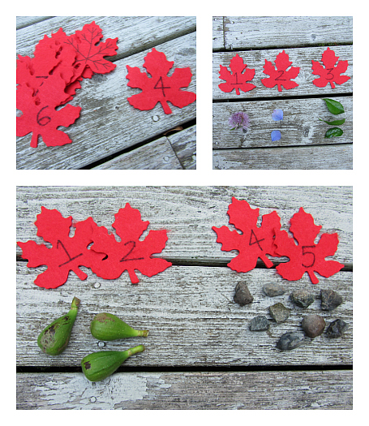
Numeracy: outdoor maths fun

Slide 8
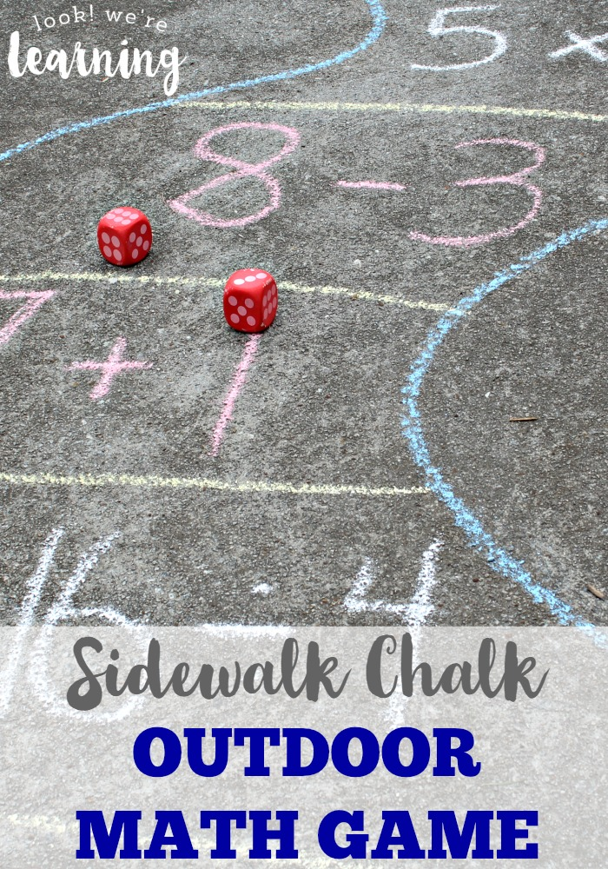
More outdoor Maths activities

Slide 9
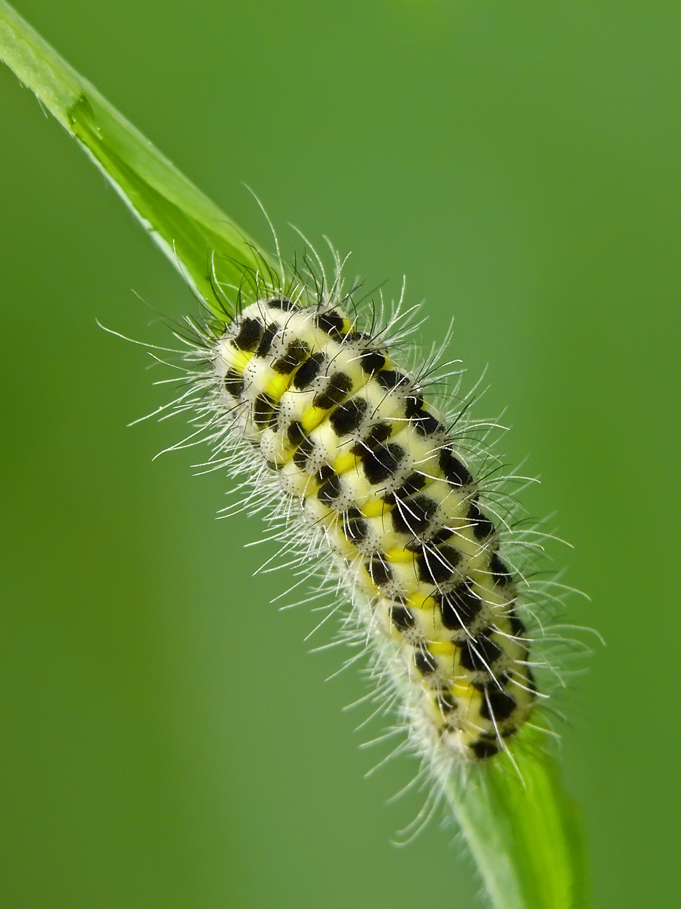
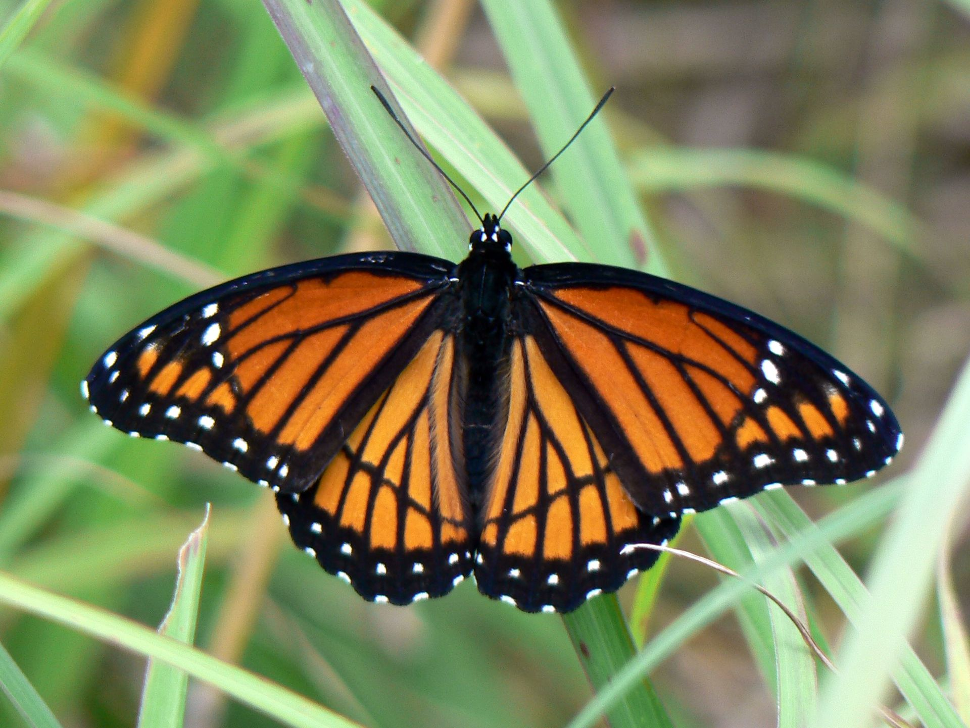
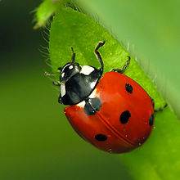
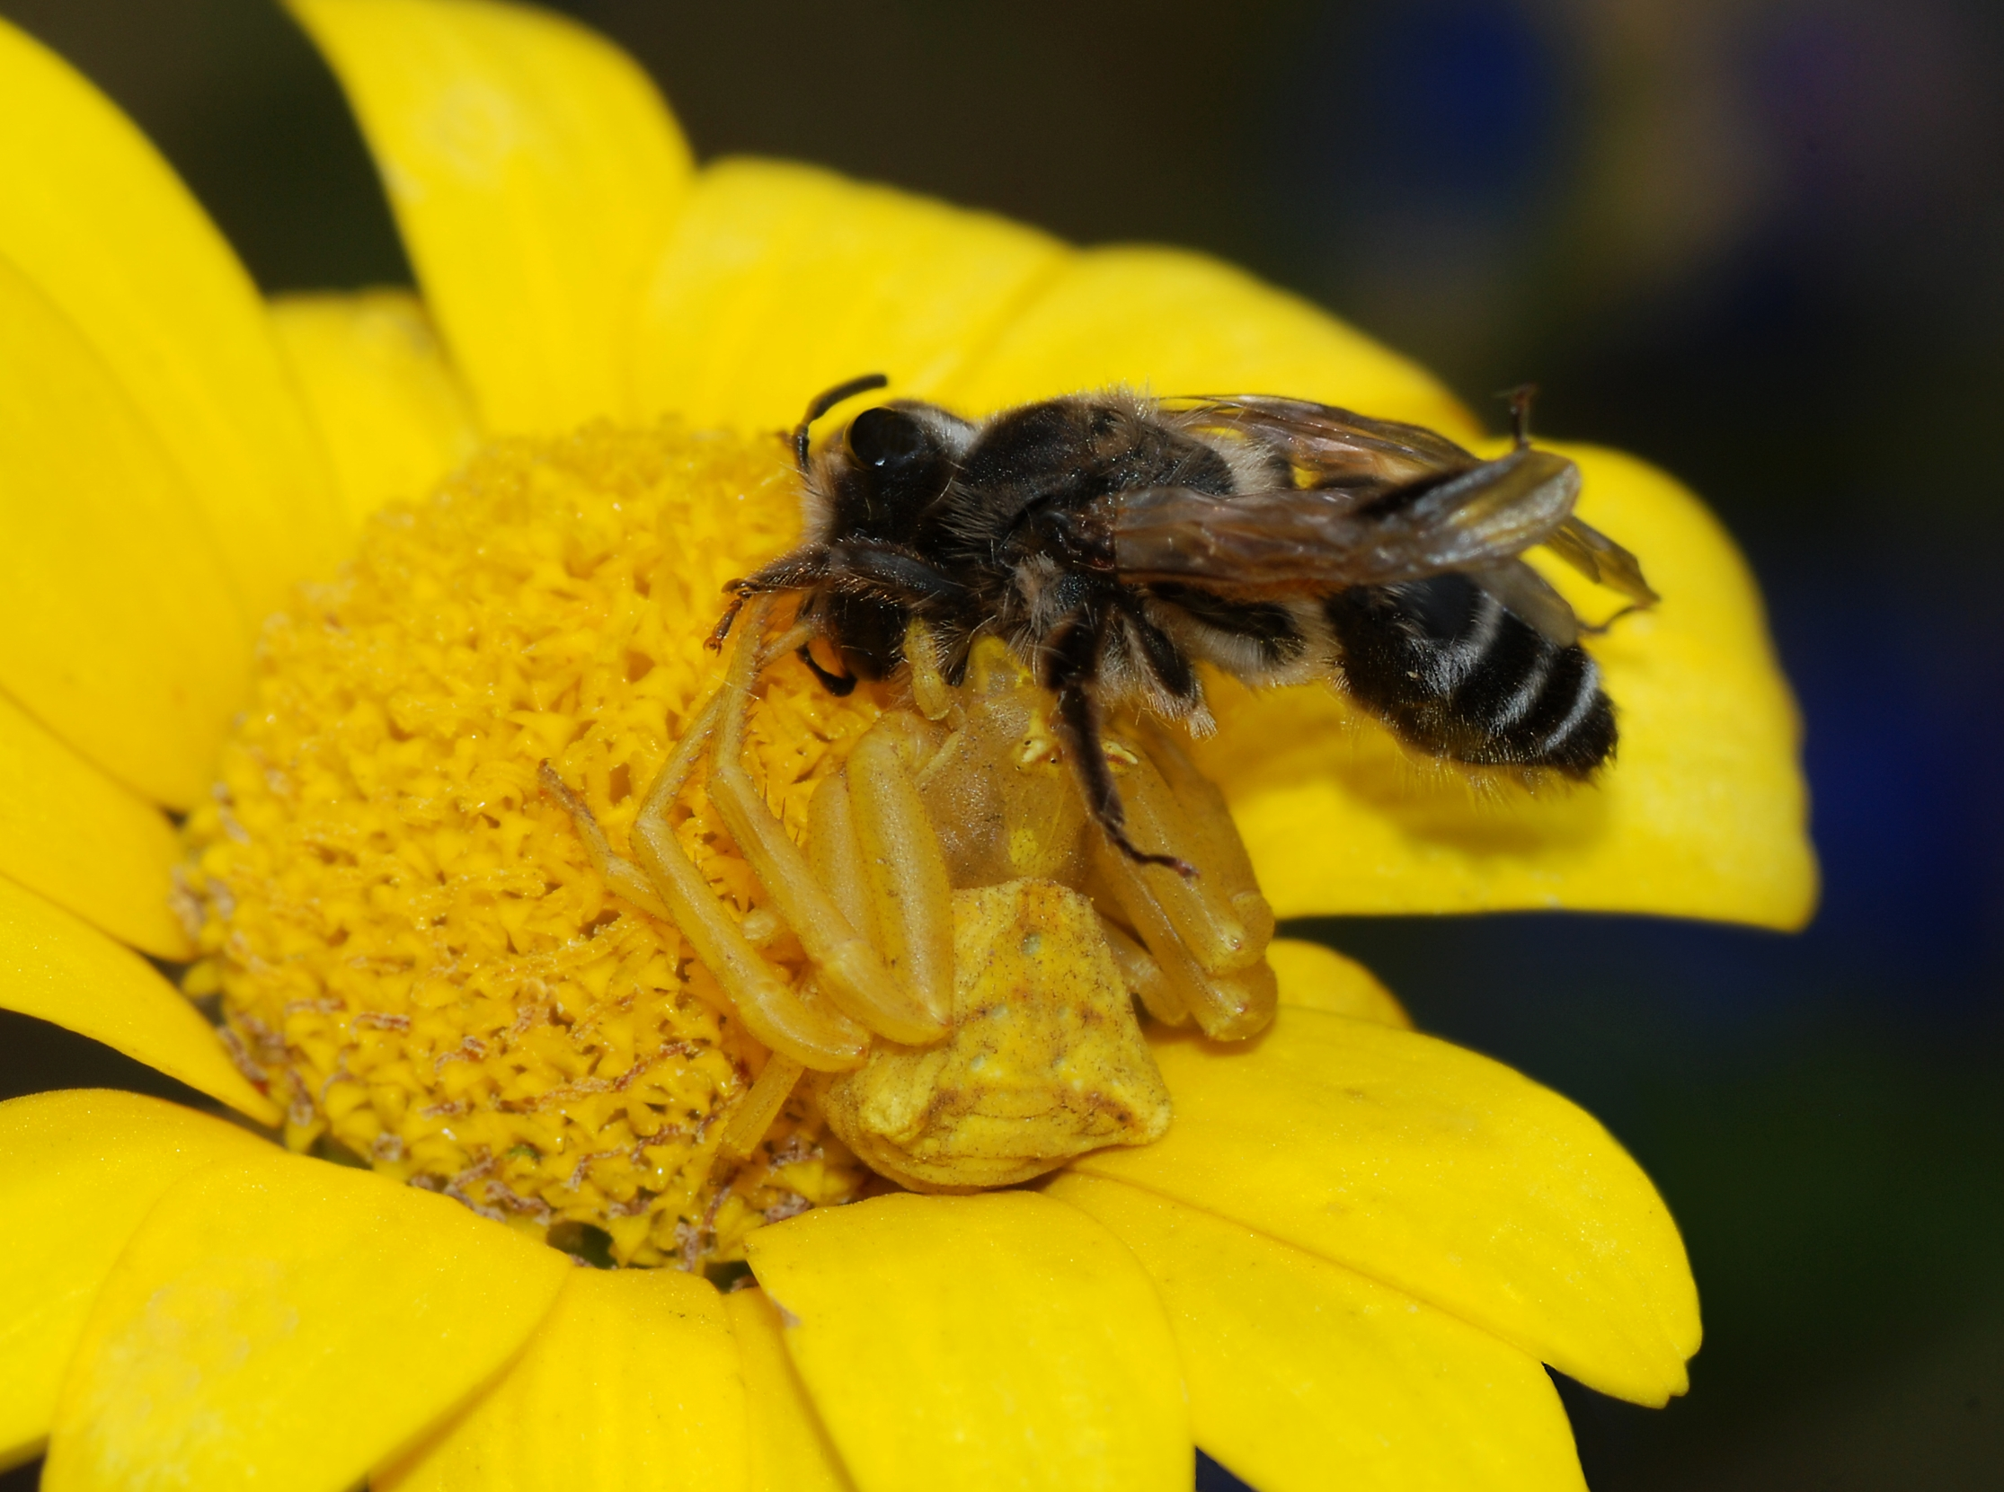
SESE- Go on a Minibeast Hunt in the Garden…0r in the Park. Can you spot any of these? What is your favourite minibeast?
Minibeast Quiz
What do bees make that we can eat?
Can ladybirds fly?
Can you find out what type of butterfly is in the picture?
How long does a caterpillar stay in his cocoon?

Slide 10
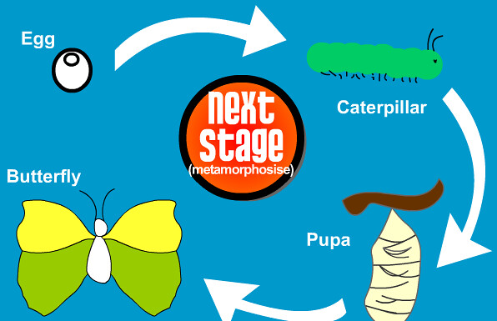
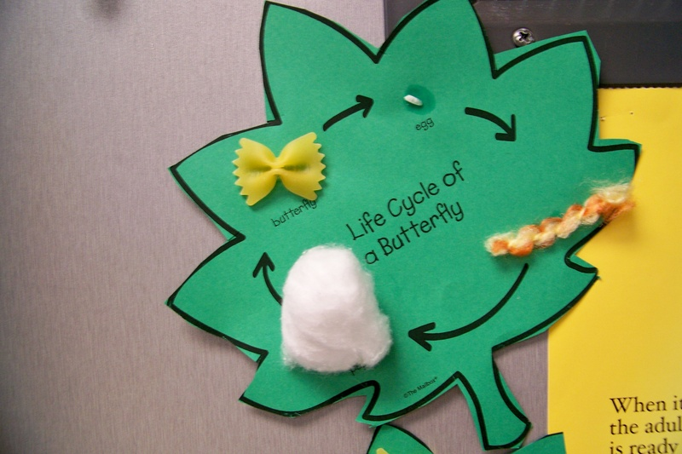
SESE Life Cycle of the Butterfly
Watch this video on Butterflies
thttps://www.youtube.com/watch?v=QH_G1dSdPes

Slide 11
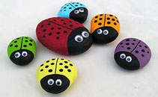
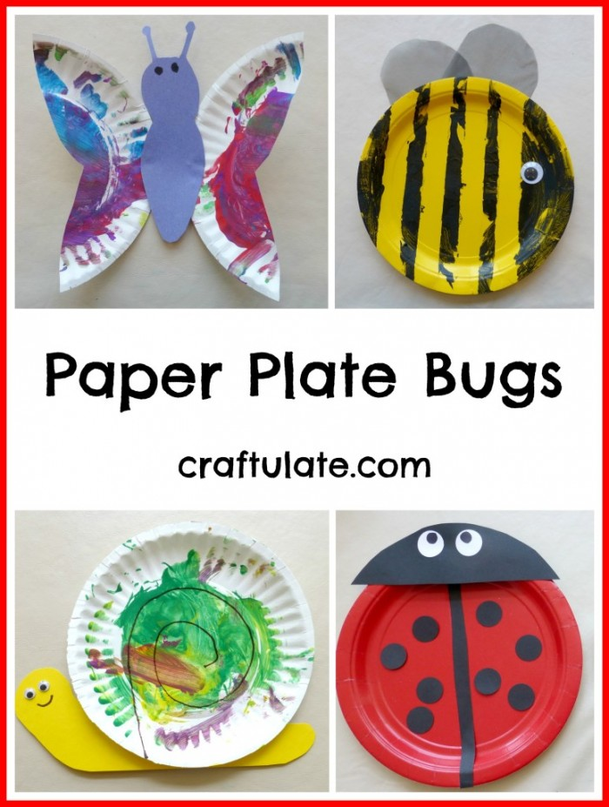
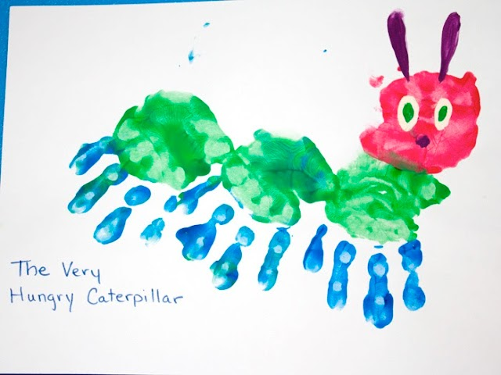
Minibeast Art
Painted Stone Ladybird
Step 1-Find a flat round stone
Step 2-Paint the stone in red and leave to dry
Step 3-Paint the head and spots in black
Step 4-Stick on googly eyes or paint on the eyes
You can make a whole ladybird family and display in your garden , balcony or windowsill!

Slide 12
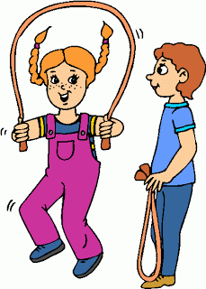
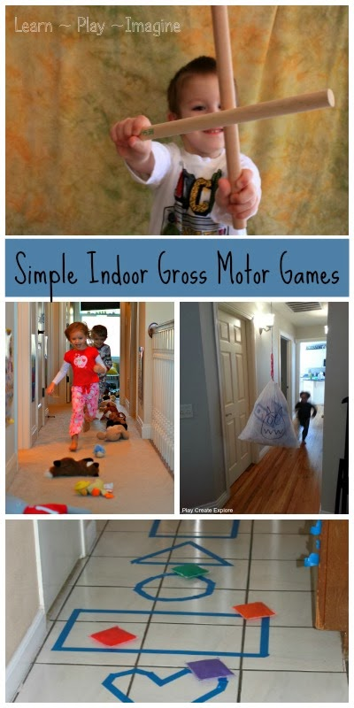
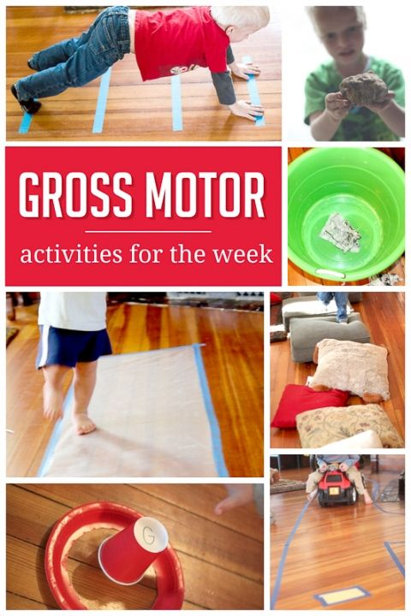
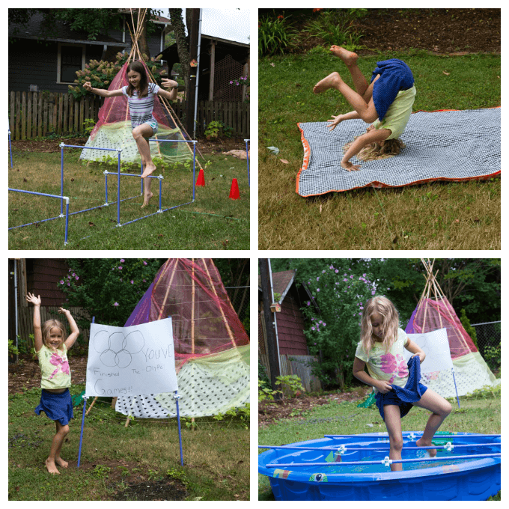
Sports Day Design Your own Obstacle Course using items in your house

Slide 13
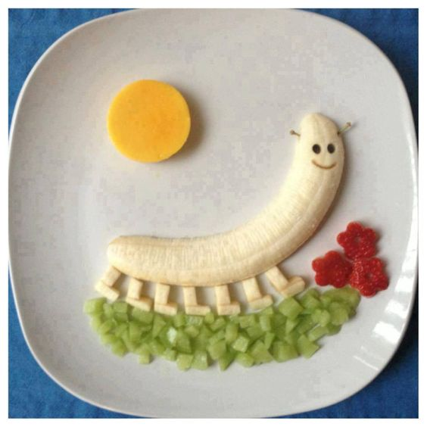
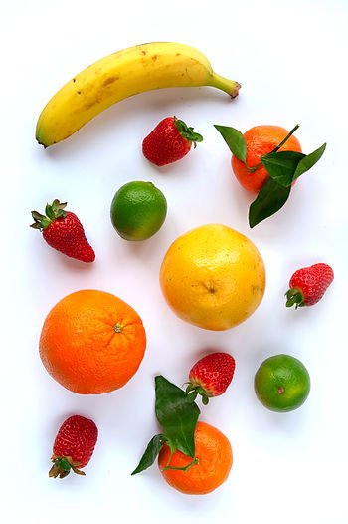
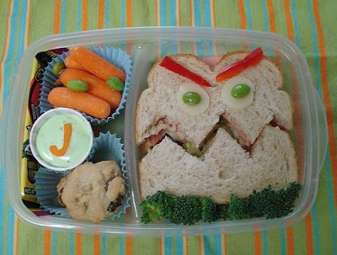
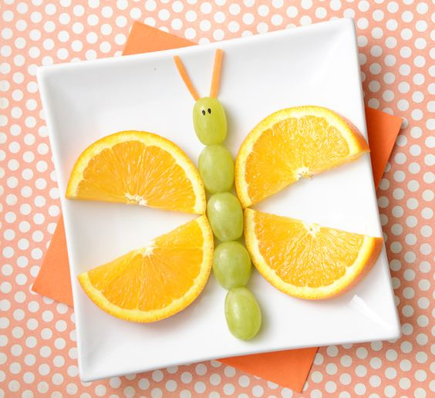
Healthy Eating Read or watch the story of The Very Hungry Caterpillar. Can you remember which healthy foods he ate? What happened when he ate too much unhealthy food?
Try a new healthy food this week. You could try some of these summer fruits.
Healthy food can be fun!

Slide 14
Useful Links
Here are some websites you might find helpful:
pdfs://www.ncse.ie/theme-of-the-week
https://www.twinkl.ie (powerpoint on Life Cycle of the Butterfly/Minibeasts/Healthy Eating)
www.dublinzoo.ie
https://www.museum.ie/en-IE/Museums/Natural-History/Visitor-Information/3D-Virtual-Visit
https://storytoys.com/app/my-very-hungry-caterpillar/
www.facebook.com/earlylearninginitiative/ for a lovely interactive storybook on Happiness.

Slide 15
Finally…
Special hello to our 2nd class friends Ava, Ciara, Kalem, Kacper and Max, who have to wait a bit longer to celebrate their 1st Communion. Waiting can be hard but it will be an extra special day when it does happen.
Remember to keep washing your hands and keep safe.
We are here if you need us for anything.
Enjoy the sunny weather!
Take care ☺
Also on the school website, you might like to check out:
Attention Autism videos
Occupational Therapy games
Storytime video
Bedtime stories with Holly
Our school community special video message

