Slide 1
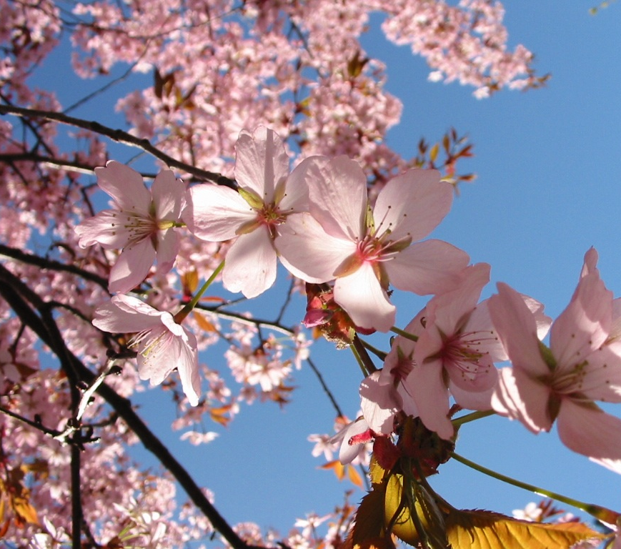
S.P.H.E/ Wellness
This Photo by Unknown Author is licensed under CC BY-NC-ND

Slide 2
This is a difficult time for everyone, so be kind to yourself and others. These are just some ideas you might like to do/ use during this time to keep your body and mind healthy ☺
This Photo by Unknown Author is licensed under CC BY-SA-NC

Slide 3
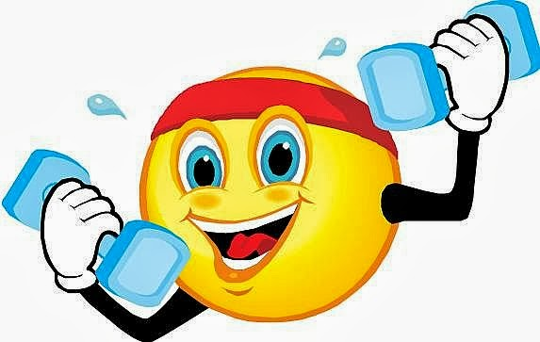
Keep active
PE with Joe Wicks
https://www.youtube.com/playlist?list=PLyCLoPd4VxBtWi7RnRLz6qHgOqWiB_LrH
Daily Dance breaks
https://www.youtube.com/channel/UCqscMO1YfPB3-7dZZSxKPrQ
Yoga for kids
https://www.youtube.com/user/CosmicKidsYoga
This Photo by Unknown Author is licensed under CC BY-NC-ND

Slide 4
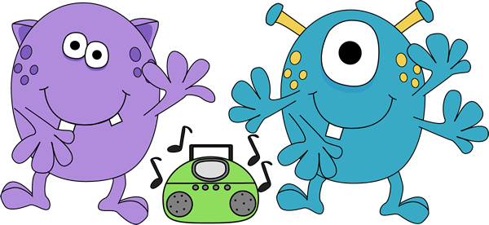
Go Noodle- some of our favourites
Cant stop the feeling/ Trolls
https://www.youtube.com/watch?v=KhfkYzUwYFk
Pop See Ko
https://www.youtube.com/watch?v=Pwn4beja1QE
Chicken Dance
https://www.youtube.com/watch?v=npp1z32idrc
Run the Red Carpet
https://www.youtube.com/watch?v=Shm8ByZswQ8
This Photo by Unknown Author is licensed under CC BY-SA

Slide 5
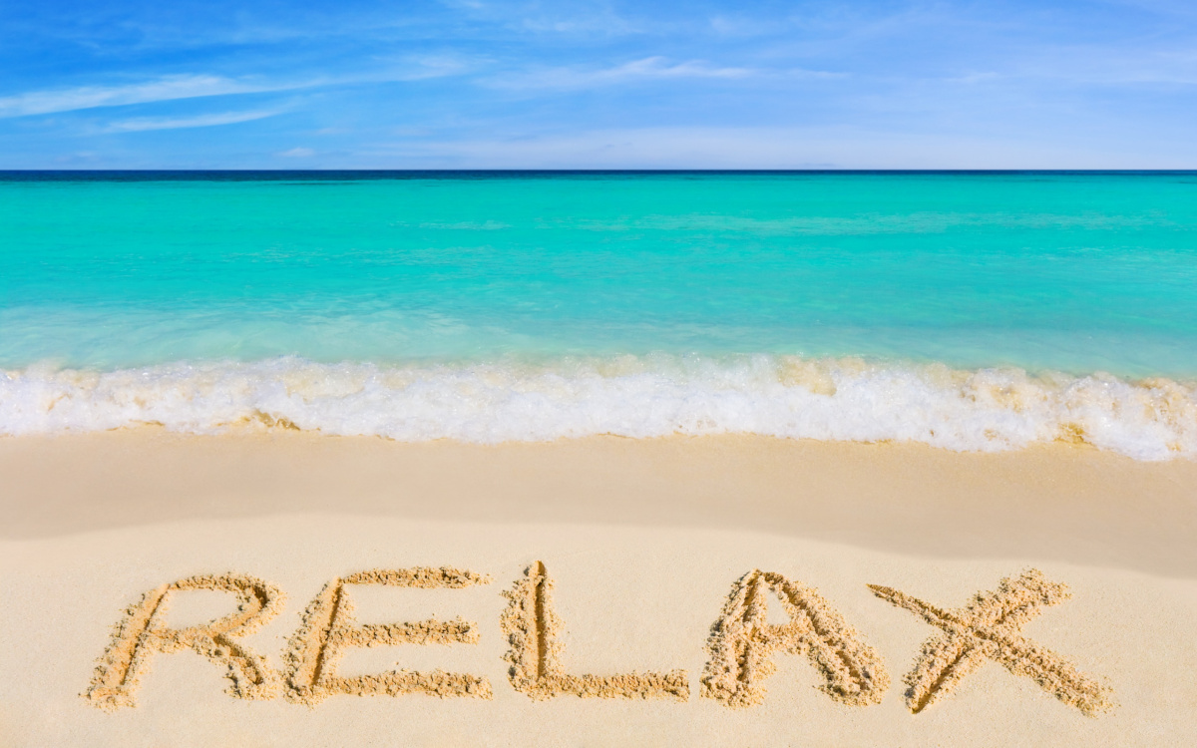
You might be tired after that exercise! Time to relaaaax..
Rainbow breathing
https://www.youtube.com/watch?v=O29e4rRMrV4
Be the Pond
https://www.youtube.com/watch?v=wf5K3pP2IUQ
Butterfly stretch
https://www.youtube.com/watch?v=oYI0TPJOuGk
This Photo by Unknown Author is licensed under CC BY-SA

Slide 6
*Do something you enjoy everyday*
toys
play
games
What do YOU like to do??
write
paint
art
exercise
read
draw
bake
Lego
jigsaws

Slide 7
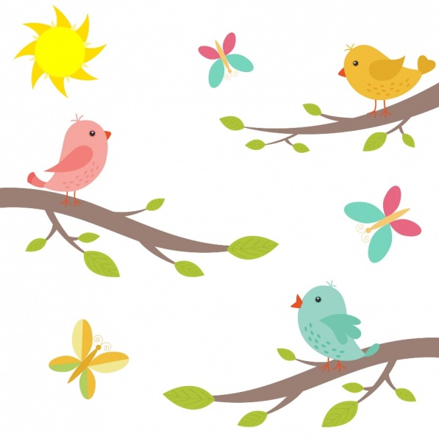
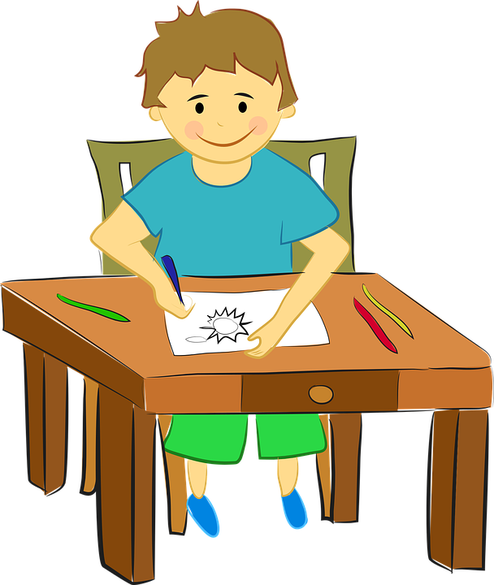
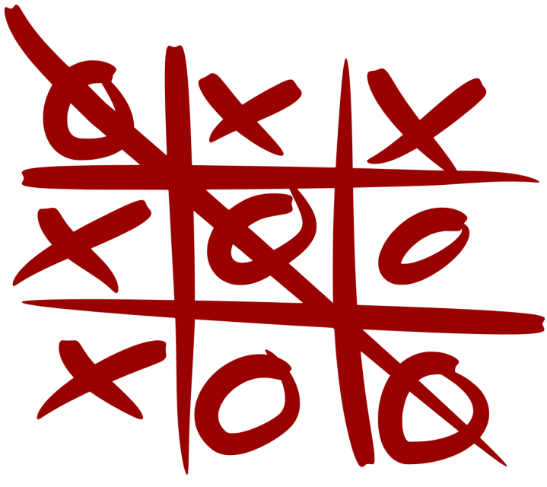
Next are some ideas that you might like to try ☺
This Photo by Unknown Author is licensed under CC BY-SA

Slide 9
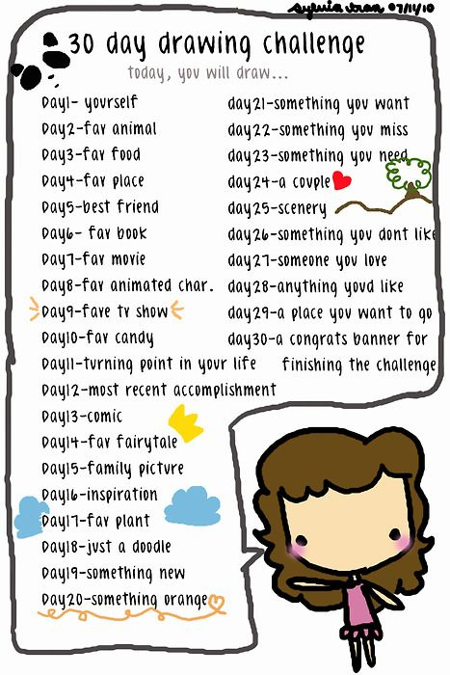
This Photo by Unknown Author is licensed under CC BY-ND

Slide 10
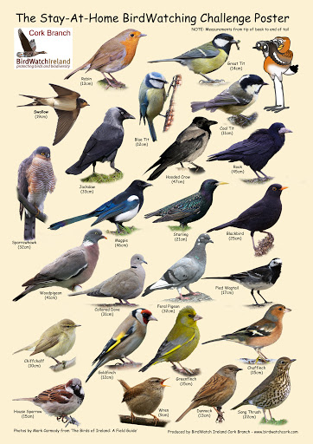
Can you spot any of these birds from your window??

Slide 11
Pen and Paper game: X’s and O’s
Step 1: Draw the grid- 2 lines across and two lines down. You will have 9 squares.
Step 2: first person outs an X in a box of their choice.
Step 3: second person puts an O in a box of their choice.
Keep taking turns.
Winner is the first person to get three in a row!

Slide 12
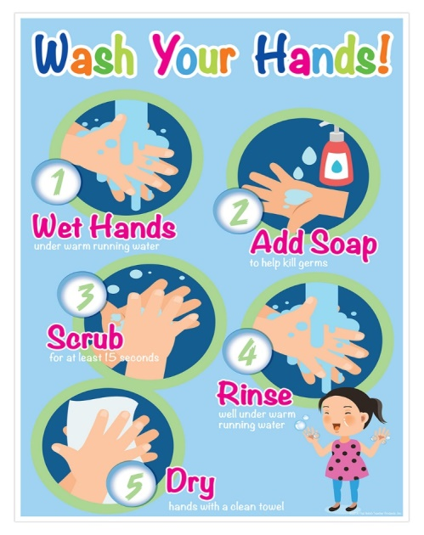
Don’t forget: Stay safe, have fun and wash your hands ☺

