Slide 1
Junior Infants
SESE
Remote Learning
Sacred Heart Junior National School April 20th-April 24th

Slide 2
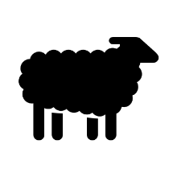
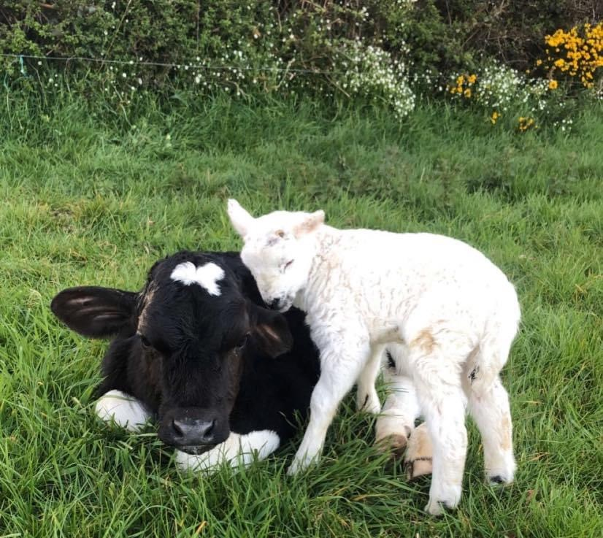
The Farm
We are learning all about the farm in our Aistear (structured play) and SESE.
Please choose one activity a day and revise the activities you have already completed.

Slide 3
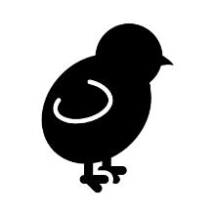
Spring time on the farm…
How many animals can you see in the picture?
Can you name the animals in the picture?
Can you name the baby farm animals?
Can you list some jobs a farmer does?
Can you see any signs of Spring in this picture of the farm?
What signs of Spring can you see around your house or in your garden?

Slide 4
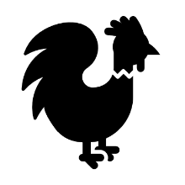
Farm animals
Watch this short video to learn about the animals you would find on the farm.
Learn also about where they live and the sounds each animals make.
https://www.sheppardsoftware.com/preschool/animals/farm/animalfarmmovie.htm

Slide 5
Song: I Went to Visit a Farm One Day
I went to visit a farm one day.
I saw a cow across the way.
And what do you think I heard it say?
MOO, MOO, MOO.
MOO, MOO, MOO.
I went to visit a farm one day.
I saw a sheep across the way.
And what do you think I heard it say?
BAA, BAA, BAA.
BAA, BAA, BAA.
I went to visit a farm one day.
I saw a pig across the way.
And what do you think I heard it say?
OINK, OINK, OINK.
OINK, OINK, OINK.
Listen on…
https://www.topmarks.co.uk/Flash.aspx?bbc=i-went-to-visit-a-farm
*Or why not sing one of our favourite songs… Old Mac Donald Had a Farm https://supersimple.com/song/old-macdonald-had-a-farm-2018/

Slide 6
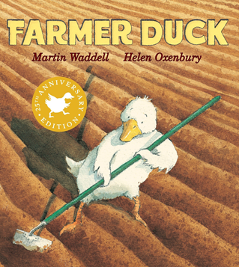
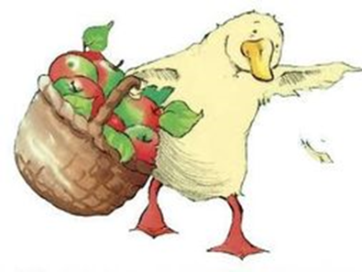
Storytime: Farmer Duck
Watch the story of Farmer Duck on YouTube:
https://www.youtube.com/watch?v=Gug6P8l1q6c
Can you name all the jobs Farmer Duck did for the lazy farmer?
What animals did you see in the story?
Can you make a list of jobs that you could do around the house to help Mammy and Daddy?
Don’t forget to make some predictions about the story…

Slide 7
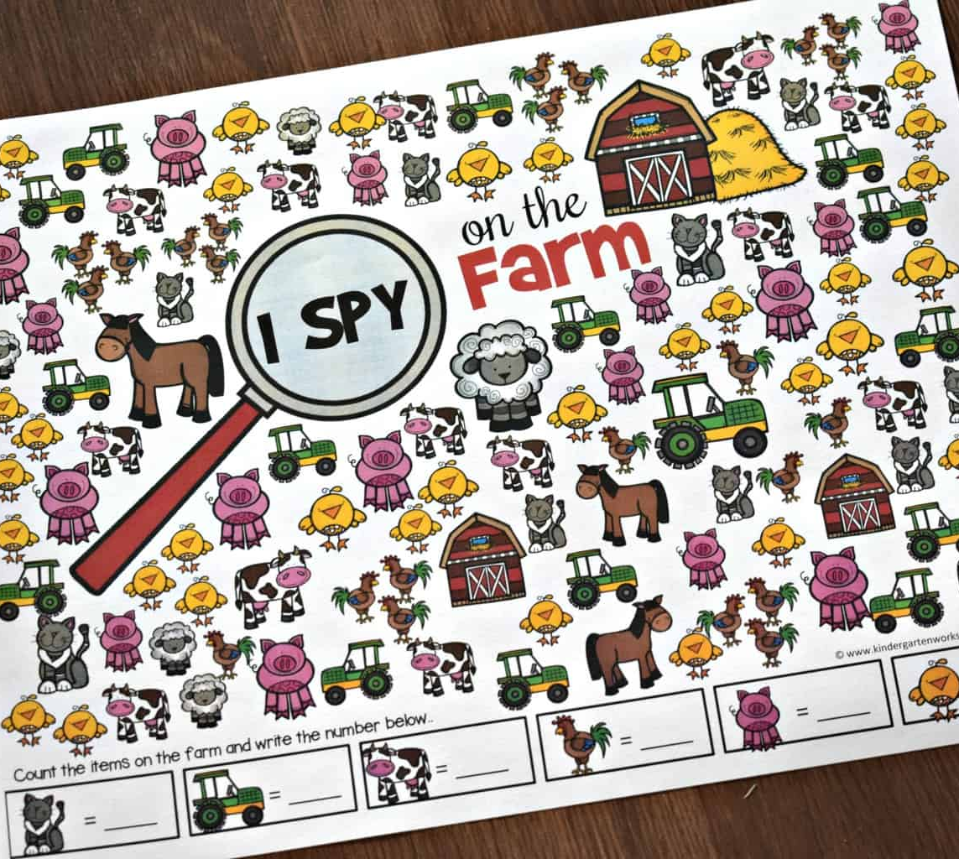
I Spy with my little eye…
something that the animals eat
something that the farmer drives
something that starts with the sound ‘h’. Say the sound.
a place where some of the animals live
Something that starts with the sound ‘s’ and goes baaa. Practice the sound.
Now your turn… make your own!!!

Slide 8
1. Can you match these baby farm animals to their mothers? 2. Can you name each of the animals and their babies?

Slide 9
Can you spot the difference?

Slide 10
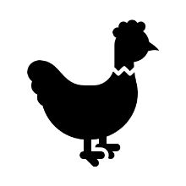
Animals and their homes matching

Slide 11
Make your own Aistear Stations…
The children are used to having 3/4 activities every day for Aistear.
Your task today is to make 3/4 Aistear activities related to The Farm.
You can use whatever you get your hands on: sand, water to wash the animals, paper, toys, playdough, lego, recyclable materials etc.
You can decide to include some art here. Perhaps make some farm animal masks, cut out some pictures or draw or paint some animals etc.
You could use a phone or tablet and create your own farm scene using this website… http://ngfl.langeroo.com/farm/sceneMaker.html

Slide 12
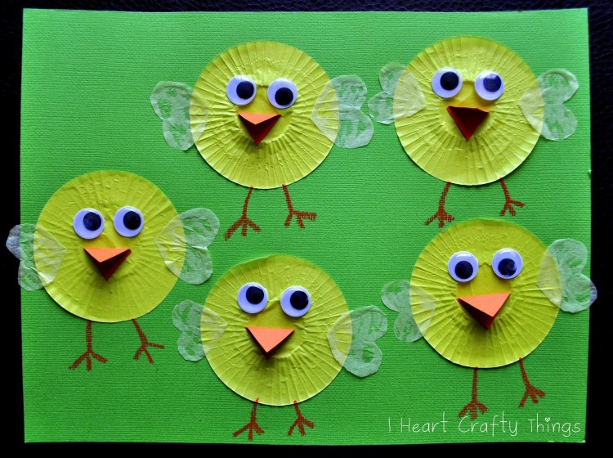
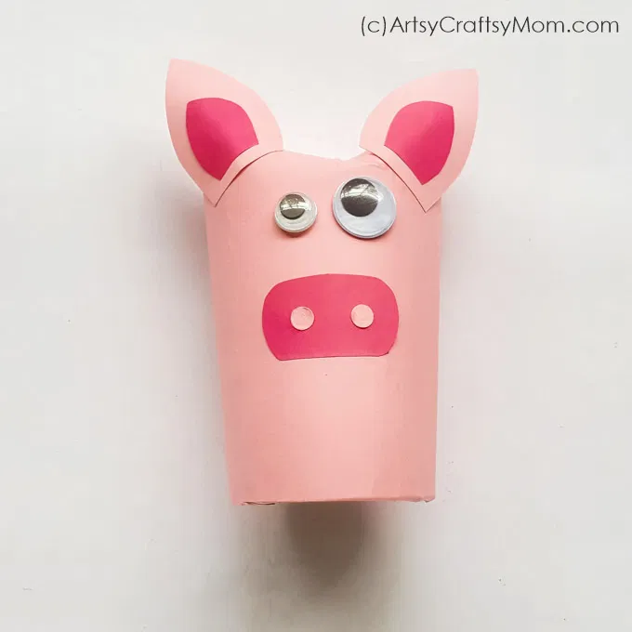
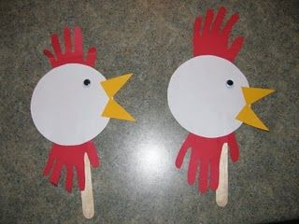
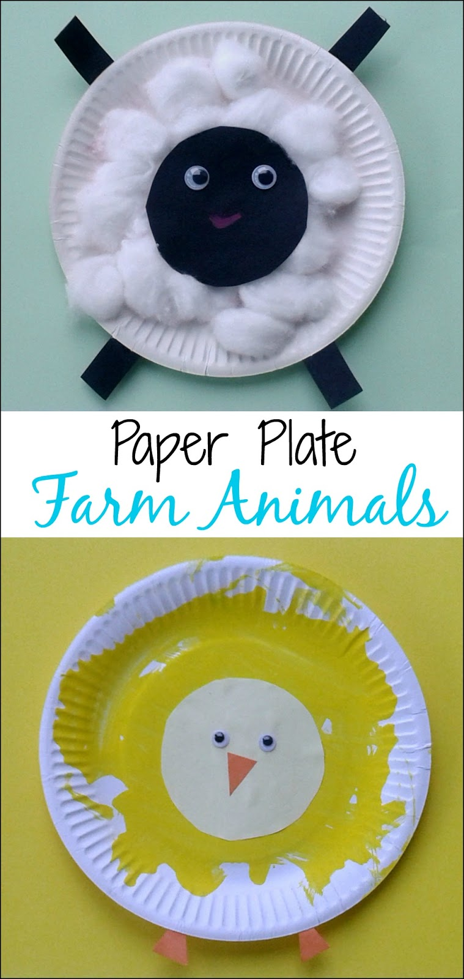
Some art ideas for Aistear

Slide 13
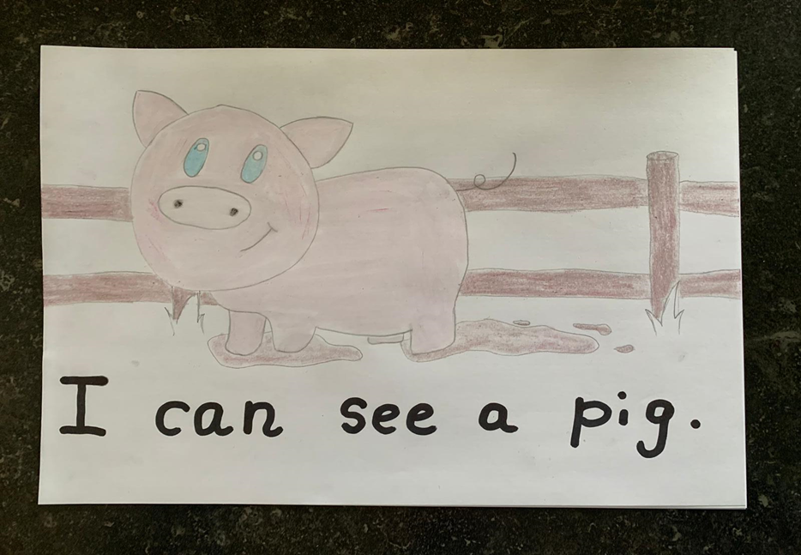
Drawing: My favourite Farm Animals
Draw a picture of some of your favourite farm animals and write what you see!
Can you draw where the farm animal lives?

Slide 14
Some farm games to play
‘Down on the farm 1-5’
http://www.sparkisland.com/down_on_the_farm_1/launch.html
‘Animal Farm Game’
https://www.sheppardsoftware.com/preschool/animals/farm/animalfarmgame.htm
Online jigsaw puzzles
https://www.dltk-kids.com/puzzle.htm
Snap game/Where do the animals live?/Count the number of legs on each animal
http://resources.hwb.wales.gov.uk/VTC/the_farm/eng/Introduction/default.htm

Slide 15
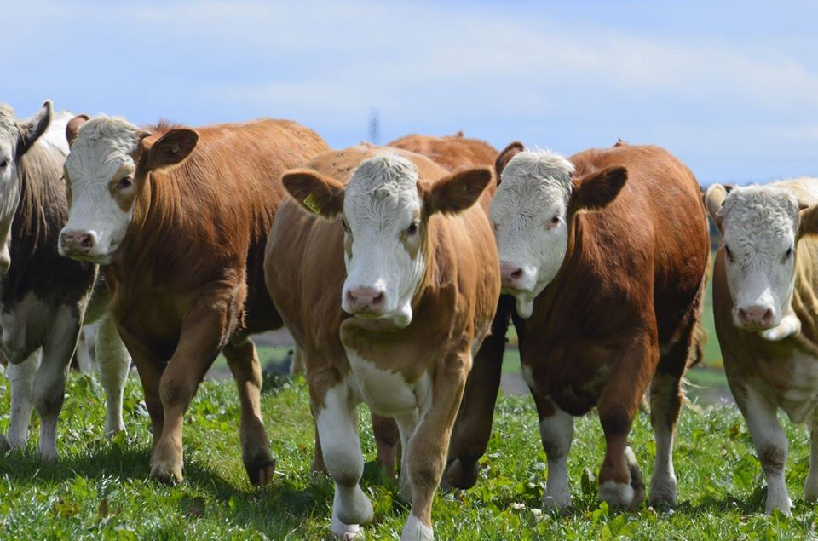
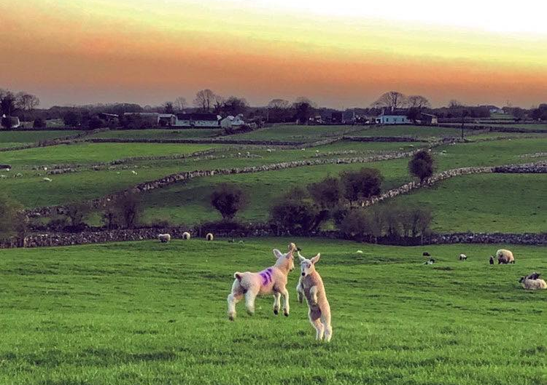
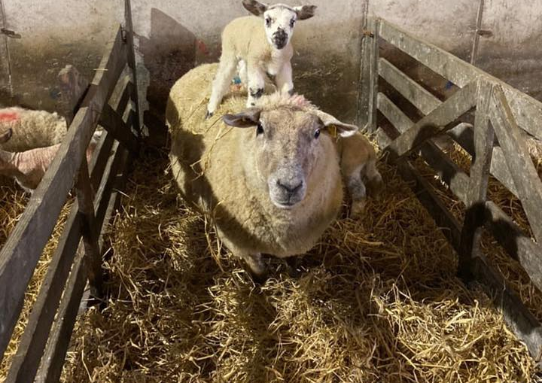
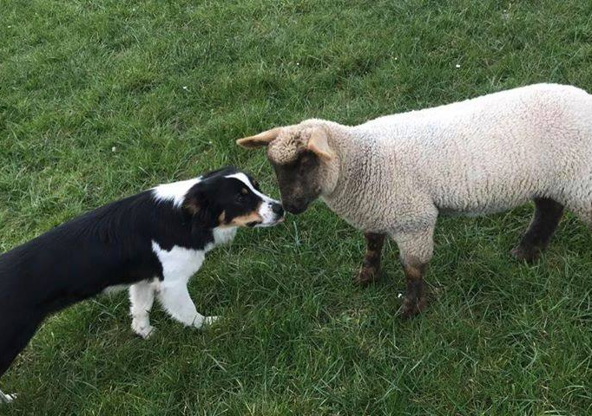
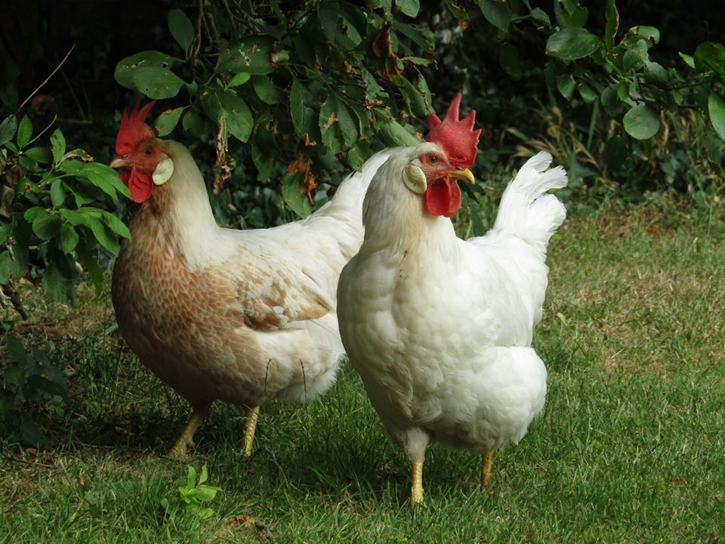
Well done on learning lots about the farm!

