Slide 1
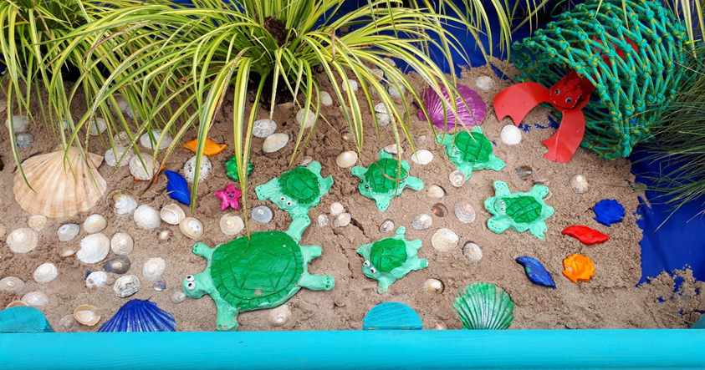
THE DEN HOME-SCHOOL LINKS
15th – 30th June 2020
Theme: The Seaside

Slide 2
Dear Parents…
We hope that you enjoyed the wonderful sunshine we had recently, fingers crossed we will see more of it again soon. It is hard to believe that we have been off school for three months now and that we are nearing the end of the school year! Of course we wanted to have a special send off for our Second Class children and a proper finish to the year. We are still praying that this will happen in the form of Summer Provision so watch this space ☺.
This is the last Learning from Home PowerPoint, thank you for engaging as much as you have with them. As always, do what you can, there is no pressure at all, you can dip in and out of the slides and pick whatever works for you.
You can keep sending your photos to Gaye (HSCL) by Whatsapp on 087 7443779 or email hscl@shjkillinarden.ie

Slide 3
CONTENTS
End of Year Awards ☺
S.E.S.E.
S.P.H.E.
Music
Literacy
Maths/Numeracy
Art
And finally….

Slide 4
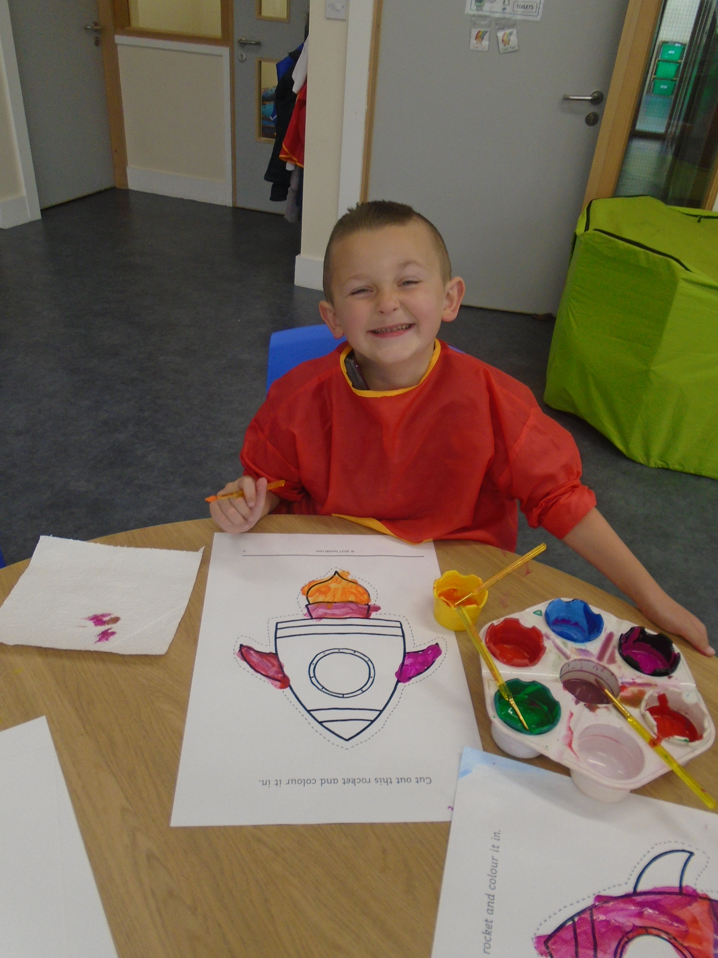
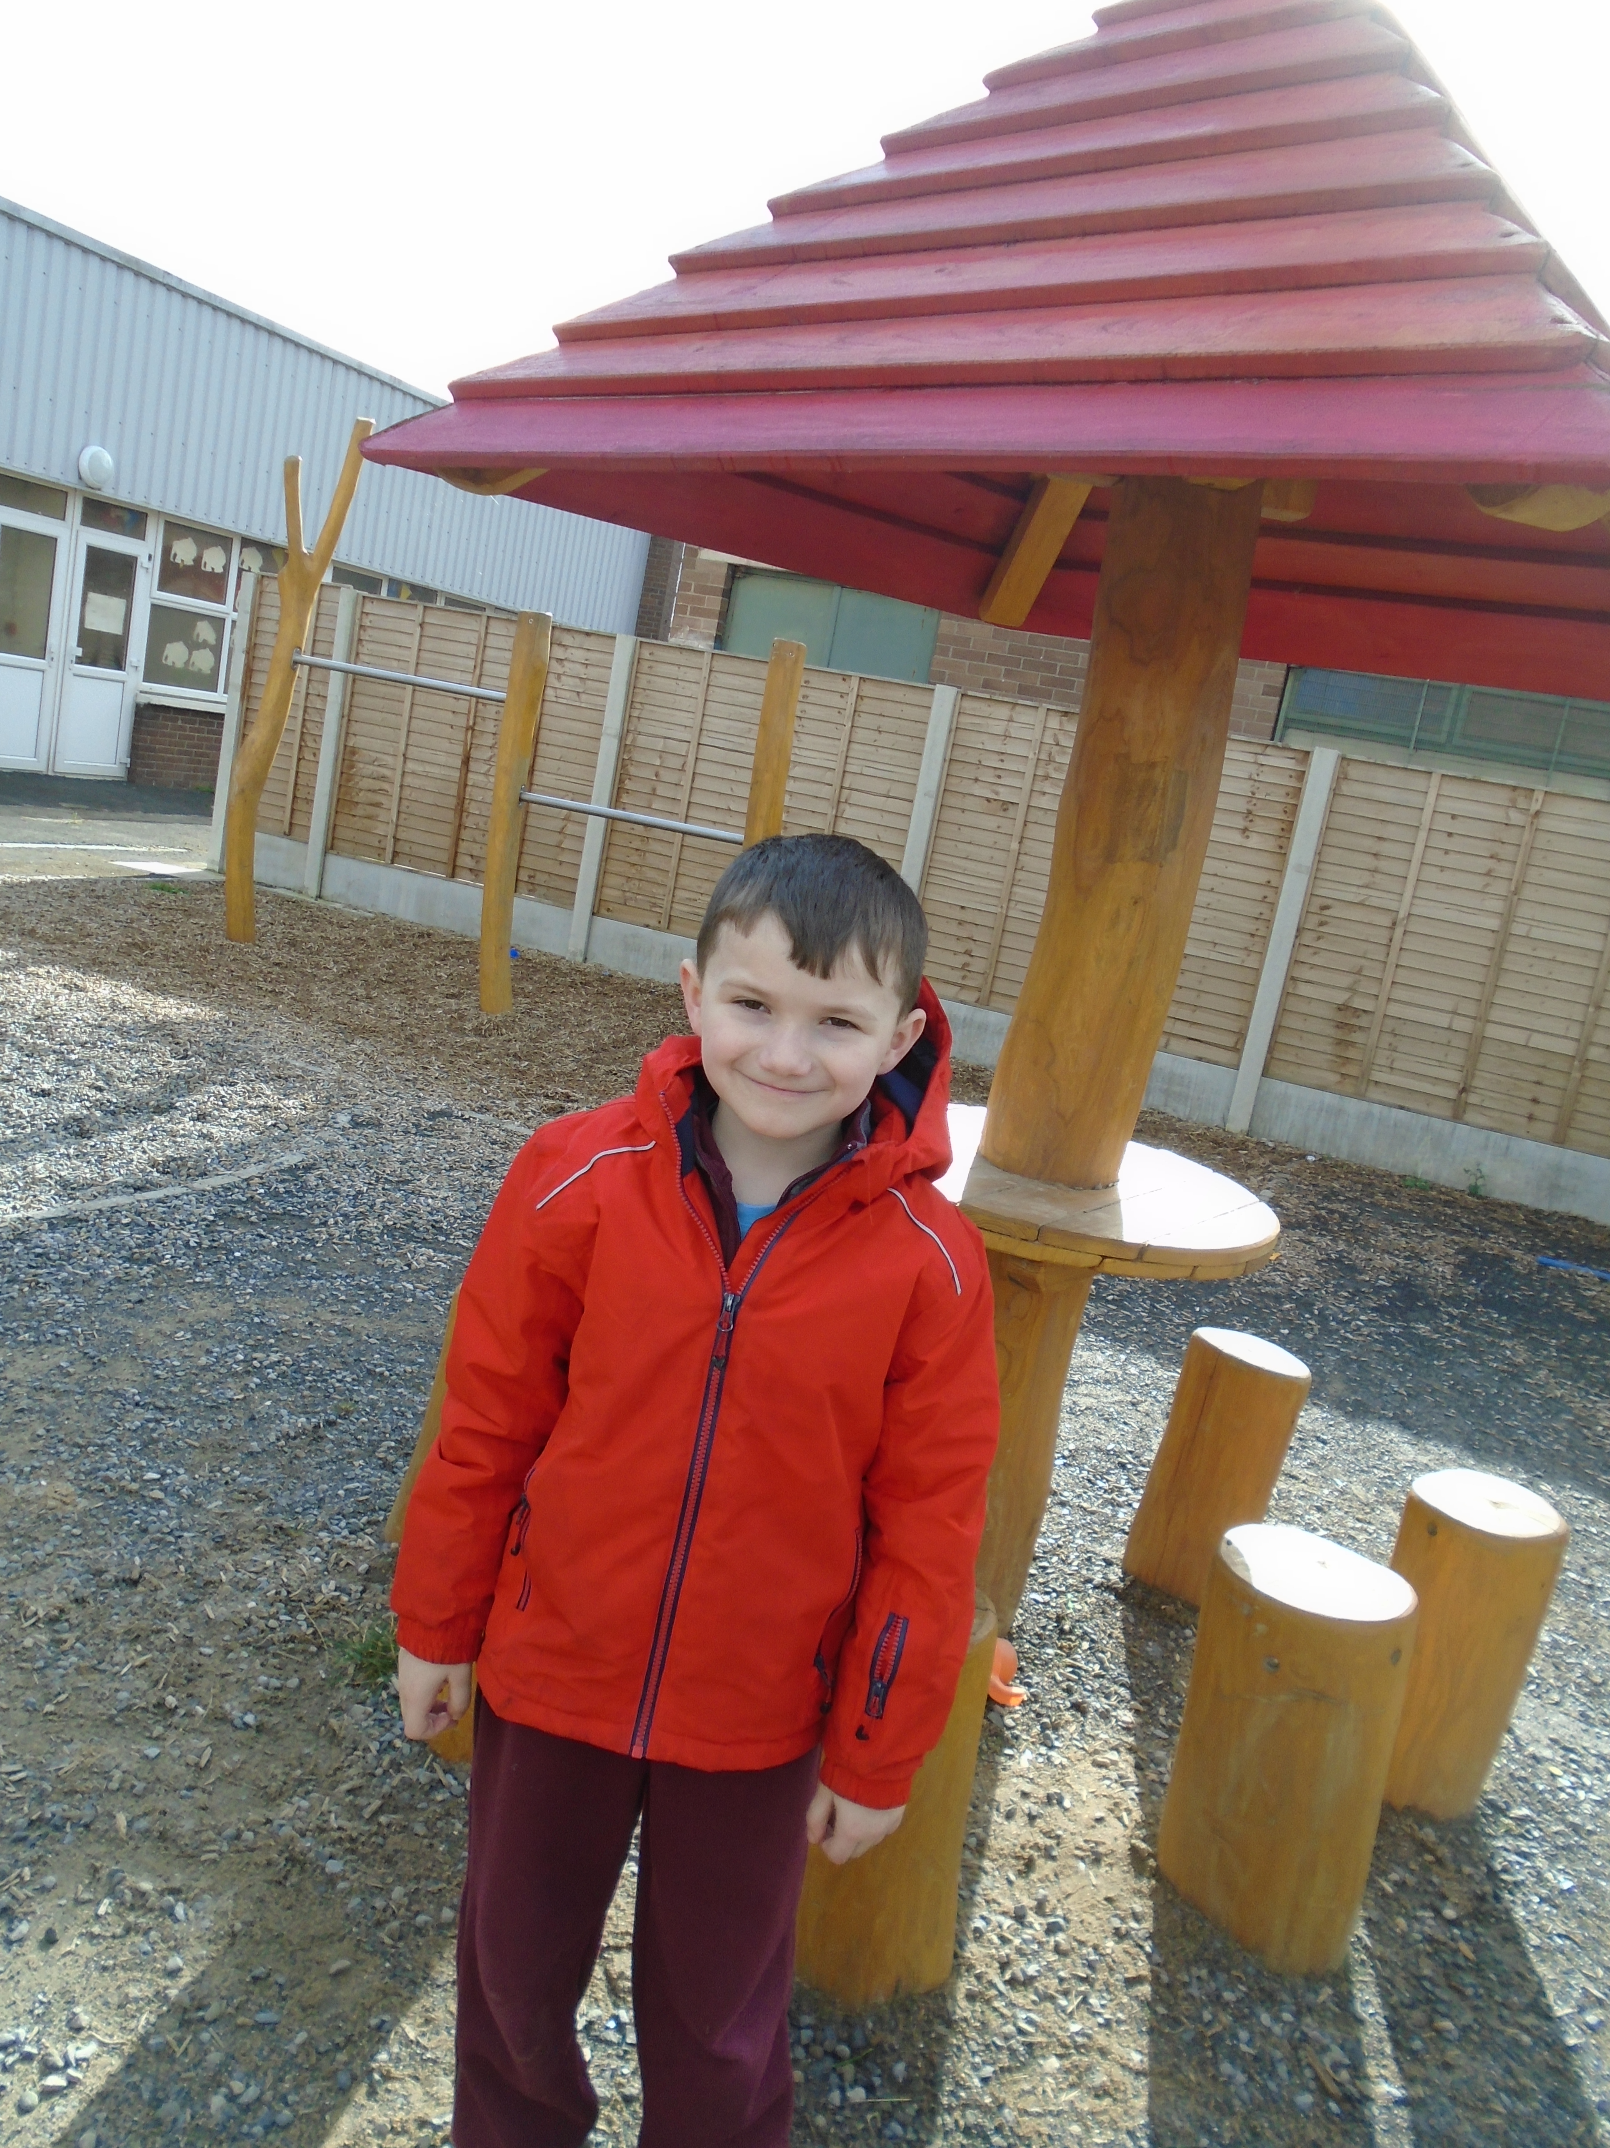
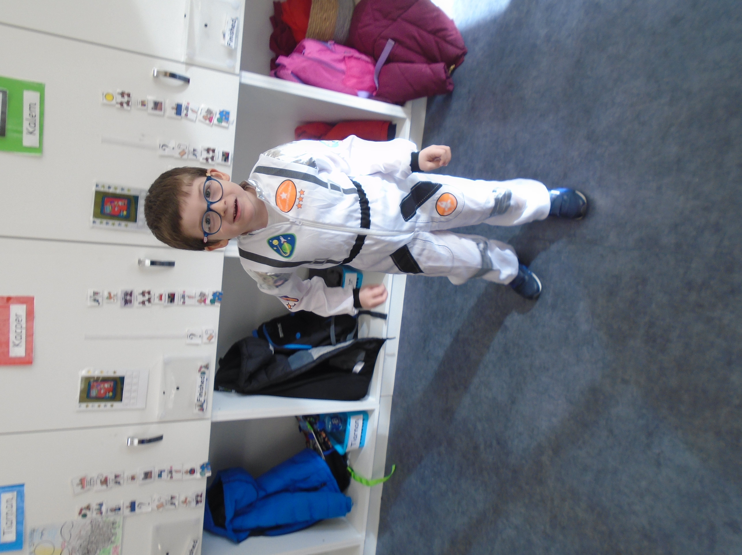
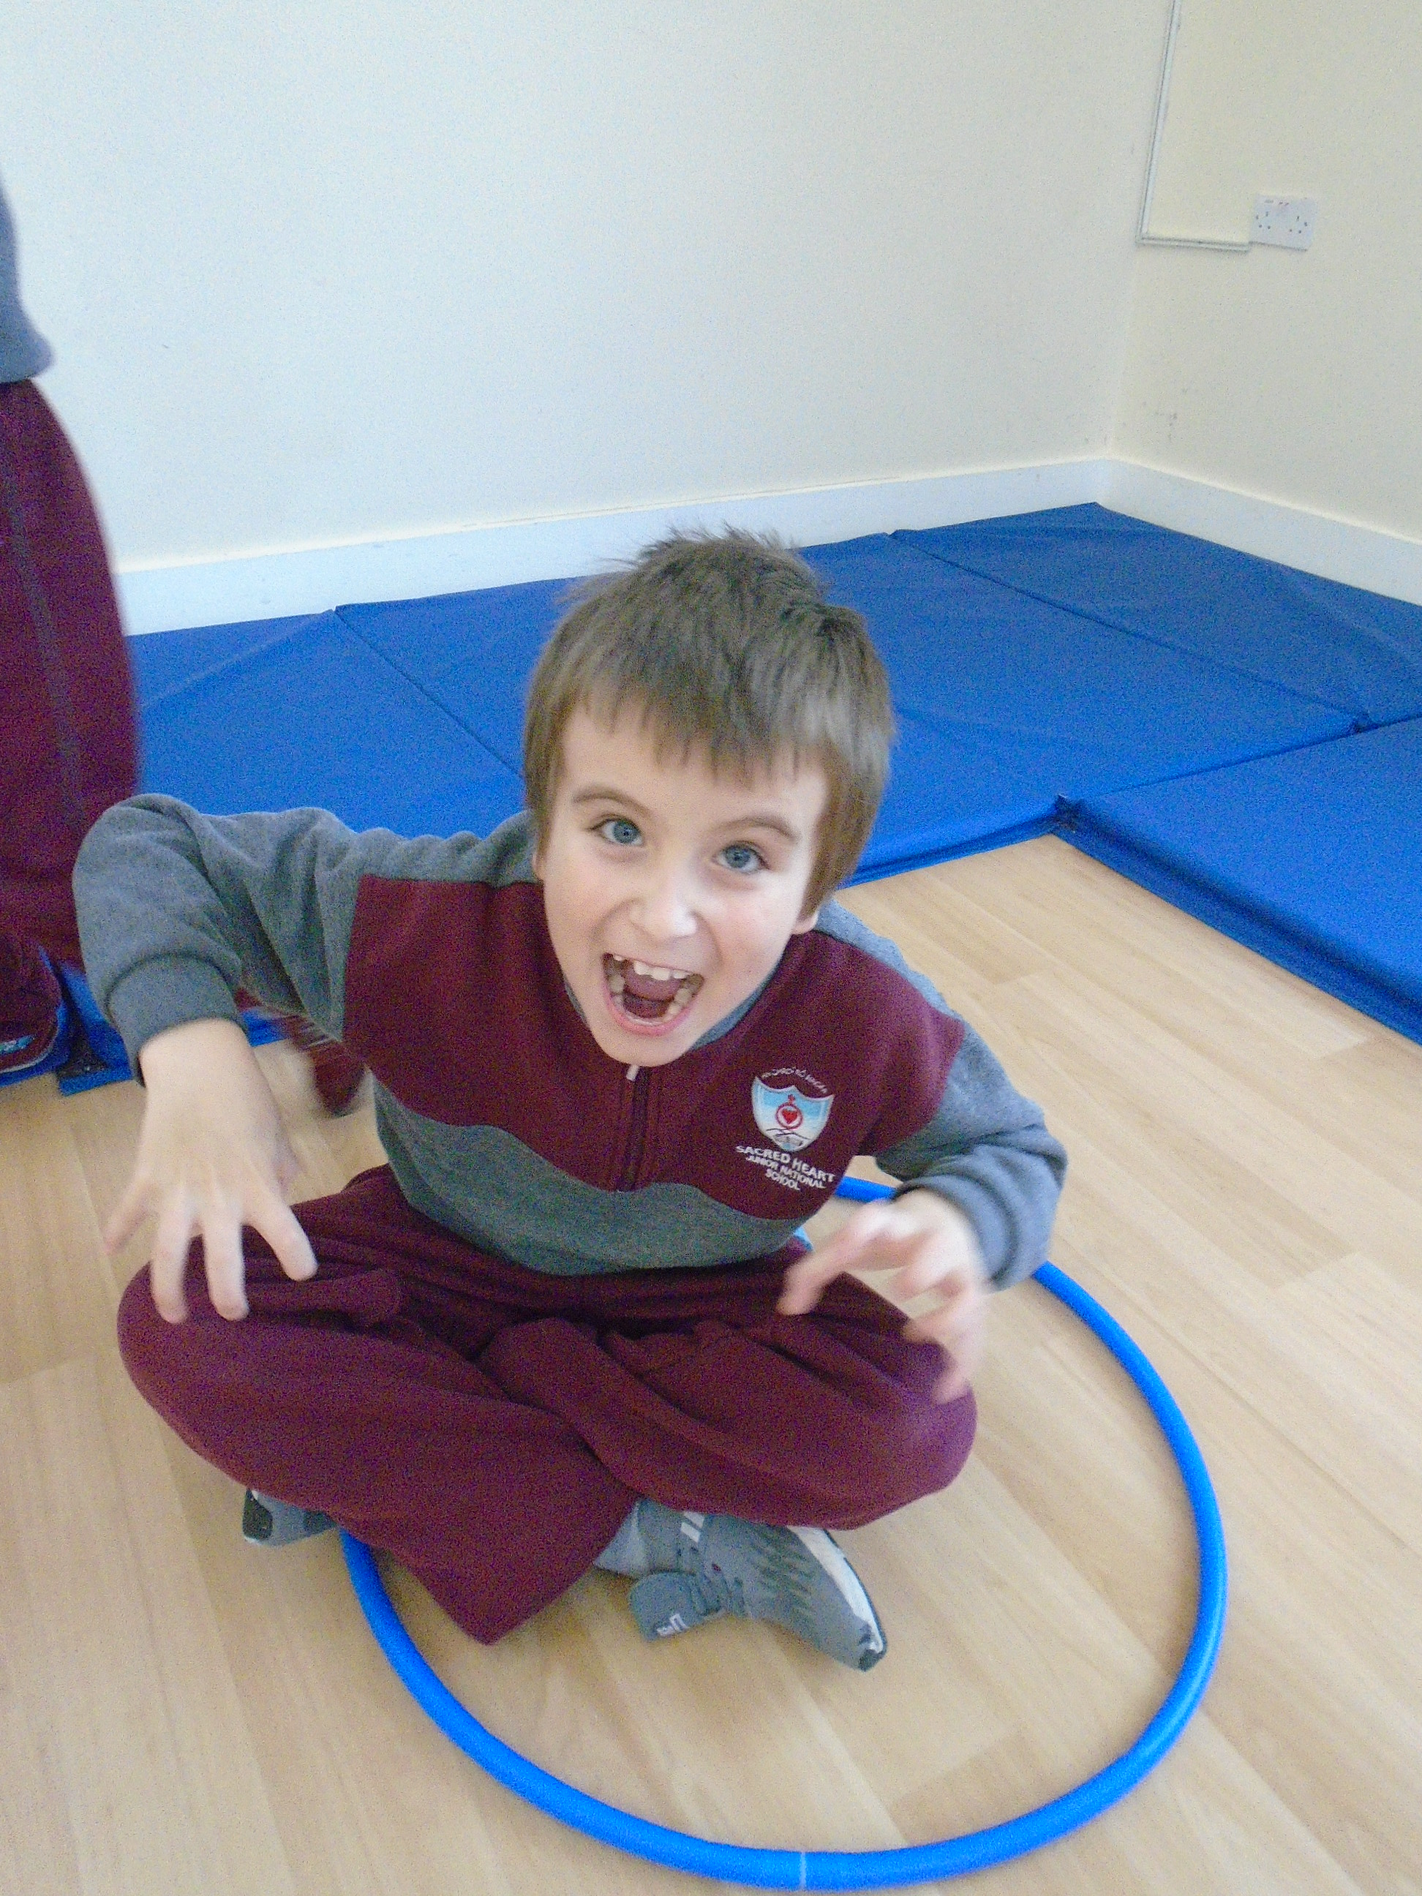
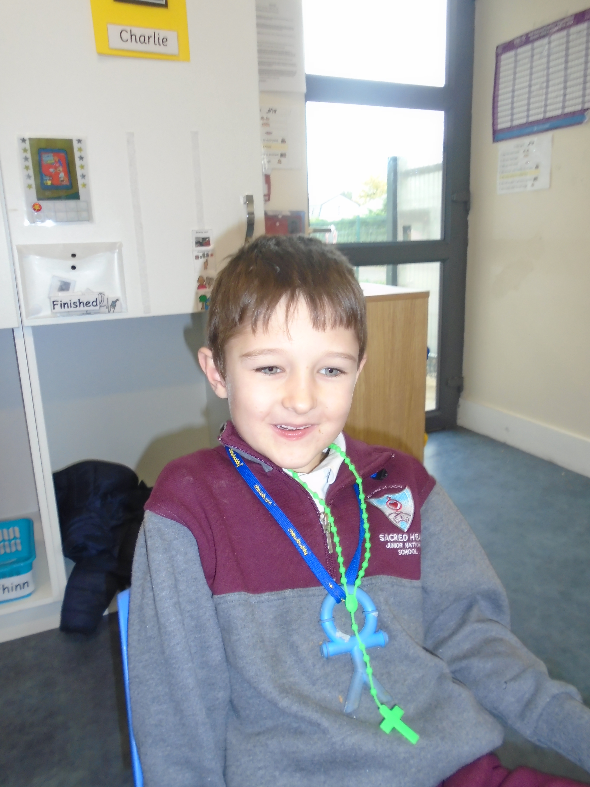
End of Year Awards
Sweetest Smile Award
CareBear Award
Amazing Imagination Award
Awesome Astronomer Award
Best Helper Award
Most Infectious Laugh Award

Slide 5
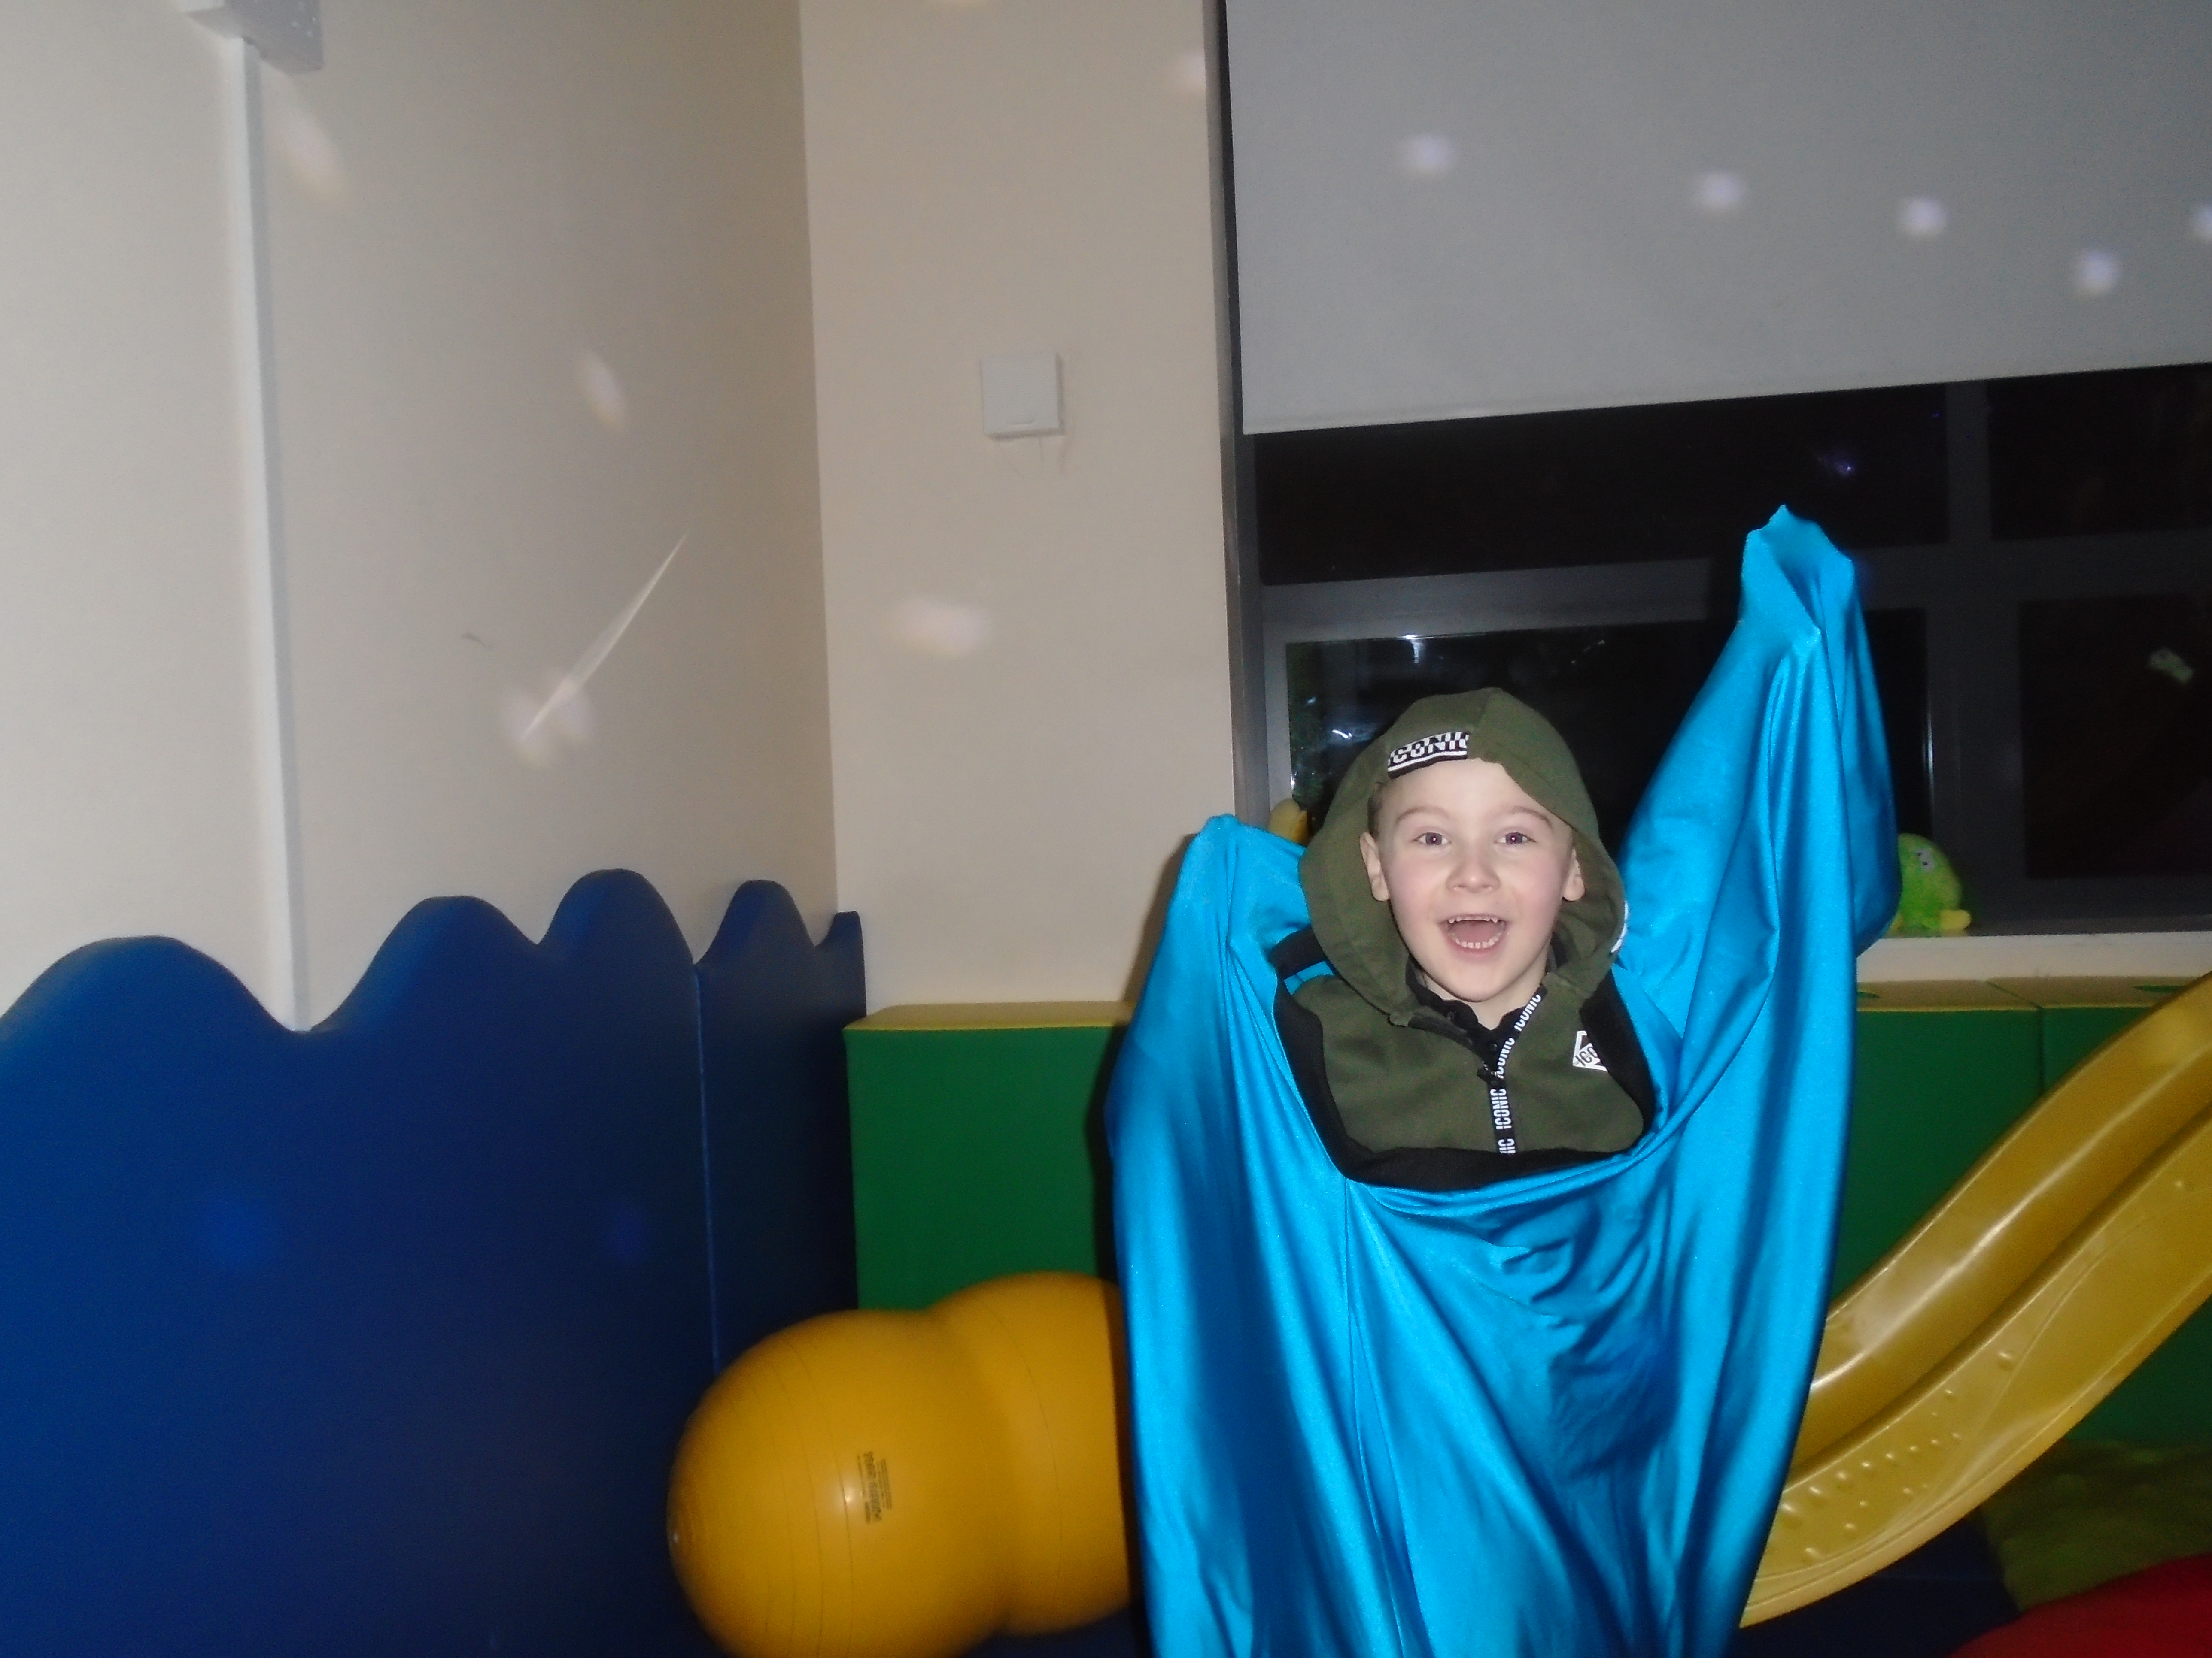
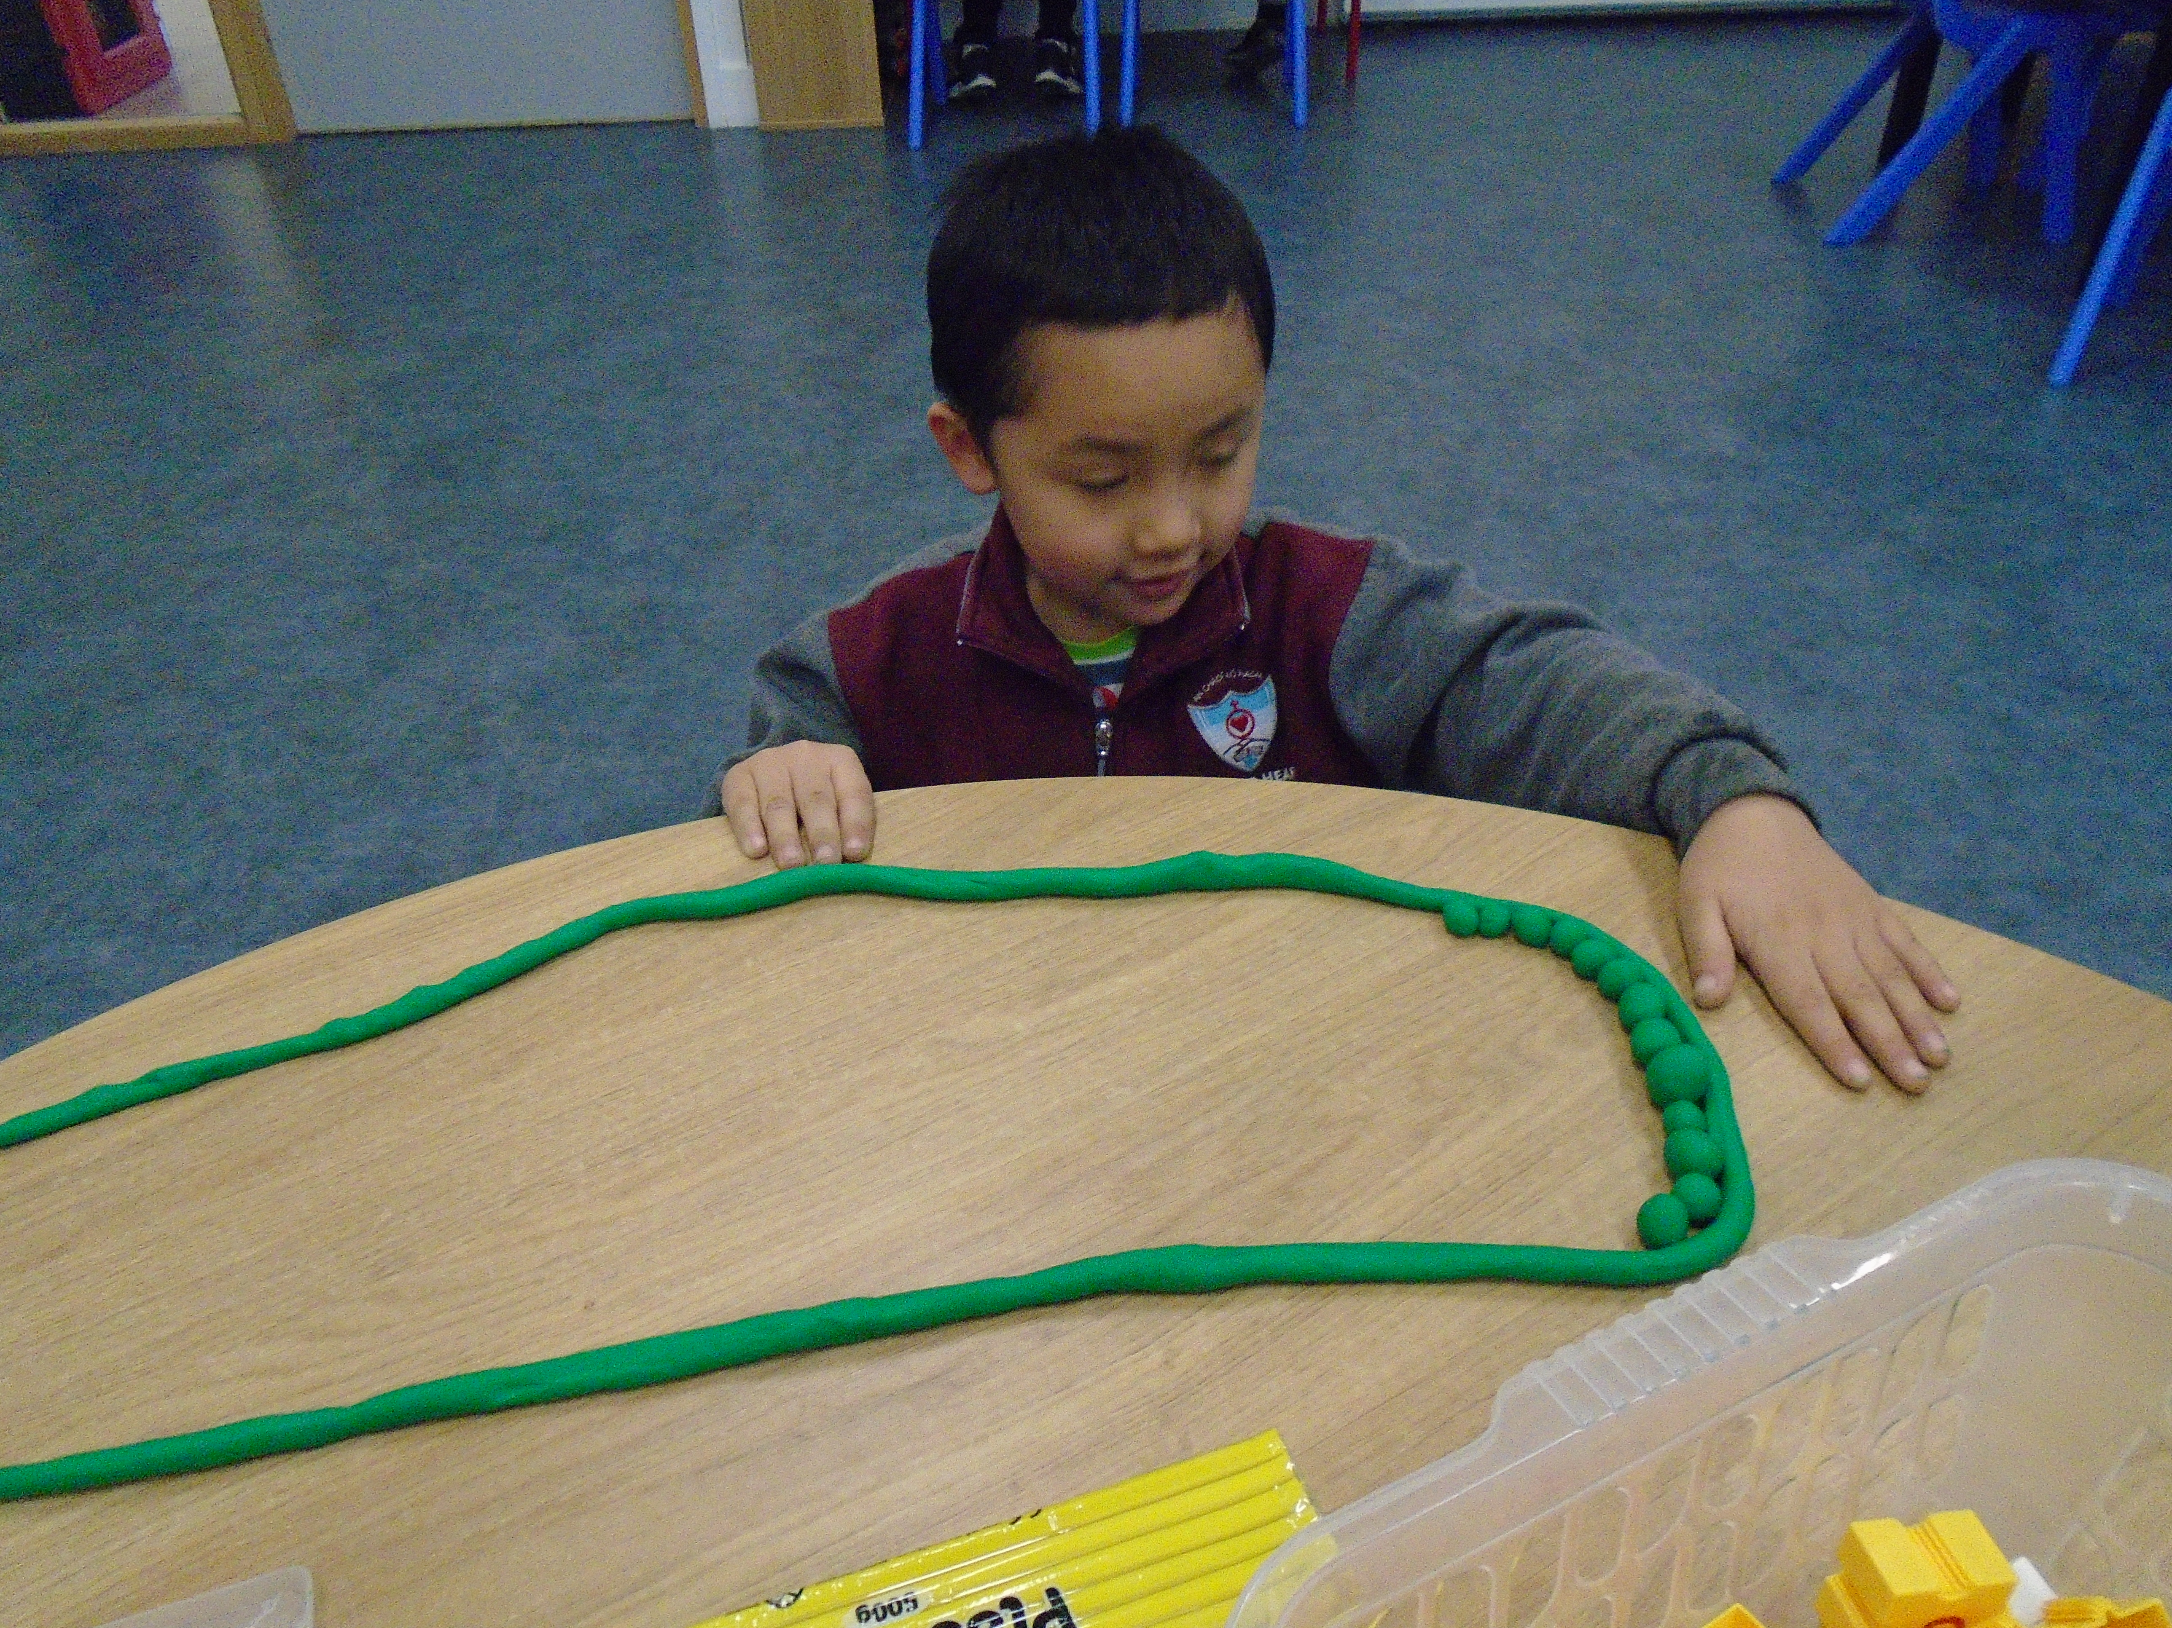
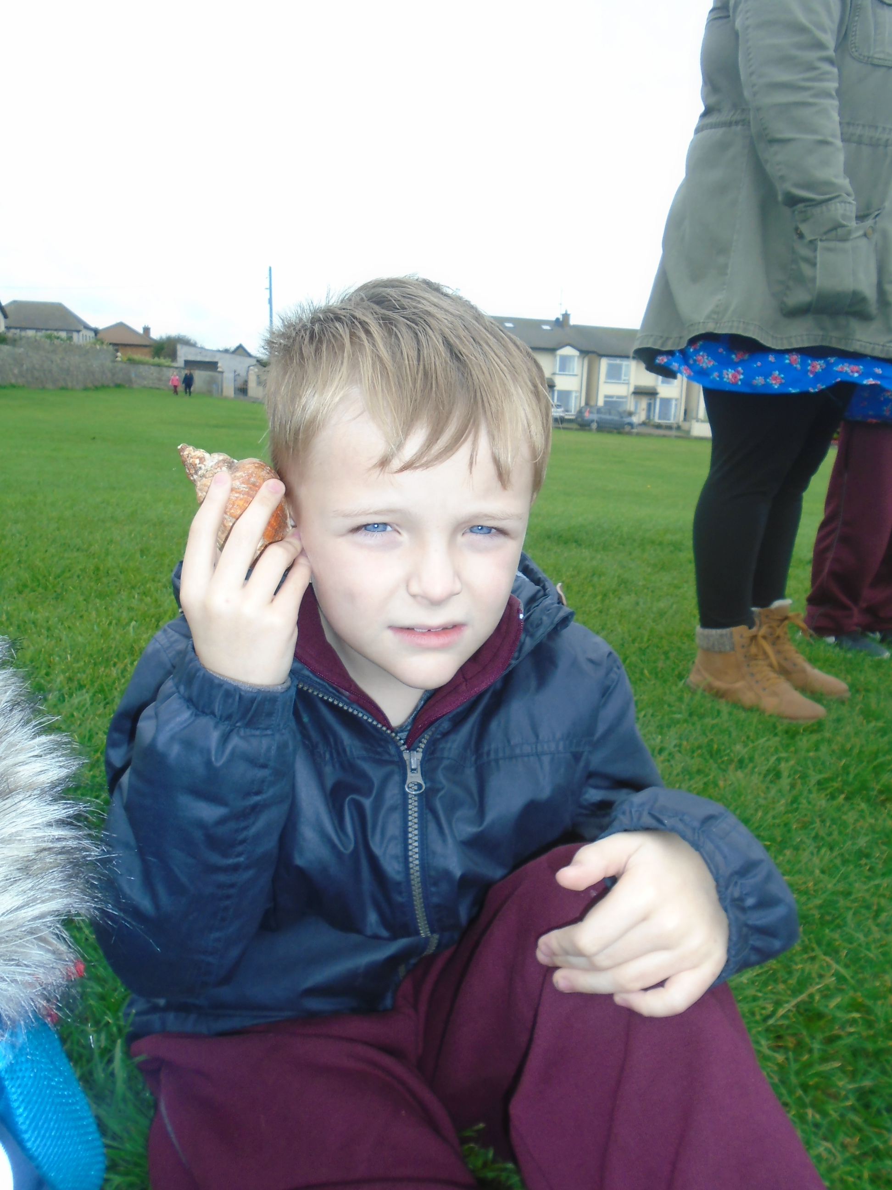
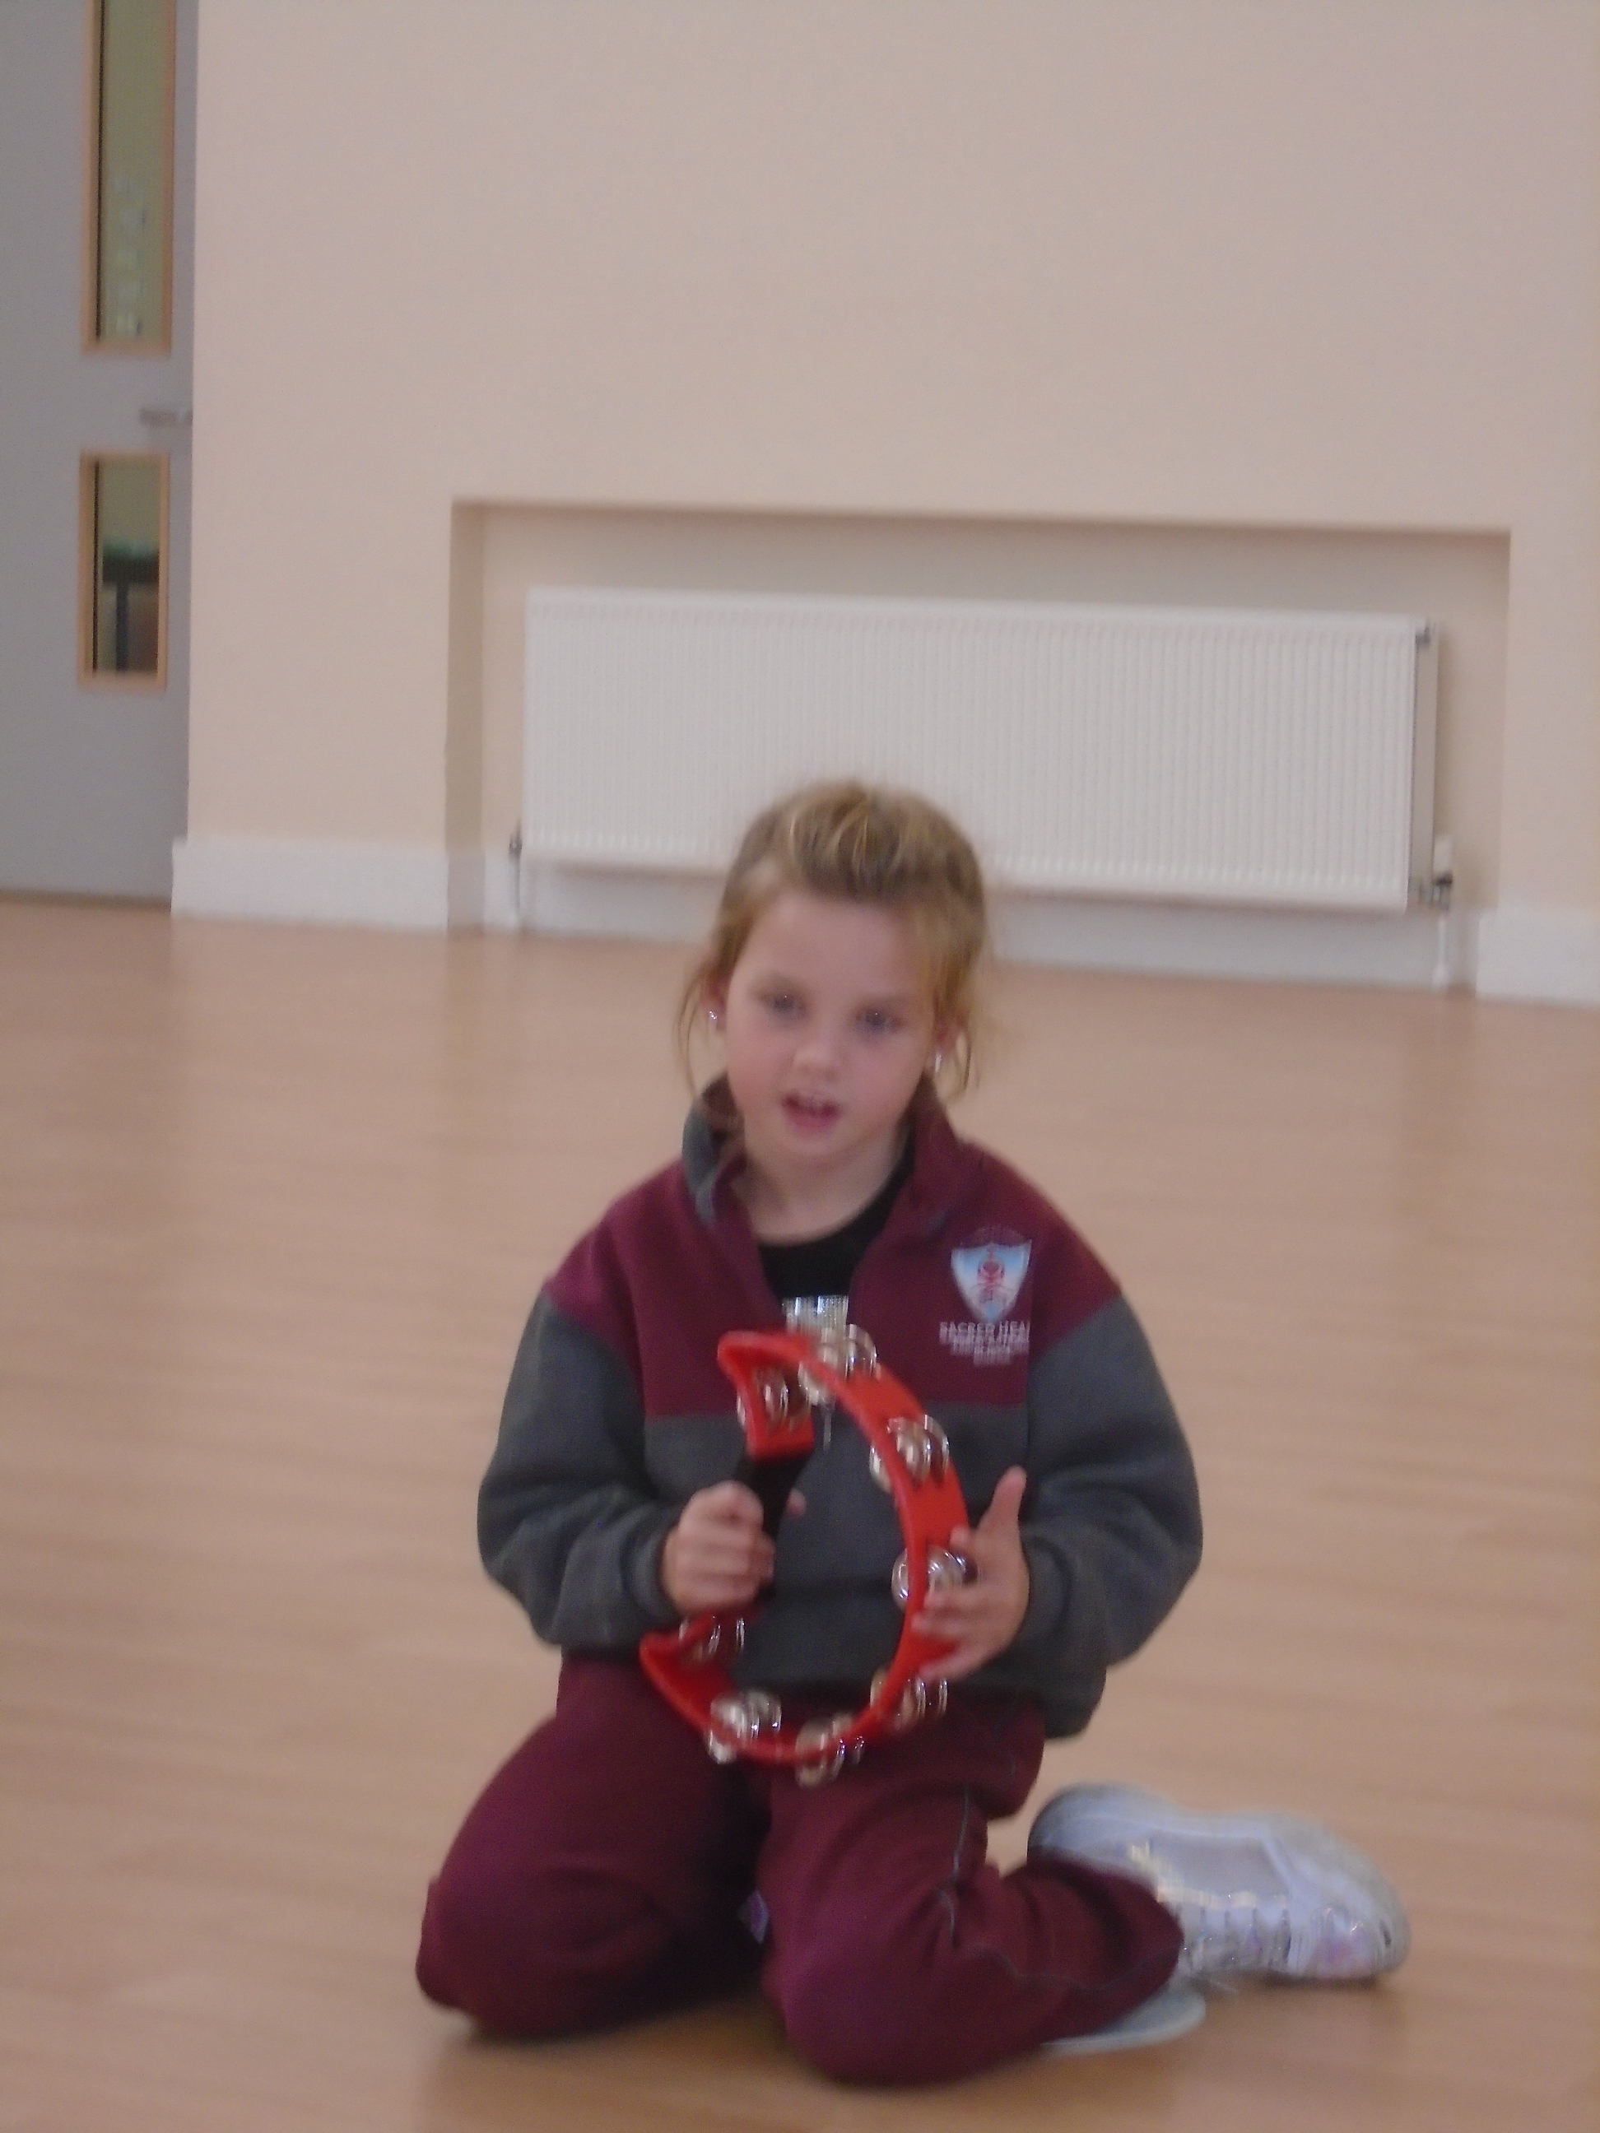
End of Year Awards
Super Scientist Award
Fantastic Friend Award
Super Writer Award
Fantastic Reader Award
Music Master Award
Amazing Artist Award

Slide 6
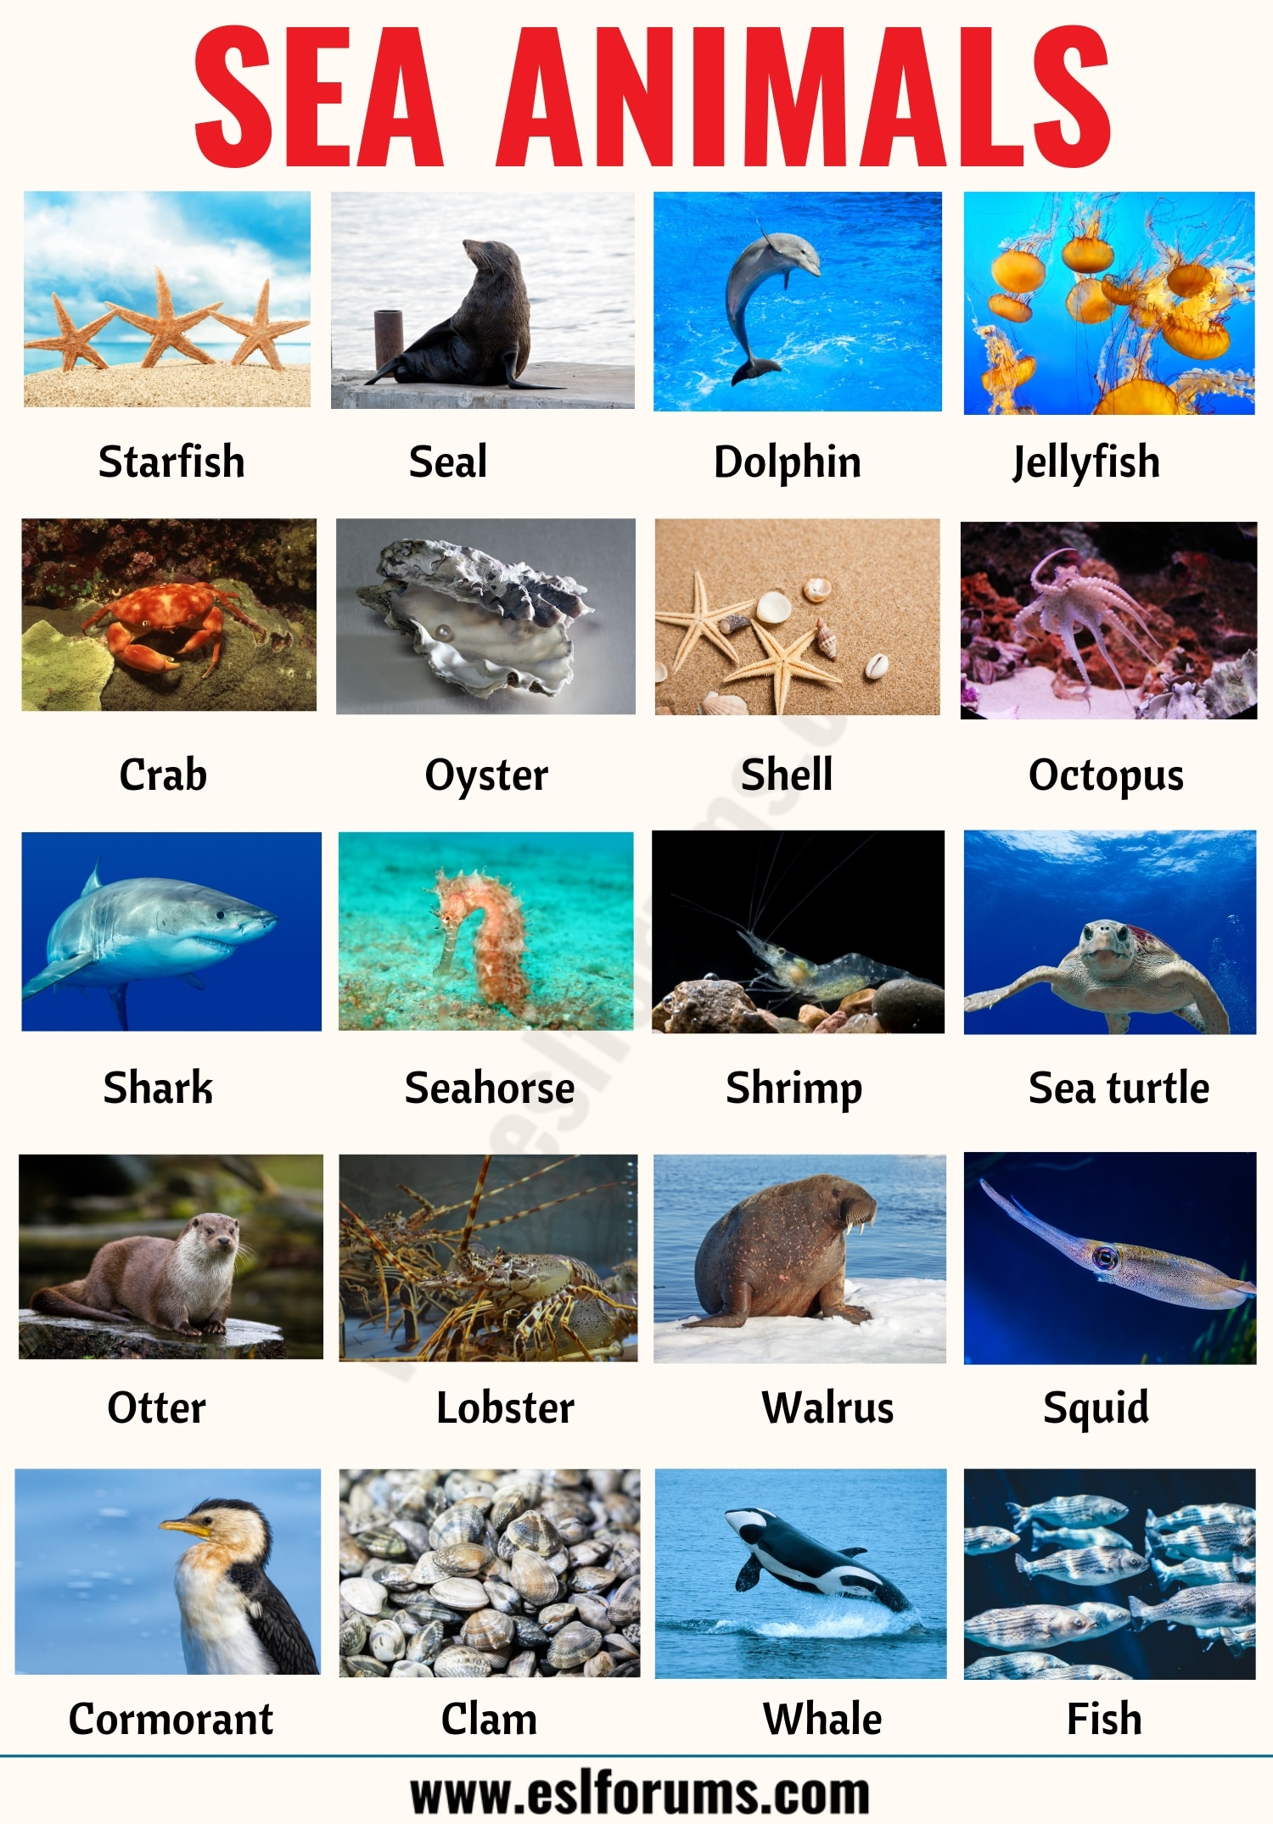
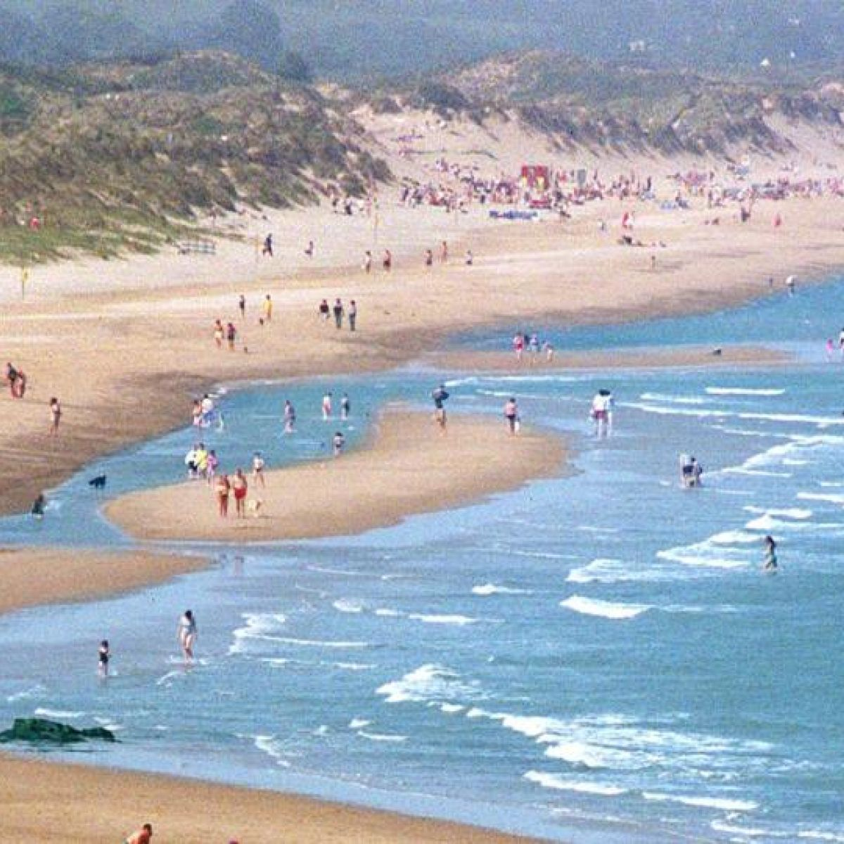
S.E.S.E.-The Seaside
If you go to the seaside this summer maybe you could look out for:
Different coloured shells – did you know shells are homes and that they can grow?
Pebbles and stones
Seaweed
Sea creatures (crabs, starfish, jellyfish! Don’t touch!)
Feathers from seagulls and other birds.
You can read up about these and other sea creatures on www.natgeokids.com or www.thelearningapps.com

Slide 7
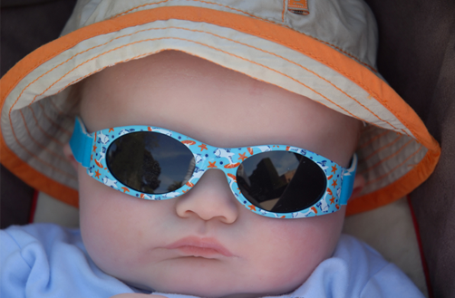
S.P.H.E. Sun Safety
.
Sunburn can happen both in Ireland and abroad. About 90% of harmful UV rays can also pass through light cloud, so take care on cloudy days too!
Sunscreen
You should use sunscreen or sun cream that has a sun protection factor (SPF) of 30 or higher and that
protects against both types of sun's dangerous rays, UVA and UVB

Slide 8
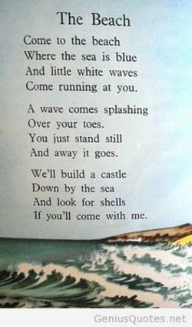
Literacy:
Here is a poem that you might like to read together.
ORAL LANGUAGE: Brainstorming words at the beach…
TASTE: Think of the taste of the sea water, ice-cream, sandwiches, crisps, fruit etc.
SMELL: Are there different smells near the sea? Seaweed? Barbecues? Chip van?
HEAR: What sounds would you hear by the seaside?
SIGHT: What colours might you see? Birds? Sea creatures? People?
TOUCH: What does the sand feel like? the sea? a towel? a beach ball? etc..

Slide 9
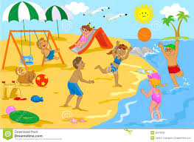
Literacy
Talk about this picture. Can you describe what the children are doing using some action words/verbs?
Can you think of any other fun activities you can do at the beach or on holidays?
Can you finish this sentence?
My favourite thing to do on holidays is _______________
If you like you can draw a picture to go with your sentence.
Here is a link to a story with a Seaside theme-There’s a Commotion in the Ocean
https://www.youtube.com/watch?v=9pRhgZ8Jffs

Slide 10
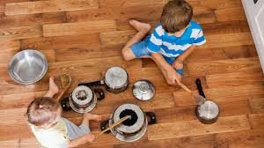
MUSIC Percussion
Check out this cool video by the group STOMP who make music simply by tapping rhythms on everyday objects. What different household items can you see? Could you find some things at home to make a rhythm with? A pot? What sound can you make by running a wooden spoon along a radiator?
While tapping out a rhythm you can say these phrases:
“I like cof-fee, I like tea”
“That is o-kay with me”
(one beat for every syllable)
Can you make your own rhythms or tap along to your favourite songs?

Slide 11
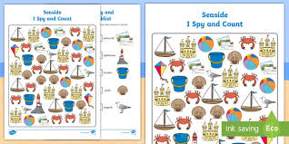
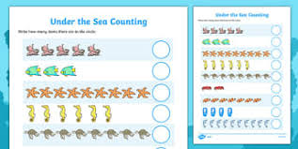
Maths/Numeracy
Twinkl.ie are still offering all parents FREE Ultimate membership. Simply go to www.twinkl.ie/offer and enter the code IRLTWINKLHELPS.
There are many resources for Maths with a seaside theme, like the examples below.
There are lots of opportunities for Maths when you are out and about during the holidays. Ask your child to count out exact money needed, tell the time, count seashells or footsteps etc.

Slide 12
Art…some seaside art ideas
We would love to see pictures of your
amazing art work!
Sailing boat scene made from fabric/material.
Make a beach scene by cutting and sticking coloured paper.

Slide 13
And finally….
Parents, thank you so much for your support throughout the year, you know your children best and we have learnt so much from you. Since the schools were closed in March we have tried to help you remotely, to the best of our ability; it has been a challenge for everyone, children and adults alike.
Children, thank you for being so brave and patient all this time. We cannot wait to see you all back in The Den again. And to our 2nd Class children who are leaving us this year – Ava, Caoilfhinn, Ciara, Kacper, Kalem and Max: we are so proud of each one of you and all you have achieved in your time with us. But this is not “Goodbye”…just the end of term and we are expecting to see you over the Summer.
Take care everyone, stay safe and see you soon xx

