Slide 1
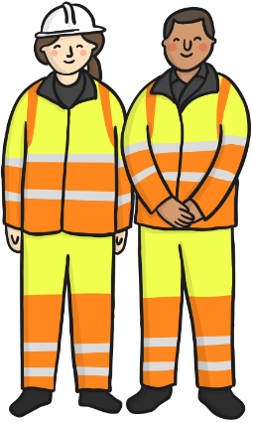
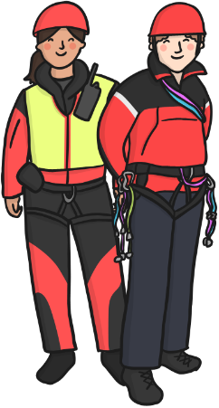
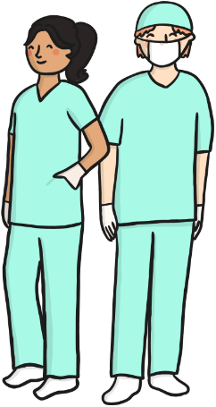
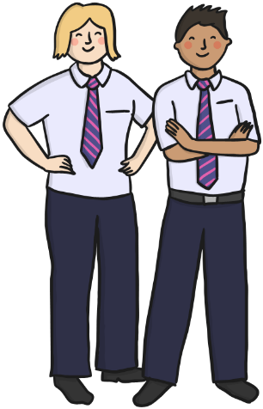
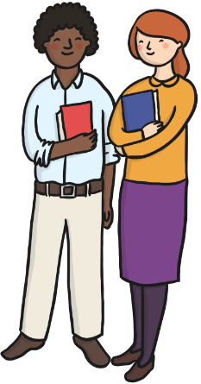
Would you like any of these jobs?
Road Workers
Mountain Rescue
Dentist
Bus Drivers
Librarian
Lifeguards

Slide 2
Lifeguards
What do lifeguards do?
Where would you find a lifeguard?

Slide 3
Lifeguard to the rescue Listen?

Slide 4
Mountain Rescue
Why do we need
mountain rescue?

Slide 5
Dentist
Do you like going to the dentist or do you get nervous?
What do you think a dentist does?

Slide 6
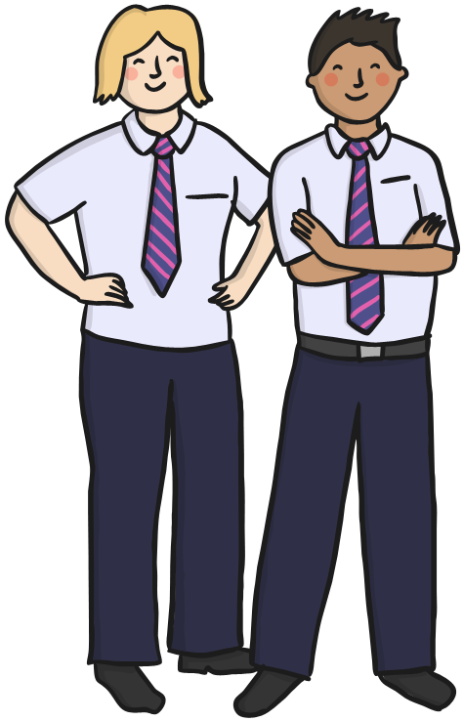
Bus Driver
Where do buses go?
What skills do you need to
be a bus driver?

Slide 7
Road Worker
What is a road worker’s job?
What would roads be like if there were no road workers?

Slide 8
Building a new road. What fun! Listen?

Slide 9
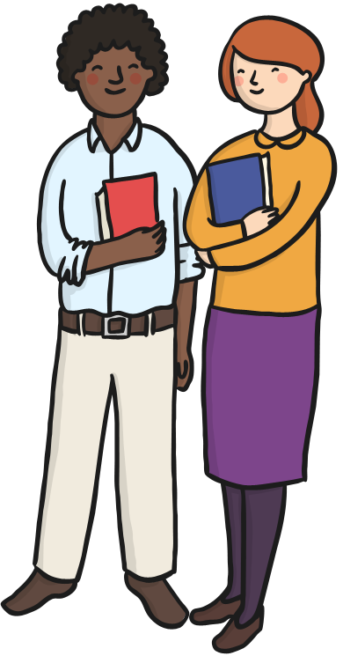
Librarian
What is a librarian’s job?
What would a library be like without a librarian?

Slide 10
What’s your dream job?
If you could have any job which would you choose?
Draw a picture.

