Slide 1
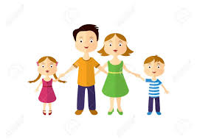
Early Start
Home Links
April 20th-24th 2020

Slide 2
Welcome to the Summer Term!
Parents and Children, our weekly ‘Home Links’ plan will be full of fun activities that will help to cover the themes we would have been doing in school.
The point of the tasks are not so much about learning and doing work. They are about making a connection between your home and our school community during this difficult time. Each week we will upload fun activities for the week ahead. Share pictures of what you get done if you like, on the website photo gallery. We would love to see them.

Slide 4
What I Need
paper
crayons/colouring pencils
pencil
adult to help me
access to phone/Ipad/computer

Slide 5
NEWS
How many Easter eggs did you get?
Which was your favourite?
Were any the same?
What was the wrapper like?
Did it have a pattern, spots or stripes?
Can you draw a picture of the egg?

Slide 6
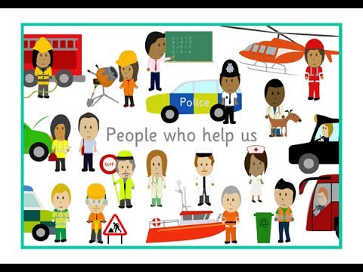
People who help us
Can you name people who help us and are helping us keep safe in our communities at the moment?
For each one you can name, can you answer these questions?
Who they are?
What they do?
Where they work?
What tools/equipment they use?
What uniform they wear?
sssh! There is help on the next slide!

Slide 7
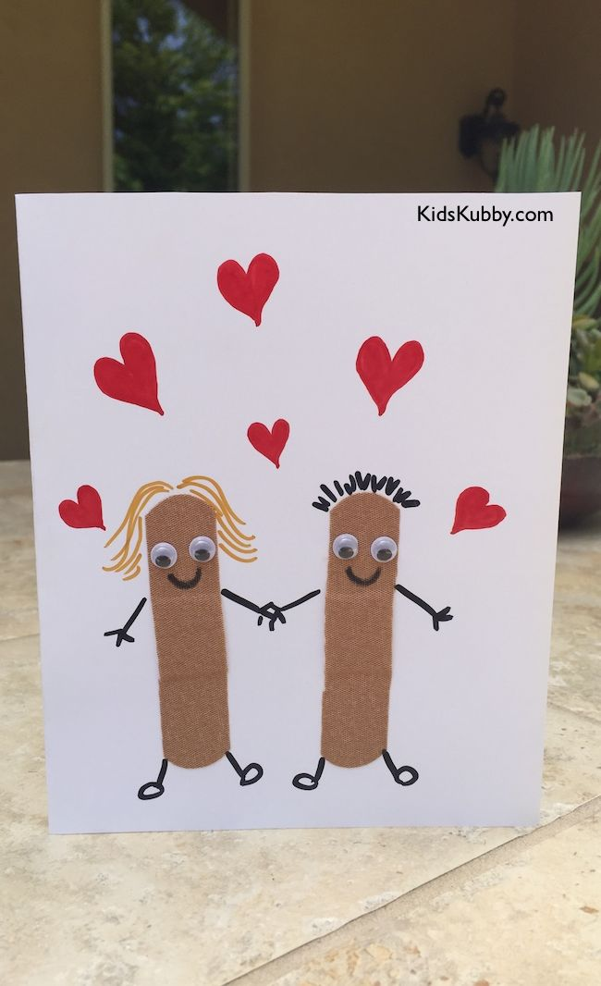
Did you think of these helpers?
doctor, nurse, garda, shopkeeper/cashier, bin person, post person, pharmacist, bus driver………
Make a Thank You card for our great helpers

Slide 8
When I grow up I want to be a …………? I want to be a builder like the 3 little pigs! Ask someone to read/tell you the story of the 3 Little Pigs
The 1st little pig built a house of ______?
The 2nd little pig built a house of S______?
The 3rd little pig built a house of B_____?
And the Big Bod Wolf came along!
What did he do?
What happened at the end of the story?
Draw a picture of the 3 pig’s houses and the wolf.
Don’t forget to take a photo and send to the gallery, we would love to see your work.

Slide 9
Here are some extra ideas. Have fun! Have a look at next Powerpoint : People who help us 1

Slide 10
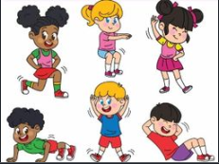
Well Being
Exercise every day: Have a go on your bike ,scooter, run, skip, hop, jump
Join Joe Wicks live at 9.00
Practice your ball skills.

Slide 11
The Bunny arrived with your eggs so you might like to try this Jumping Bunny activity in the garden. Have Fun!
How Many Jumps?
Materials: masking or painter’s tape, measuring tape
Rabbits aren’t the only animals that are great jumpers—kangaroos, frogs, and grasshoppers are too!
Go to an open space (or move furniture out of the way) and make “animal jumping stations.” Have your child help you use masking tape to mark a starting point and the distance that each animal can jump. Measure 5 feet for a grasshopper, 6 feet for a frog, and 15 feet for a kangaroo.
At each jumping station, have your child count how many jumps it takes to go the distance.
Build math vocabulary as you talk about the activity. Your child will see that the longer the distance, the more jumps it takes.

Slide 12
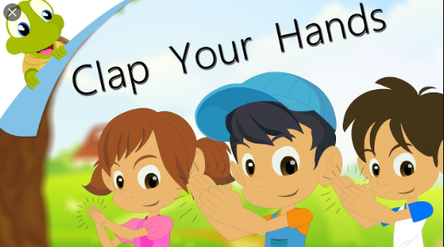
Story and Song
Enjoy listening to a story
Maybe at the end of the story you could draw a picture or write about your favourite part of the story!
https://stories.audible.com/start-listen?ref=adbl_ent_anon_ds_hm_hb
Watch :The Clap Clap Song and join in!
https://www.youtube.com/watch?v=0HByXWgkMwk

Slide 13
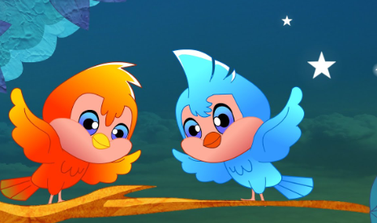
Rhyme Time
Revise: 2 Little Dickie Birds
Twinkle Twinkle Little Star
Miss Polly had a dolly

Slide 14
Bonus Story!
When I Grow UP
https://worldbookonline.com/wbel/#/stories/bk000534/en-US?category=jobs

Slide 15
Well done! You have completed all your work

