Slide 1
Senior Infant work plan for the week 20th to 24th April
Art, Music, SPHE, P.E., SESE, Religion
If you would like any of your child’s work displayed on the school website please send it to Gaye our HSCL teacher on
whatsapp 0877443779 or by email hscl@shjkillinarden.ie

Slide 2
Visual Art

Slide 3
Van Gogh Inspired Blossom Tree
Van Gogh – Who is he?
Almond Blossoms by Van Gogh
Van Gogh is one of the world’s most famous artists. While he remained relatively unknown within his lifetime, in modern day his paintings have inspired artists worldwide and are some of the most valuable in the world.
Full Name: Vincent Van Gogh Born: March 30, 1853 in the Netherlands Died: July 29, 1980 in France Famous Works: Almond Blossoms (1880), Sunflowers (1888), Starry Night (1889).
To learn more about the artist – click the link below:
https://www.tate.org.uk/kids/explore/who-is/who-vincent-van-gogh

Slide 4
Create your own Van Gogh inspired Blossom.
Are you ready to create your own Blossom tree?
First - Look at the painting.
You can use white paper and paint/colour it blue.
Using brown paint, crayons, colouring pencils, markers - paint/draw/colour the branches.
Using a mixture of white and pale pink - paint or colour the blossoms.
Tip 1: Remember you can mix white and red to make pale pink.
Tip 2: You can use your fingers to finger-paint the blossoms.
Tip 3: If using paint remember to let the blue background fully dry before moving on to the branches and let the branches dry before painting the blossoms.
Tip 4: Enjoy creating your very own Van Gogh inspired Blossom Tree
Notice the background colour, colours of the branches & blossoms. Are they dark or bright colours?
Why do you think the artist used these colours?
Do you like / not like it? Why / why not?
What does this painting remind you of?

Slide 5
Music

Slide 6
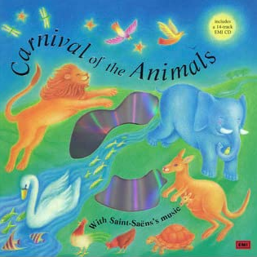
Music
).
Click on the link below to listen to a piece of ‘Classical’ music called –
The Swan by Camille Saint-Saens’ Carnival of the Animals
https://www.youtube.com/watch?v=vNdsrHPCcCg
Think: -
What instruments can you hear?
Is the music fast/slow?
Is it loud/quiet?
Do you like the music?
What do you like/dislike about it?
Draw a picture of how the music makes you feel
Or what the music makes you think about.

Slide 7
SPHE

Slide 8
Respecting differences.
Aim: To help your child understand different cultures and develop respect for and appreciation of others.
Discussion:
Talk about how we are the same or different:
a) physical characteristics - What are all the different colours of hair that people have? Eye colour?
b) family – people have different size families?
Click on the link below to listen to the story:
The Family Book by Todd Parr
https://www.youtube.com/watch?v=MIm_H01Z6Ss
Ask your child to choose which item they like best.
For example:- • Building Lego or making jigsaws • Water or milk • Rice Krispies or Coco Pops • Playing on the slide or playing on the swing
Then ask them to tell you what they like about what they have chosen and why.
Now take your tun and explain what you like about your choice.
Highlight how some people like some of the things that we do and that others prefer something different.
Something extra: As nice manners is always good to use with every-one we meet you can listen to this song as a reminder☺
https://www.youtube.com/watch?v=qSnAVyqYT6c

Slide 9
The Family Book Activity Sheet
Draw a picture of
you with your family
on a special occasion

Slide 10
P.E.

Slide 11
Keep active
PE with Joe Wicks
https://www.youtube.com/playlist?list=PLyCLoPd4VxBtWi7RnRLz6qHgOqWiB_LrH
Daily Dance breaks
https://www.youtube.com/channel/UCqscMO1YfPB3-7dZZSxKPrQ
Yoga for kids
https://www.youtube.com/user/CosmicKidsYoga
This Photo by Unknown Author is licensed under CC BY-NC-ND

Slide 12
SESE (History, Geography & Science)

Slide 13
SESE
Senior Infants You will need: copybook, pencil, colours
SESE
20th – 24th April 2020
If you would like any of your child’s work displayed on the school website please send it to Gaye our HSCL teacher on whatsapp 0877443779 or by email hscl@shjkillinarden.ie

Slide 14
History: Story
This week the children will be listening to the story ‘Peace at Last’ by Jill Murphy.
In History, the children learn to re-tell a story and sequence the events in the correct order.
https://www.youtube.com/watch?v=PWMuB6IwzE4
Can you re-tell the story to someone at home in your own words?

Slide 15
Science: Energy and forces(sounds)
We hear sounds everyday but all of these sounds are very different. The sounds can be loud, quiet, high or low. Can you think of any sounds you might hear everyday?
Stand outside and close your eyes for one minute. What did you hear? Talk about it with an adult.
Watch this short video. You have to decide if the sound you heard is high or low. A high sound might be a whistle or a bird chirping however, a low sound can be a drum or a lion roaring. https://www.youtube.com/watch?v=hKQKAI2q1kg

Slide 16
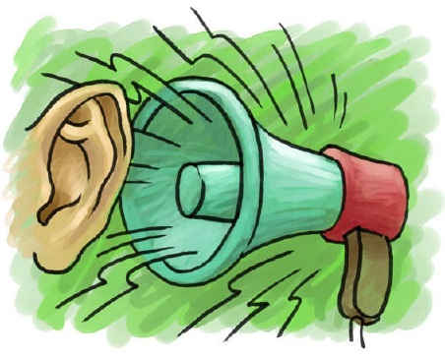
This Photo by Unknown Author is licensed under CC BY-NC-ND
Now lets think about loud and quiet sounds. Loud sounds can be really noisy and they might hurt our ears sometimes. Quiet sounds might be really hard to hear.
Remember when you closed your eyes and listened to the sounds you could hear outside? Were any of them loud or quiet?
You are going to listen to a short song about when it’s okay to be loud and quiet. https://www.youtube.com/watch?v=ylJ2IBauypE

Slide 17
Activity
With an adults permission, you have to find objects in the kitchen that might make sound. (pans, spoons, wooden utensils, plastic, cups, bowls etc)
Put these objects on the floor or on a table.
Using the objects explore what kind of sounds they make, are they high or low, do they sound loud or quiet? Can you make sounds with two or more objects?
Draw a picture of an object that you used that made a sound you really liked. Then draw a picture of an object that you used that made a sound you really did not like. We would love to see the pictures on our school website!
Make sure to tidy up and put everything back where they belong.

Slide 18
Geography: People and places in other areas
The children are going to be thinking about other countries.
As you know Ireland is a country and many people live here. How many people do you think live in Ireland? Write your answer down.
More than 4 million people live in Ireland!!
There are so many other countries around the world that other people live in, there might even be children in your class who were born or lived in another country before coming to Ireland. Can you name any countries that you know already? Perhaps you have visited these countries on holidays or heard about them in a book, on the television or in a film.

Slide 19
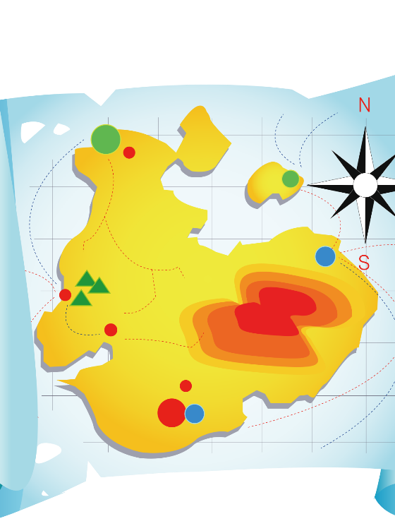
We can find countries on a map or on a globe.
Think of a country that you have been to or would love to visit. Your teacher might never have gone on holiday there before!
Draw a picture of what you think the country looks like. Is it sunny or cold? Do lots of people live there? Are there any beaches or hotels? What money do they use? Do they speak a different language?
When you have finished your picture, write a sentence about why you think your teacher should go there on holiday. I wonder could your picture convince her to go there? We would love to see your pictures on the school website.
This Photo by Unknown Author is licensed under CC BY-NC-ND

Slide 20
Religion

Slide 21
Religion
).
Grow In Love
Our religious education programme Grow in Love is available for free online at
https://www.growinlove.ie/en/ .
You can login using the following;
email: trial@growinlove.ie
password: growinlove.
You can browse through any of the Senior Infants stories/ songs you like.
This week you could look at Unit 8: The Church (1. A Place to Gather).

