Slide 1
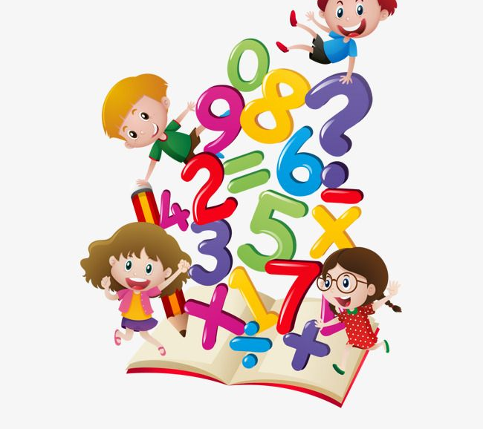
Maths
Week: April 20th- 24th 2020
Recommendation:
Pick one activity from our Math’s challenges on slide 1 and then 2 activities from one of the other topics each day.
There is no pressure to complete any of this work! Feel free to dip in and out of any activities and most importantly have fun with maths at home.
**Our Maths book Busy at Maths is available online at https://my.cjfallon.ie/dashboard/student-resources . Simply enter your details then click (Senior Infants > Maths > Busy at Maths ).
This is just in case anyone would like to look at additional activities!

Slide 2
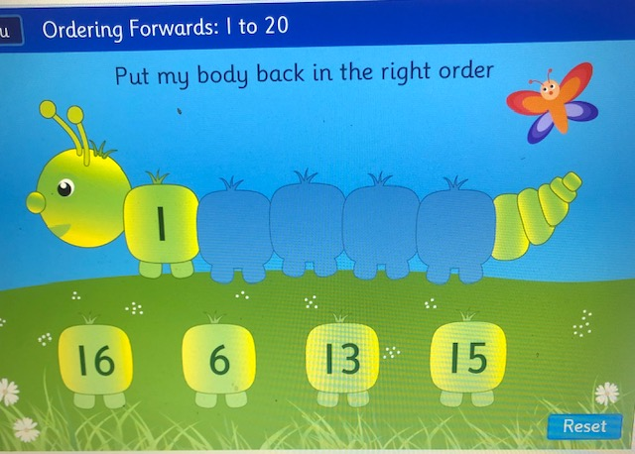
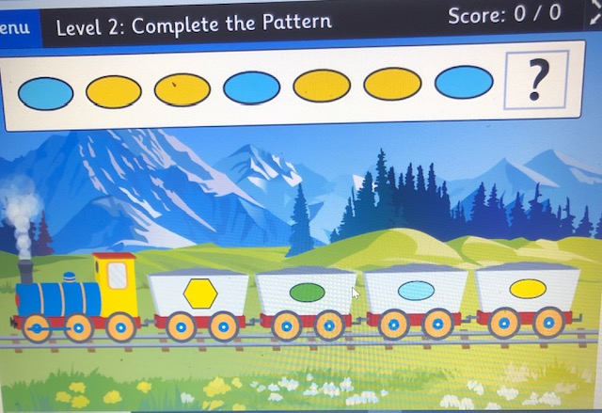
Warm up your Maths brain!
Write out numbers 1-10
Count backwards from 10. Make it harder and try from 15 !
Caterpillar Game-
Ordering Numbers
https://www.topmarks.co.uk/ordering-and-sequencing/caterpillar-ordering
Count from 1- 20!
Now try start at a different number
Game- Complete the shape pattern!
https://www.topmarks.co.uk/ordering-and-sequencing/shape-patterns

Slide 3
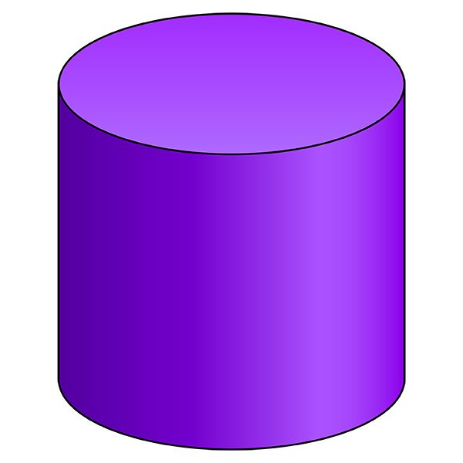
3D Shapes
A.
3D Shapes we already know- Sphere, Cube, Cylinder
Watch this video to help you remember these shapes !
https://www.youtube.com/watch?time_continue=1&v=guNdJ5MtX1A&feature=emb_logo
B. Can you find an example of each 3D shape somewhere in your house?
Explain why it is a (cube, sphere, cylinder).

Slide 4
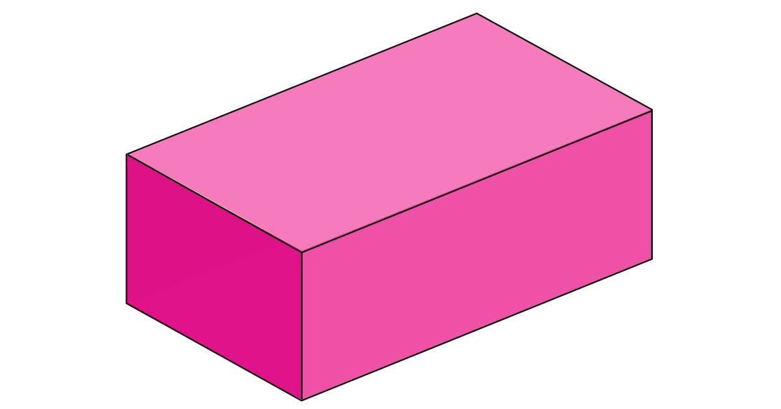
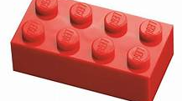
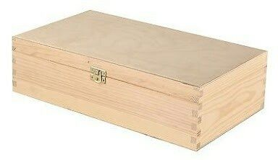
Learning about the cuboid
It looks a bit like a cube but all of the faces are not squares they are rectangles.
C.
Find 3 objects that are cuboids in your house! e.g. cereal box
D. Try these activities to check if you really know your 3D shapes! Activities 33/33A
http://data.cjfallon.ie/resources/19602/activity-33/index.html

Slide 5
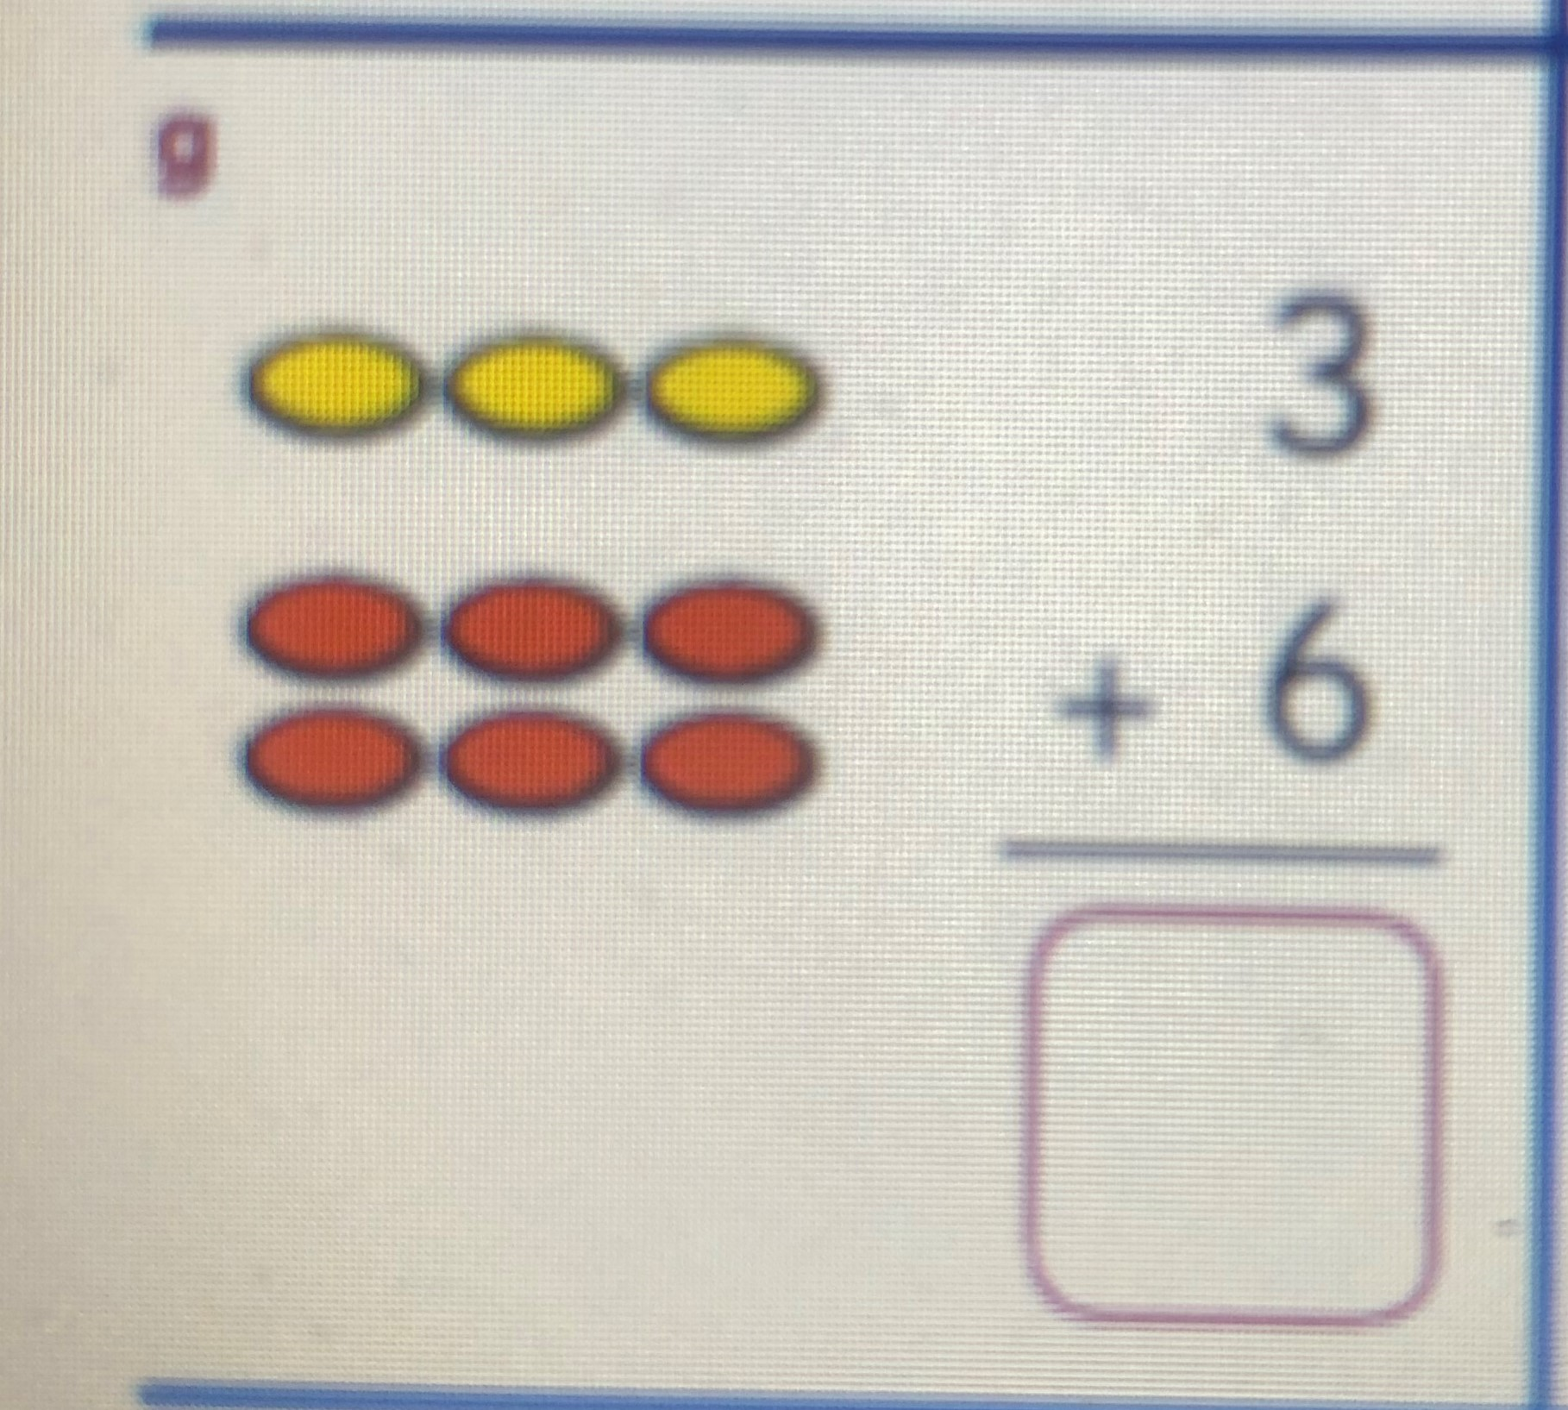
Adding Numbers
A. Practise some simple sums like what we have been doing in class.
Remember the different ways we can figure out the answer (draw pictures/ dots beneath, use our fingers, counting on..)
B. Ask an adult to give you some more sums or make your own!
C. Sometimes, we write our sums like this. This will help us when we learn to add bigger numbers next year.
Look where we write the answer
D. Have a go at activities 96/ 96A
http://data.cjfallon.ie/resources/19602/activity-96/index.html
What is the answer to the question in the picture? How can we figure it out?
5 + 3 = | 7 + 3 =
3 + 6 = | 2 + 8 =

Slide 6
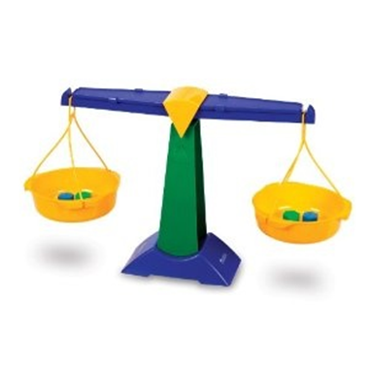
Weight
A. Can you find these objects in your house
( a pencil, a cup, a pillow, a pair of shoes, a spoon).
Now answer these questions! Try make a prediction first!
Which is heavier, a pencil or a cup?
Which is lighter, a spoon or a pair of shoes?
Which item is the lightest?
Would your bed be heavier or lighter than each of these objects?
B. Pick 5 of your toys and put them in a line, now line them up from lightest to heaviest.

Slide 7
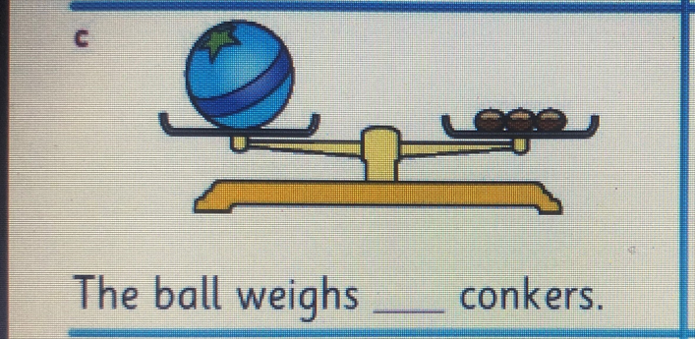
C. Bill put his ball on one side of the balance scales. He wanted to know how many conkers would it take to make the scales balance? There are 3 conkers on the other side of the scales, which means the ball weighs the same as 3 conkers. D. Try activities 81 / 81A http://data.cjfallon.ie/resources/19602/activity-81/index.html

