Slide 1
ENGLISH AND GAEILGE 20th to 24th April
SENIOR INFANTS

Slide 2
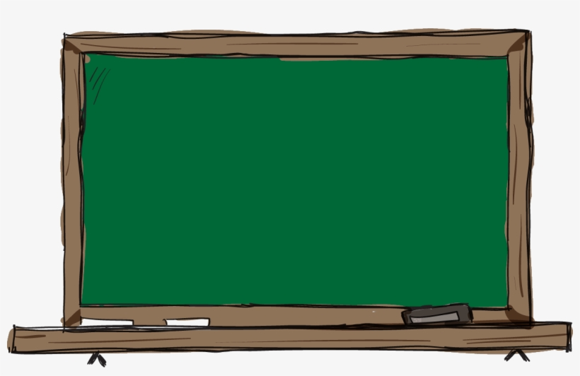
Dear Parents/Guardians,
I hope you are all well and staying safe in these uncertain times. We miss our wonderful Senior Infants and we are looking forward to being back in the classroom.
We have put together a plan of work for this week and hopefully the children will be able to do some of the activities. It is important that all plans are adapted to your family needs. If some things work, that is great. If some things are not possible, it is not the end of the world - adapt our plans as fits your situation. Of huge importance is the wellbeing and spirit of the children. It is key to praise and encourage them as much as possible. Look after yourselves and your families.
Regards and thank you.
The Senior Infants Team

Slide 3
ENGLISH
Words
he | she | we | me
be | you | was | my
they | all | are | here
Reading
https://www.oxfordowl.co.uk/
To log in, go to pink button on the top that says ‘My class login’
Username: sacredheartjns
Password: seniorinfants
Start with age 4-5 books.
Record the titles of books read.
Practice as often as possible.
Follow the link to ‘The Tricky Word Song’
Tricky words
Story
Listen to the story.
The Ugly Duckling
Draw or write about your favourite part.

Slide 4
Sounds
ai words Reading Machine
Practice reading the ‘ai’ words.
How many ‘ai’ words can you write?
Poem
Spring Song
Frogs croak Rains soak Chicks peep Crickets leap Bees hum Robins come Birds sing It’s spring!
~ Author Unknown ~
ai song
rain | pail | aim
train | tail | wait
pain | snail | paid

Slide 5
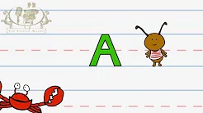
Letter Formation
My News
Draw and write about your news. If you would like it displayed on the school website take a photo of it and send it to Gaye, our HSCL teacher, on whatsapp 087 744 3779 email hscl@shjkillinarden.ie
Capital A

Slide 6
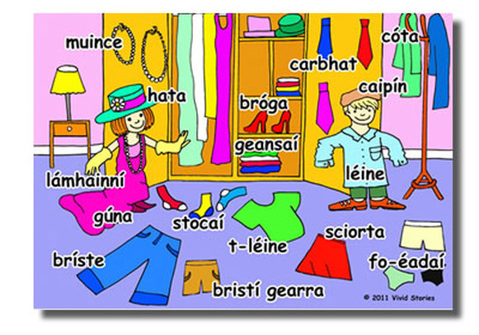
GAEILGE
Éadaí /Clothes
https://www.seideansi.ie/dep/files/connacht/Eadai.html
Cén sort éadaí atá ar Shiofra?
https://content.folensonline.ie/programmes/AbairLiom/SI/resources/GuestView/AL_SI_ACT_Comhra_L04_002/index.html
Scéal/Story: Fliuch Báite
https://www.seideansi.ie/dep/files/connacht/Fliuch_Baite.html
Cluiche/Game. Press ‘Imir’ to play.
https://www.seideansi.ie/naionain-mhora/gniomhaiocht-1-dearg/ceim3.html

