Slide 1
SESE- communication
1st class- 20th April

Slide 2
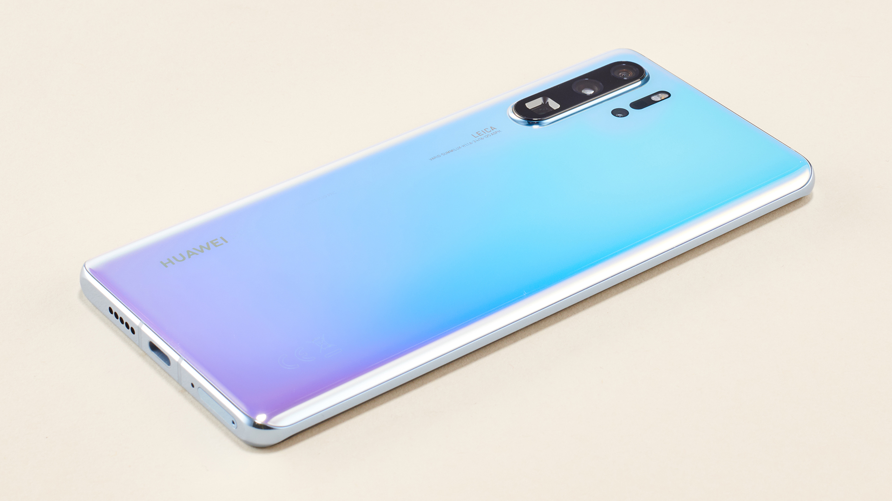
Geogrpahy-How do we communicate?
People learn and share information through communication. We communicate in lots of different ways-
Face- Sad , Happy , confused. Hands- Thumbs up, Handshake, Phone- call someone,
Stop with two hands. Send them a message,
Go online
Can you think of other ways which you communicate? Talk with someone else!

Slide 3
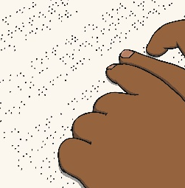
Did you get any of these?
paper
books
magazines
newspapers
satellites
signs
type writer
flags
movie
DVD
braille

Slide 4
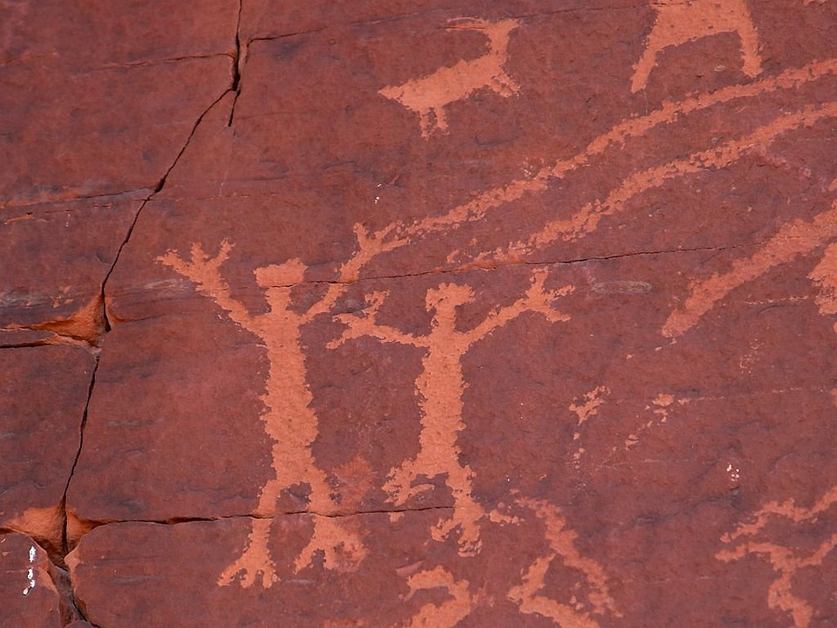
History- How we communicated
Communication was very different long ago. People had different ways of communicating-
Cave paintings
Letters
Carrier pigeons
Ask people in your house how they communicated long ago- how many ways did you find?

Slide 5
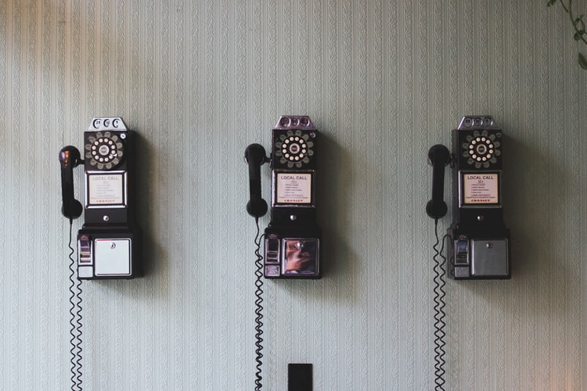
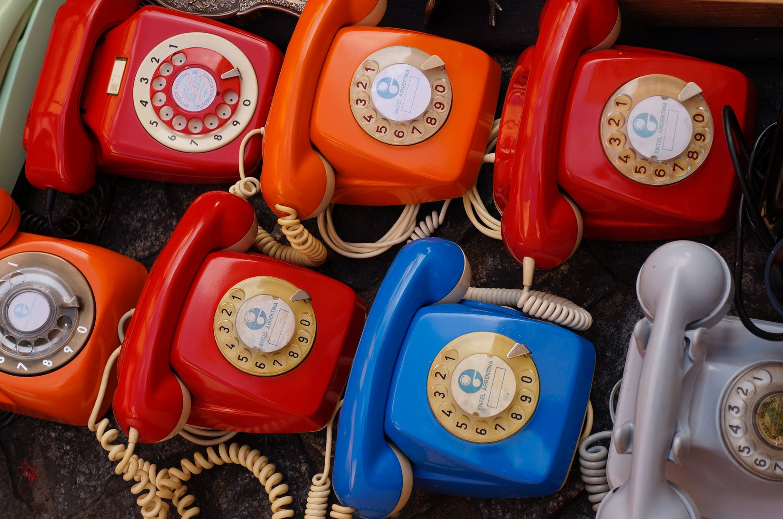
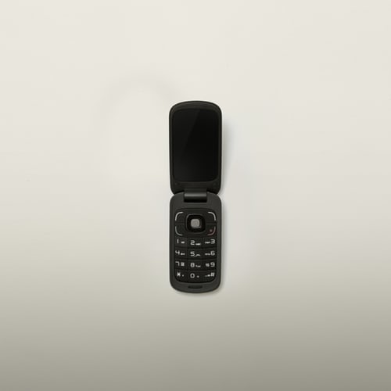
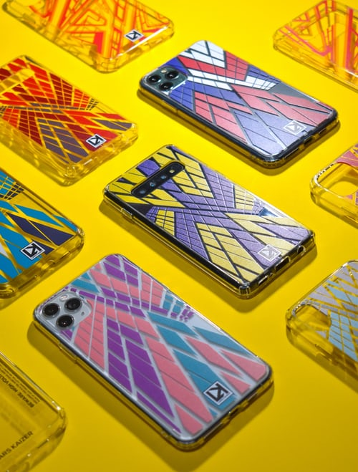
Phones- Watch a story about Alexander Graham Bell.
Phones have changed a lot over the years. In the late 1800s, a man named Alexander Graham Bell invented the first telephone using wire to transmit voices over long distances. Watch a clip about him online here: https://www.youtube.com/watch?v=X8rxszM6amM
See if you can find 5 facts about him.
Ask people in your house how their phones have changed.

Slide 6
Science- 2 activities
Try the telephone game! See how sound travels https://icebreakerideas.com/telephone-game/
OR
Make your own string telephone! (remember always ask someone for help!)
http://www.sciencekids.co.nz/projects/stringphone.html

