Slide 1

Sacred Heart JNS
First class Maths
1 week; 20th April

Slide 2
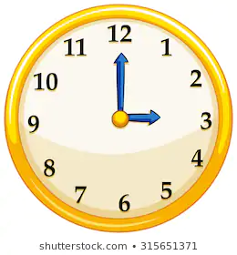
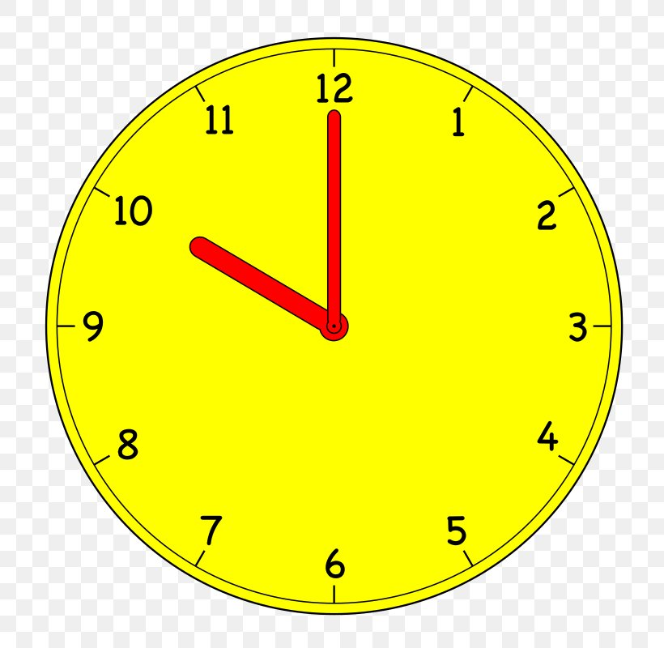

Warm up Activities
Monday | Tuesday | Wednesday | Thursday | Friday
Counting in 2s – 2,4,6 … 20 https://www.youtube.com/watch?v=GvTcpfSnOMQ What time is it? | Count from 18 – 33 Today is Tuesday. What day will it be tomorrow? | Counting in 5s – 5,10,15 … 50 https://www.youtube.com/watch?v=EemjeA2Djjw What time is it? | Count from 28 – 16 What time is it? | Counting in 10s – 10, 20, … 100 https://www.youtube.com/watch?v=Ftati8iGQcs&list=PLM95cb_Szq3am4n6jJw127QbBlDivZgIc Today is Friday. What day was it yesterday?

Slide 3
Warm up gAMES
https://mathsframe.co.uk/en/resources/resource/117/telling-the-time-in-words
This game is based on time. Try level 1 (read the time to one hour) first and then level 2. An untimed game would be best to begin with.
https://mathsframe.co.uk/en/resources/resource/549/Addition-Mini-Maths-Golf
This is an addition game. Begin with adding numbers up to 10 and then 20 or click Year 1.
https://www.topmarks.co.uk/maths-games/hit-the-button
Begin with addition within 20. Children could also try subtraction (take away) within 20 if they wish.

Slide 4
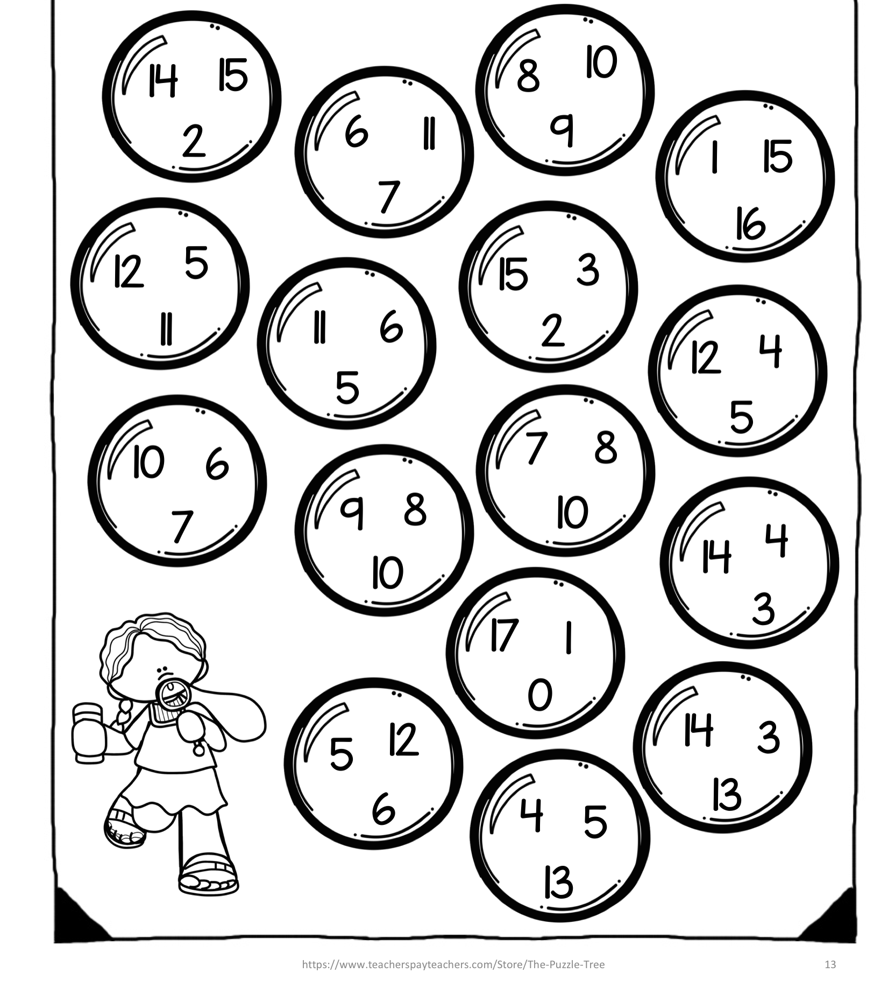
Monday
Find the two numbers in each bubble that add to make 17. Example: 15+2 = 17

Slide 5
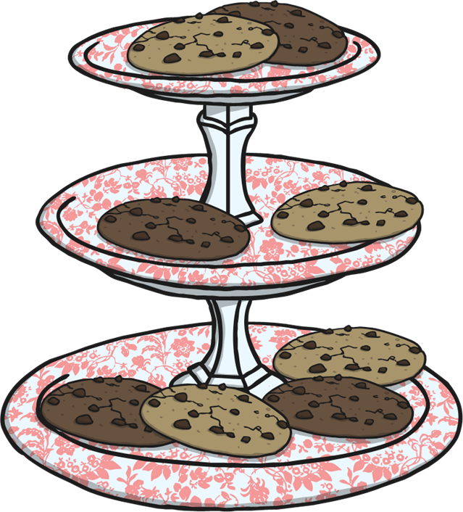
Monday
Ben made ten cookies for the bake sale. Layla made six.
How many cookies did they make
altogether?

Slide 6
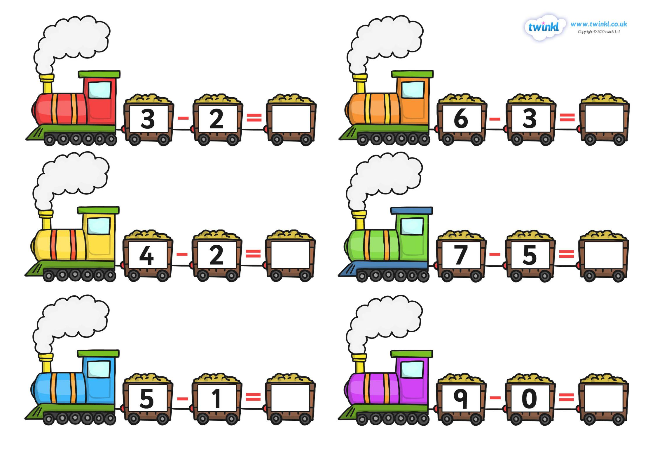
Tuesday
Can you solve these take away sums?

Slide 7
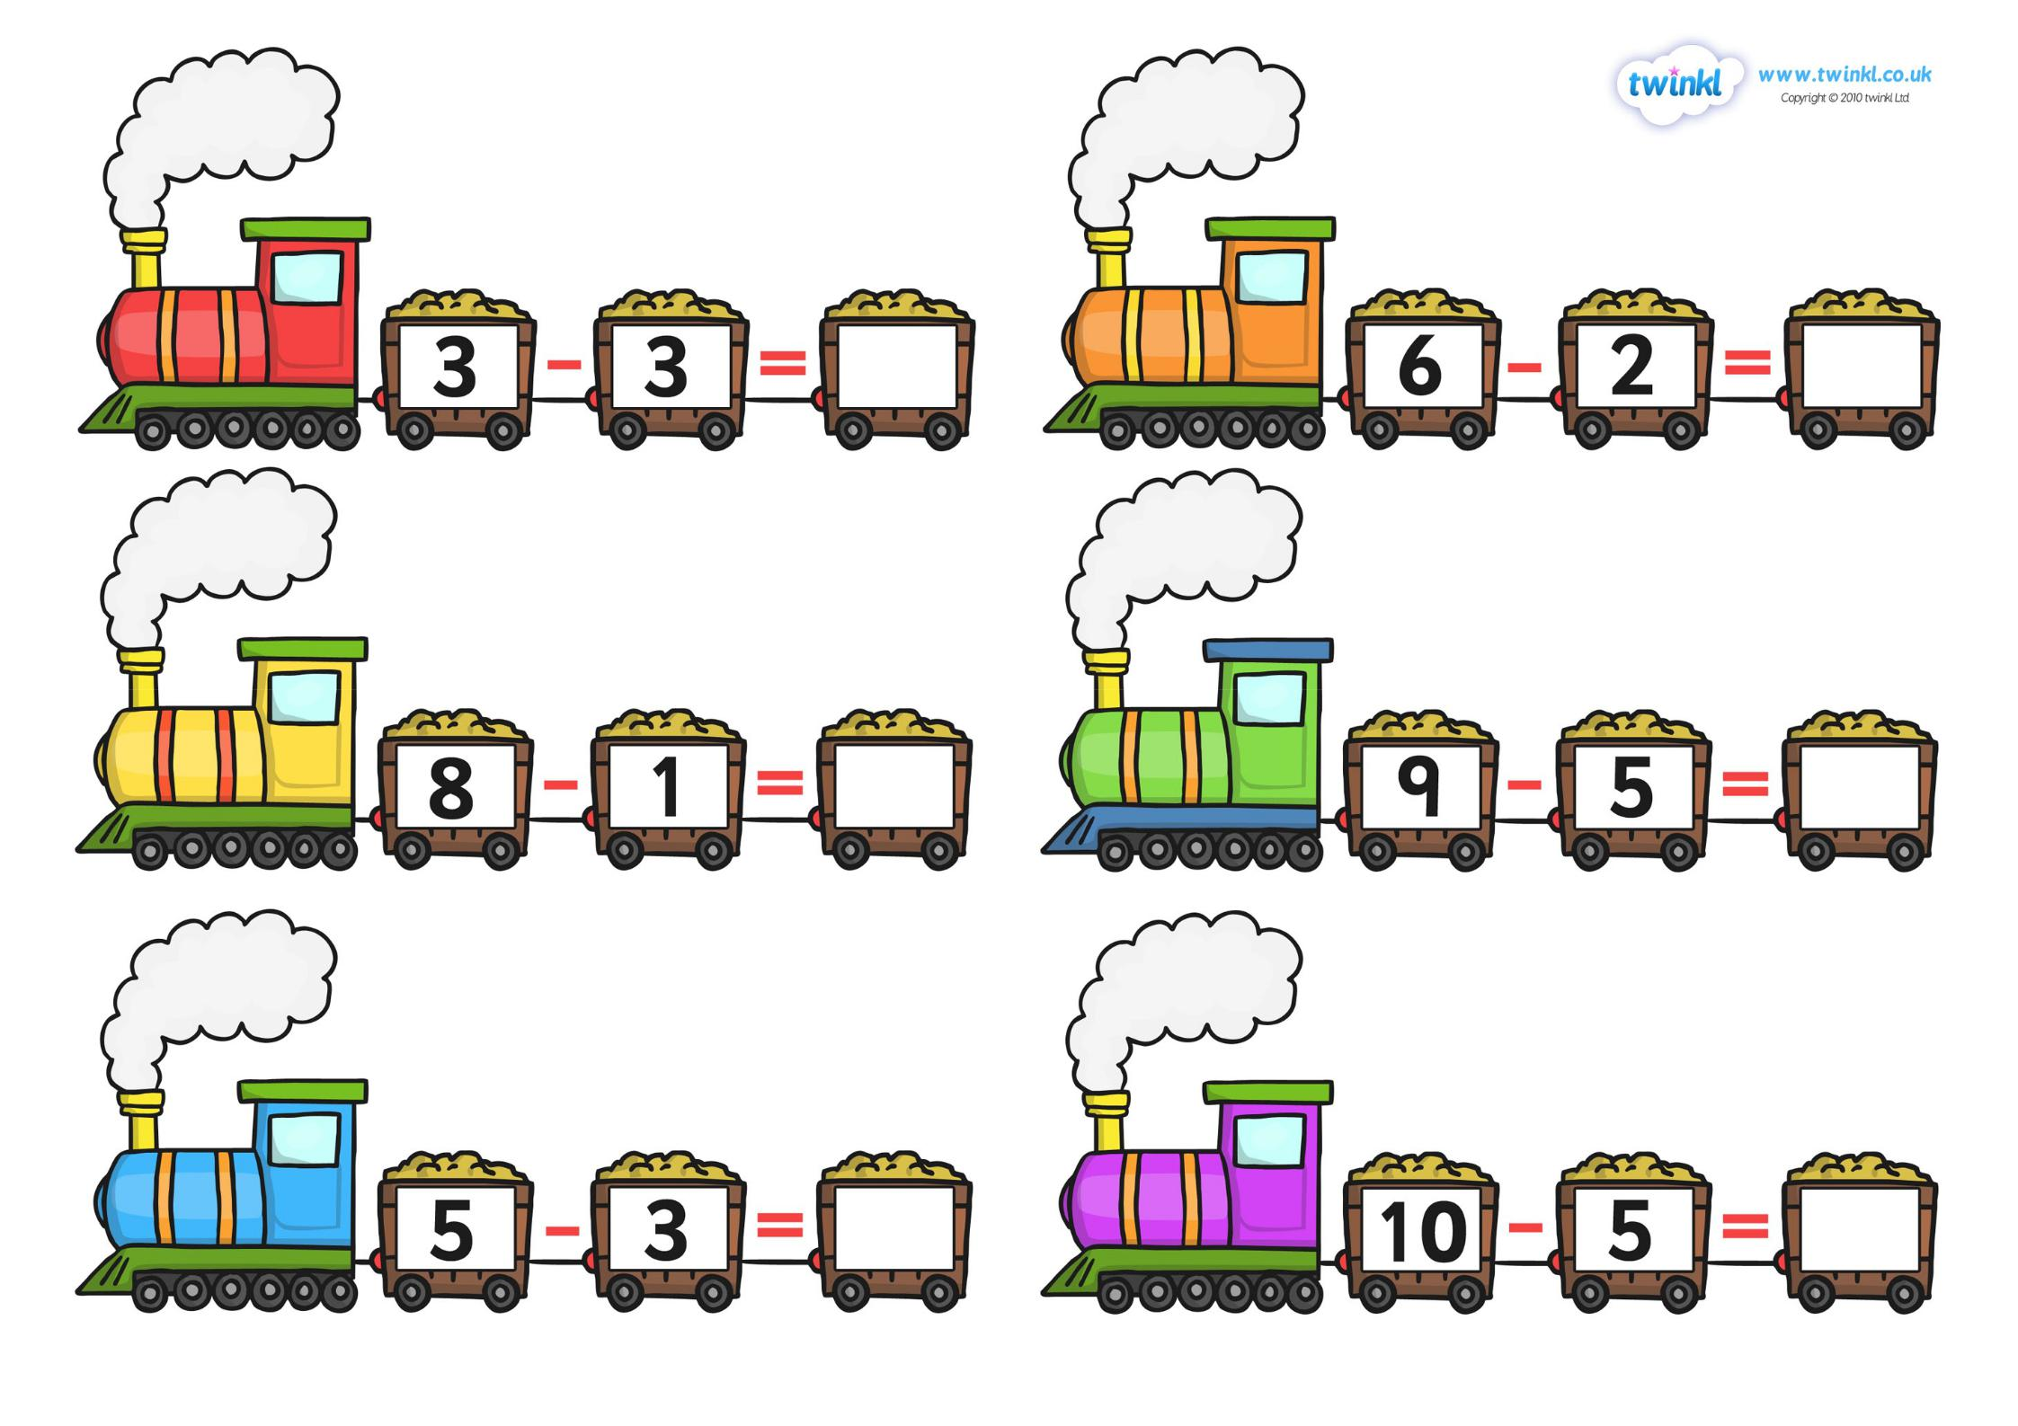
Tuesday

Slide 8
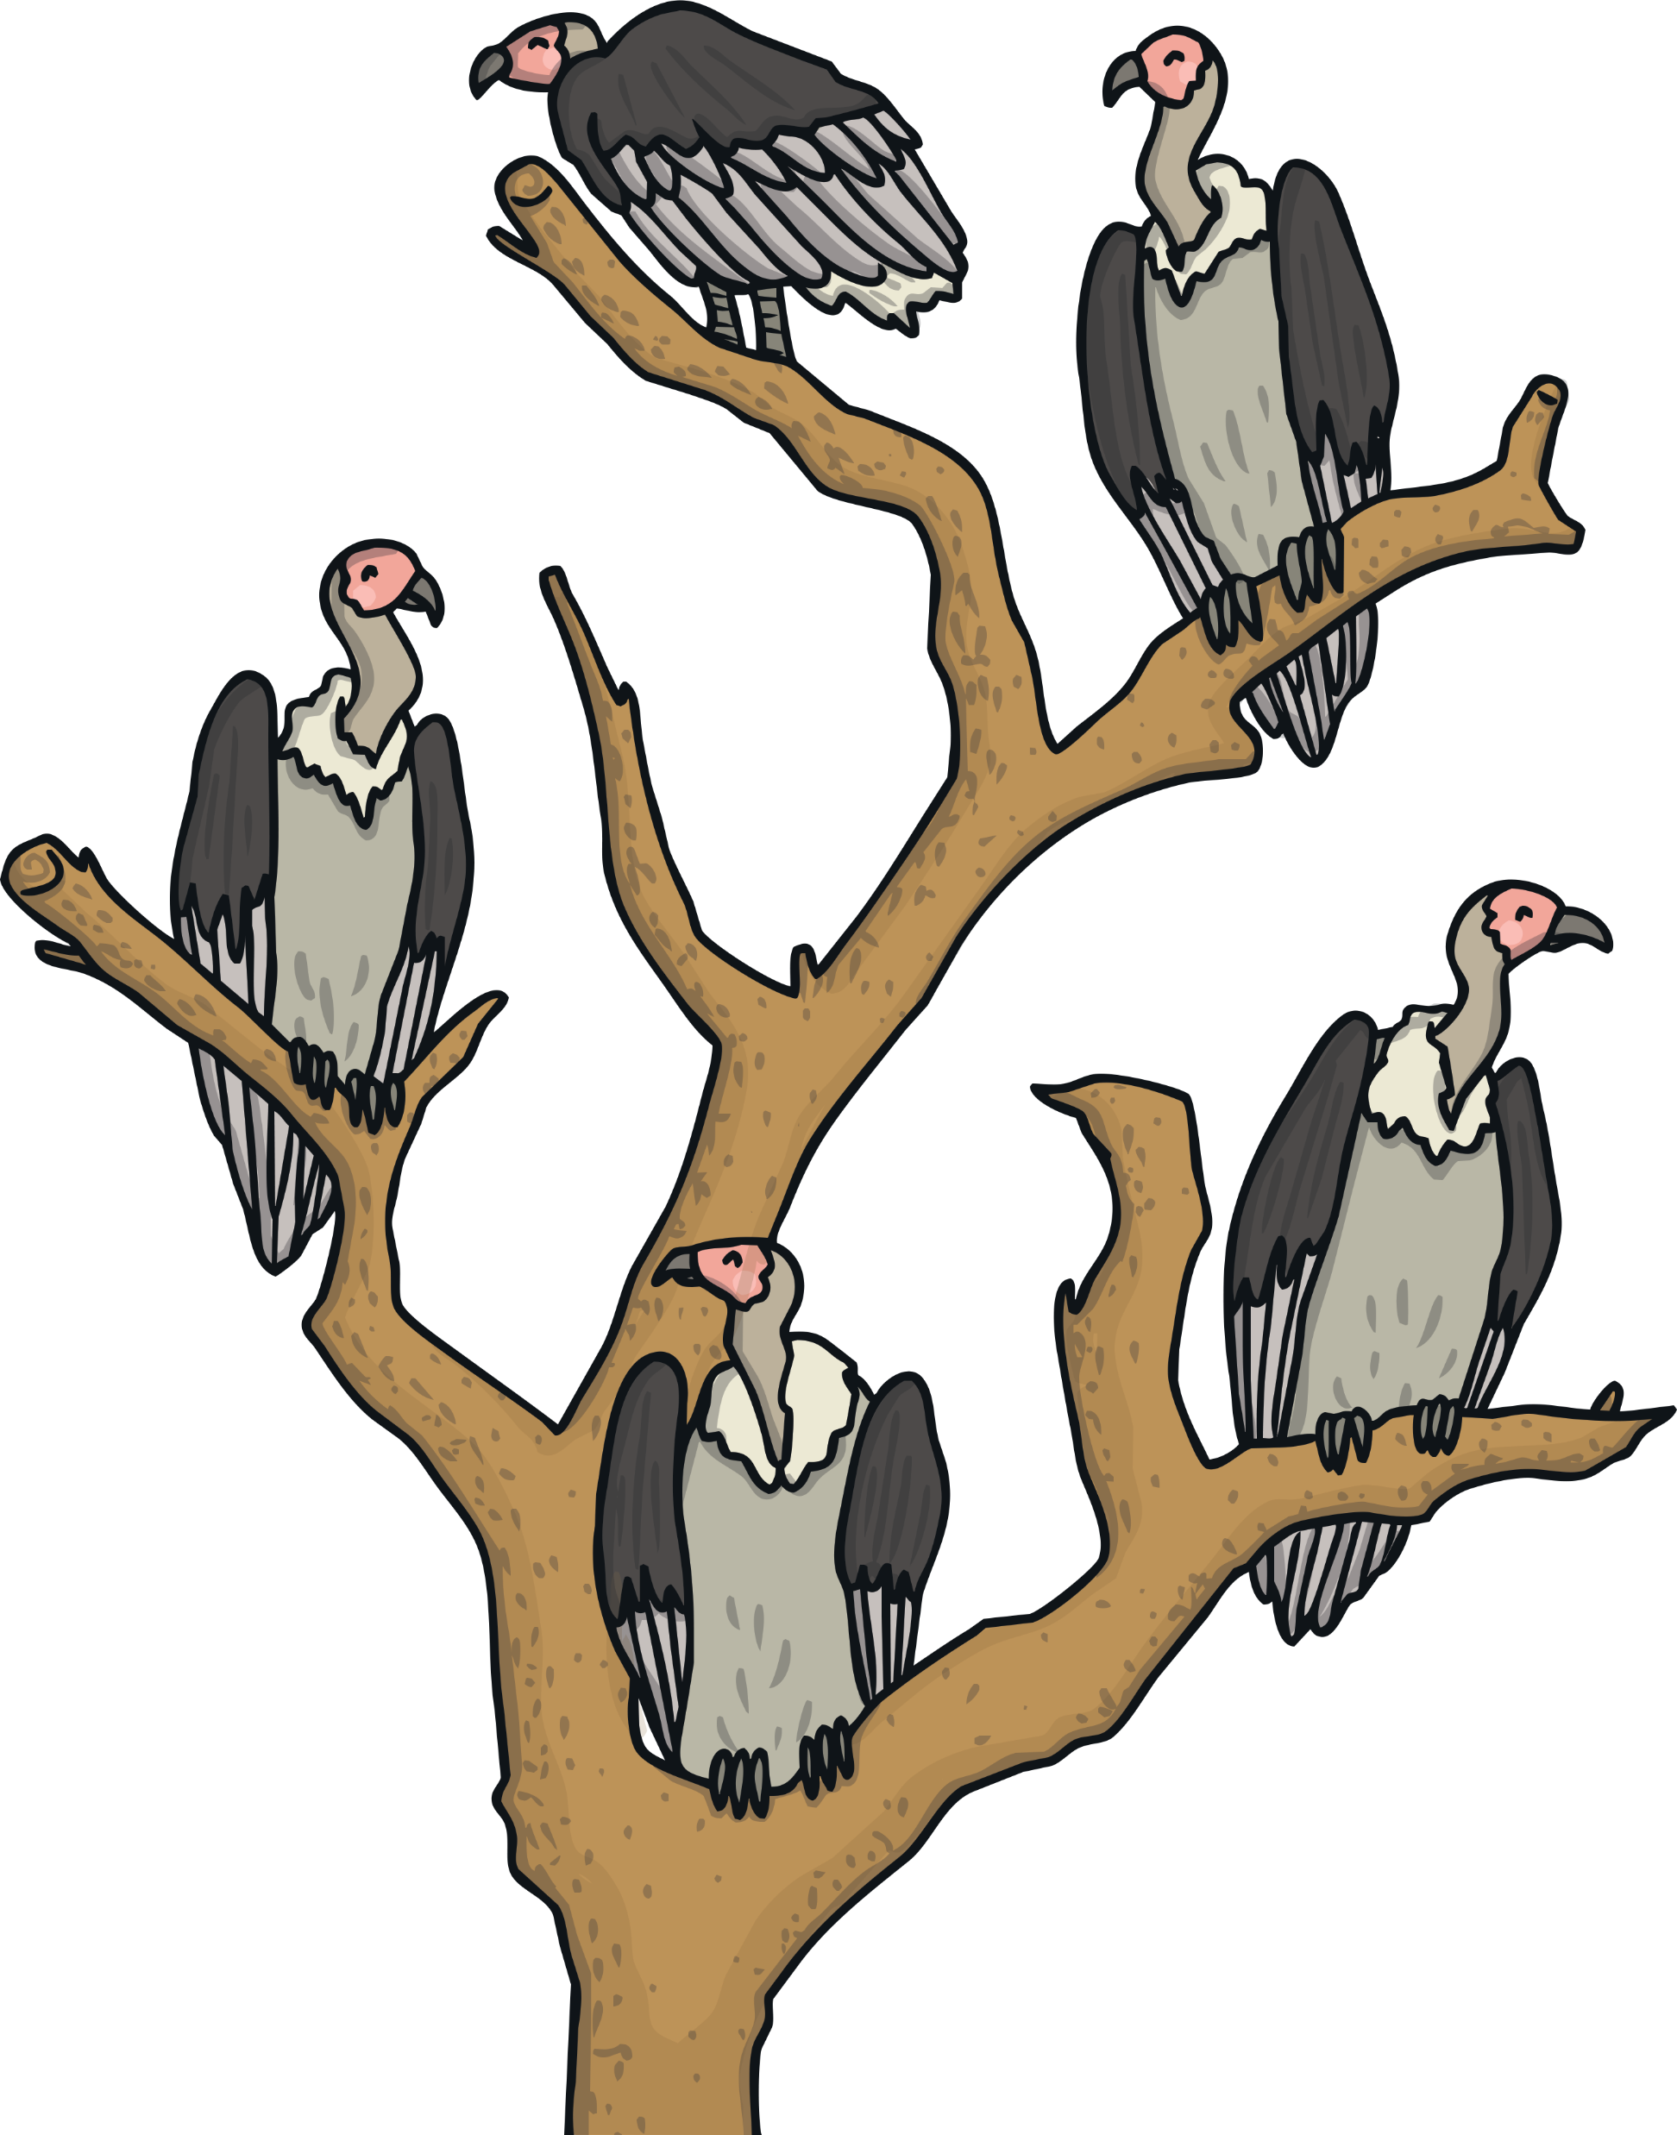
Tuesday
There was 5 birds sitting on a tree. 2 birds fly away.
How many birds are left?

Slide 9
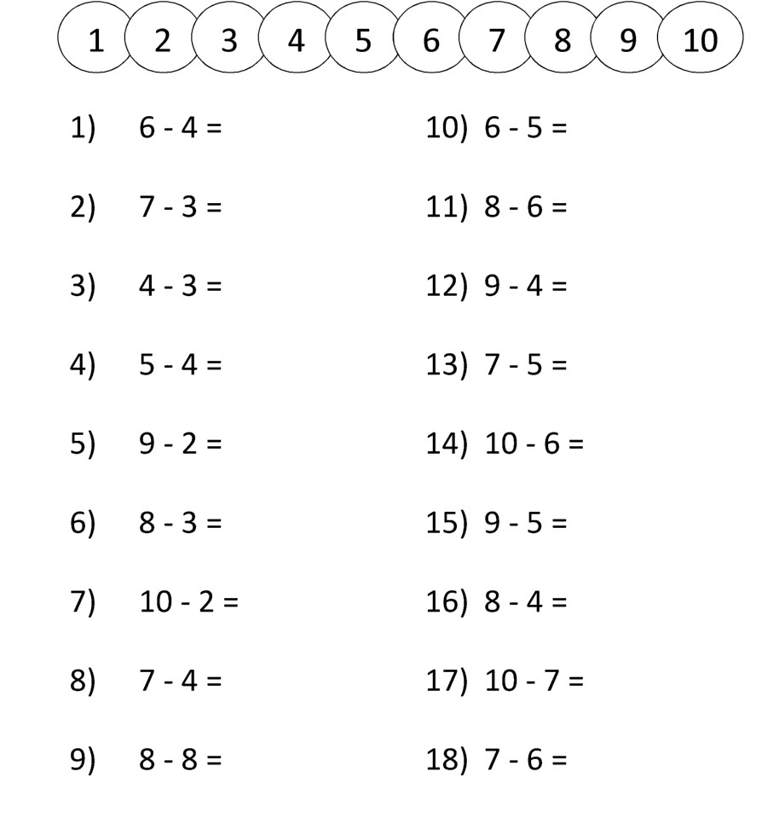
Wednesday

Slide 10

Floppy has six bones. He finds three more.
How many bones does Floppy have altogether?
Wednesday

Slide 11
Thursday
How many ways can we make 22 here?
12 + 5 =
20 + 2 =
18 + 3 =
15 + 5 =
14 + 8 =
23 – 1 =
19 + 4 =
10 – 4 =
21 + 2 =
10 + 10 =
13 + 6 =

Slide 12
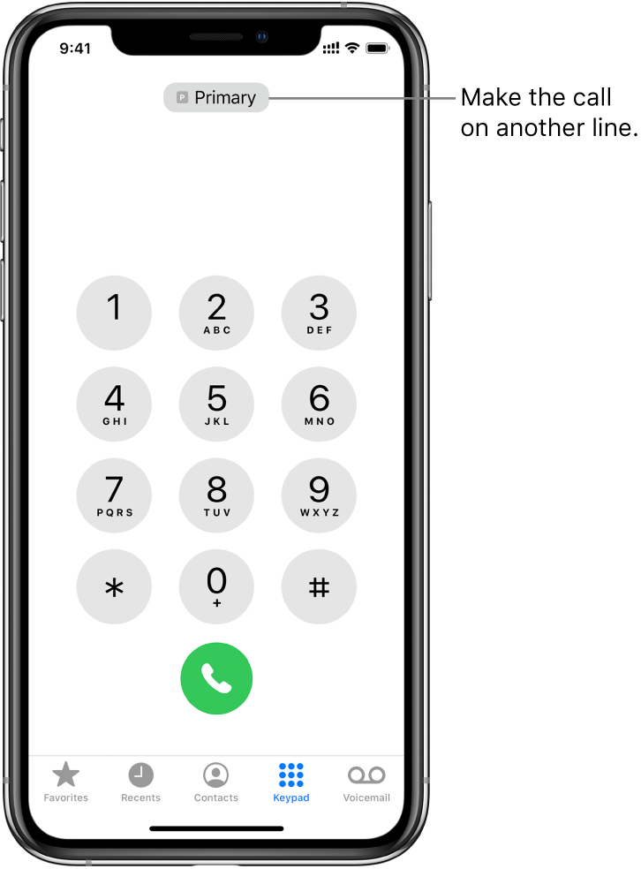
Thursday
Can you fill in the missing numbers?

Slide 13

Jack got ten crayons in the shop. He lost three.
How many does Jack have left?
Thursday

Slide 14
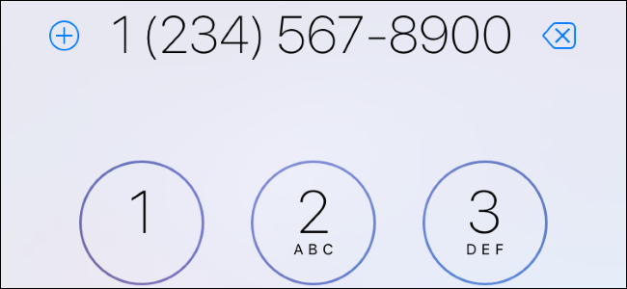

Friday
2 + 5 = 7
Write down the phone number of someone at home.
Can you find two numbers to make 8?
Can you find two numbers that make 12?
Can you find two numbers that make 6?
Can you find two numbers that make 11?
Can you find three numbers that make 10?

Slide 15
Can you find the missing numbers?

Slide 16


Friday
Mr. Morris bought 10 fidget spinners for the prize box. He gave 4 away.
How many fidget spinners does Mr. Morris have left?

Slide 17

Extra practice
https://www.factmonster.com/math/flashcards
Here are some extra addition and subtraction sums for you and your child to do if you wish. Select level 1 to begin.
You have completed this weeks work!
WELL DONE!

