Slide 1
***Children will need a copy, pencil, eraser and colours to complete the tasks***
Sacred Heart JNS Literacy for First Class
Week 1 - to be completed over one week starting Monday 20th April
N.B. This work is designed to be completed over the course of a week. Children and parents can do as much or as little as they want daily.

Slide 2
Spellings/ Phonics
Sound of the week – o with magic e
Remember Magic e is a sneaky letter! Magic e plays a game it makes the vowel say it’s name.
Week 1: phone, tone, robe, hole, throne, hope, more, cone
*Some of these words may need explanation

Slide 3
Activities
List as many words as you can with the magic e with o sound. You could use books you might have at home to search for the magic e with o.
Draw an illustration to go with your words.
For example:
phone cone
SPELLINGS/ PHONICS

Slide 4
Spellings and Phonics
Choose 6 ‘magic e with o’ words and put them into sentences.
You can ask a brother/sister/parent to help you.
Make your sentences long and interesting – (who, what where, when…)
Remember to
Write clearly – use a capital letter at the beginning of the sentence and a full stop at the end.
Use up all the space on the lines
Neat and tidy handwriting!

Slide 5
Spellings/ Phonics
Complete ‘magic e with o’ word search
(this page can be printed or write the words you find into your copy)
Find the words: home, hole, joke, smoke, one, throne, stone, hope, nose, stroke, wrote, bone, whole.
Challenge: List any bonus words you find hidden in the word search. Hint: they are not magic e words!

Slide 6
Spellings/Phonics
Dictation
Parents/siblings, where possible please read out the following sentences and ask your child to write them down. Make up your own sentences using the ‘magic e with o’ words.
1. I got a phone call.
2. The dog put the bone in the hole.
3. They put on their bath robe.
If you would like to write more sentences ask your parent to make up some more sentences.

Slide 7
Reading
We are asking parents to sign up to the website https://home.oxfordowl.co.uk/books/free-ebooks/
Create an account and each day choose a book for your child to read from the appropriate age category. They NEED to read each day.
(PLEASE do this)
We encourage you to read to your child as much as possible. This is a nice way to bond but it also shows them how reading should sound. It shows them that you see it as a meaningful activity.
Roald Dahl books, Horrid Henry, Princess Mirrorbelle, Fairy tales and David Walliams books are a few examples to use or pick a book you enjoyed as a child.

Slide 8
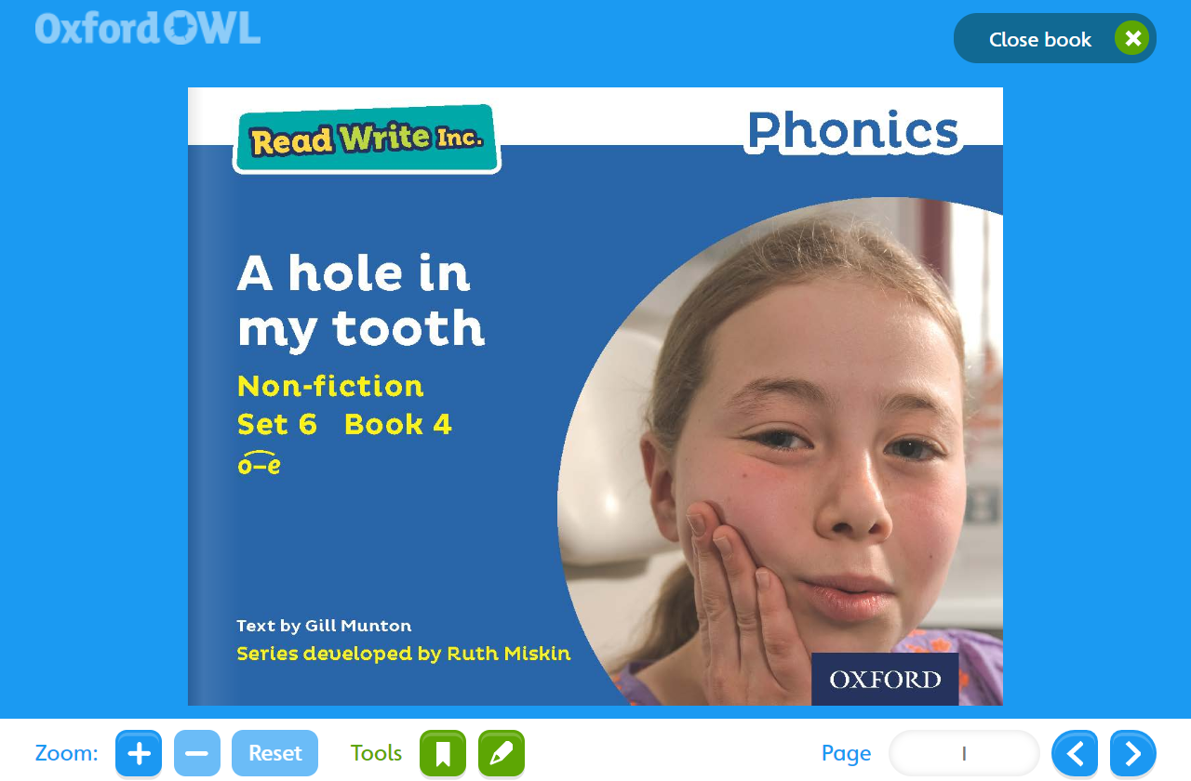
On the Oxford Owl website there is a book called A Hole in my Tooth. We recommend you read this book this week as it has lots of ‘magic e with o’ words. You can find it here https://www.oxfordowl.co.uk/home/reading-site/find-a-book/library-page?type=book&view=&query=hole
Reading

Slide 9
Poetry
Read this silly poem about the elephant with a telephone. Try to read it every day and see how much you can remember by the end of the week!

Slide 10
Reading
Grammar -Verbs
A verb is an action or a doing word. It is when someone or something is involved in an action e.g. sneezing, smiling, talking, walking, bouncing, listening, whispering. Can you think of any other verbs? List them into your copy.
The ball is bouncing. The verb is bouncing because that is the action or the doing word.
The baby is crying. What is the verb?
The dentist is cleaning my teeth. What is the verb?
The phone is ringing very loudly. What is the verb?
Can you hear any 'action words' in the story ‘A Hole in my Tooth‘. Listen to the story again and write them in your copy. Put them into new sentences if you are feeling very clever!

Slide 11
Writing
Procedural writing
How to make a phone call to a friend. (You will need an adult to help you).
Remember what you need to make a phone call: phone book, a phone, adult to help you.
You need to follow the four step format .... First, Next, Then, Finally
You need to use 'Bossy verbs' (examples: Find phonebook, Search for name, Pick up phone, dial the number, speak politely)
Draw 4 pictures to illustrate each step.

Slide 12
Writing
Free writing
Encourage your child to write freely each day. Here are some ideas to help them get started
Write about;
When I am famous I will.....
Invent your own animal. Tell others about it
You are a spy disguised as a bird watcher....
If I were President.....
If I was the Principal.....
Or just let their imaginations go wild.

Slide 13
Gaeilge – An teilifís (television)
Click on this story about Eoin. Eoin is on television.
Ar an teilifís: https://seideansi.ie/dep/files/connacht/Eoin_ar_an_Teilifis.html

Slide 14
You have completed this weeks tasks!
Well done!

