Slide 1
1st Class
20 April 2020

Slide 2
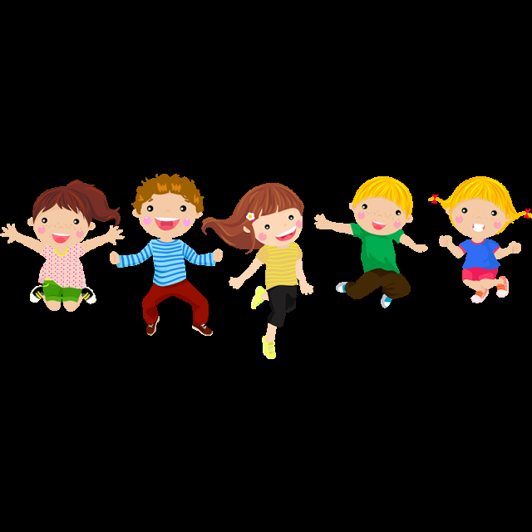
Welcome back after Easter
Ms Kirrane, Ms Loughnane, Ms Mason and Ms Ryan welcome you back after Easter.
We have changed how we will work.
We now have slides for Literacy (reading and writing) Numeracy (Maths) and SESE (history, geography and science).
We have also included some extra relaxing ideas for you.

Slide 3
Before you begin…….
Think about….
Where will I work?
What can I use? (phone, paper, pencil, table, sofa?)
Who will help me?
What about a timetable?

Slide 4
Possible Timetable
Time | Monday | Tuesday | Wednesday | Thursday | Friday
9:00 - 9:30 | Joe Wicks | Joe Wicks | Joe Wicks | Joe Wicks | Joe Wicks
9:30 – 10:00 | Literacy | Literacy | Literacy | Literacy | Literacy
10:00 – 10:30 | Break | Break | Break | Break | Break
10:30 – 11:00 | Numeracy | Numeracy | Numeracy | Numeracy | Numeracy
11:00 – 11:30 | RTE 1 Home School | RTE 1 Home School | RTE 1 Home School | RTE 1 Home School | RTE 1 Home School
11:30 – 12:00 | SESE | SESE | SESE | SESE | SESE

Slide 5
Our theme this week….Telephones
 | Telephones
Draw a telephone. | Speak into a telephone. | Add up all the numbers in a telephone number.
How many telephones where you live? | Talk to a grandparent about their first telephone. | What is your favourite app on a mobile phone?
Make a mobile phone. | How long does your mobile phone battery last? | Make an old fashioned phone.

Slide 6
Other ideas!
Yoga for Kids
https://www.youtube.com/user/CosmicKidsYoga
Go Noodle – some favourites!
Pop See Ko
https://www.youtube.com/watch?v=Pwn4beja1QE
Chicken Dance
https://www.youtube.com/watch?v=npp1z32idrc
Art for Kids
https://www.youtube.com/artforkidshub

