Slide 1
Second Class SESE (History, Geography & Science) SHPE (Social, personal, health education)
April 20th – 24th
You will need: A copybook/paper, pencil, colours, ruler.
Ms. N. Fox, Ms. Troy and Ms. C. Fox

Slide 2
A note from your 2nd class teachers:
Dear parents,
We hope you are well and staying safe!
In this PowerPoint you will find work for History, Geography and Science. We have also included some Sphe activities to help keep your mind and body healthy ☺
The 2nd class team have set as much work as we can that your children can do independently. However, they might need some help reading and figuring out some of the tasks / instructions. Please note that we have also included audio on each slide, all you need to do is click on the sound icon ☺
Please note that this work is planned for one week.

Slide 3
History – The Titanic
Titanic was a very big ship. It carried over 2000 people. Its first journey was from Southampton to New York but the ship never got to America.
What Happened to Titanic?
Sadly, Titanic hit an iceberg and sank. Many people died.
Did You Know…? 1. Titanic was 269 metres long (the same length as three football pitches or 24 buses!). 2. The iceberg that hit Titanic was 30 metres tall.
Fun fact: Titanic was built in Belfast, Northern Ireland!

Slide 4
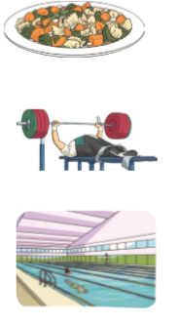
What Could You Do on Titanic?
There were lots of things to do on Titanic if you were rich!
Restaurants
a pool
libraries
lifts
a gym

Slide 5
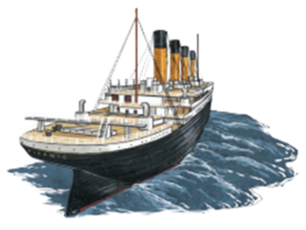
Task 1: Find the answers from the slides!
Answer these questions in your copy/ notebook:
How many people did Titanic carry?
Where was Titanic going to?
Pick one word to complete the sentence. There were lots of things to do on Titanic if you were : poor , sad, naughty or rich ?
4. What did Titanic hit?
5. Which of these was not on Titanic? A pool , A cinema , A gym?
6. Where was the Titanic built?

Slide 6
Geography: Transport
What is transport?
It is the movement of people and items from one place to another!
Can you think of different types of transport? Make a list!
(Here is a clue to start you off… one type of transport is on this slide)

Slide 7
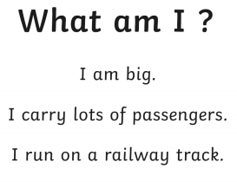
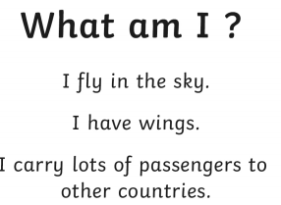
Guessing game! What transport am I ??

Slide 8
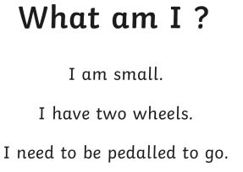
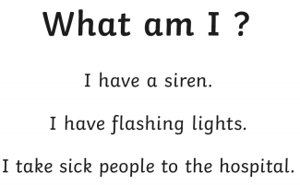
Guessing game! What transport am I ??

Slide 9
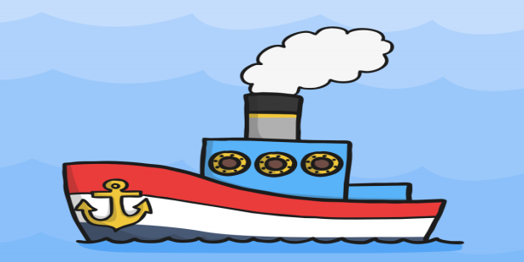
Transport – Task 1
In our history lesson we learned about a famous ship called ‘The Titanic’. This week your task is to use your recyclable items to make a junk art ship like the Titanic!
First of all, draw out your plan of what you want your ship to look like and write out what recyclable items you will need to make your ship!
For this task you will need: A copy/ notebook, pencil, colours, glue, sellotape, scissors and items from you recycling bin!
Recyclable items you could use: cereal box, butter carton, milk cartons and carton tops, newspaper, juice cartons, yogurt cartons…the list is endless!

Slide 10
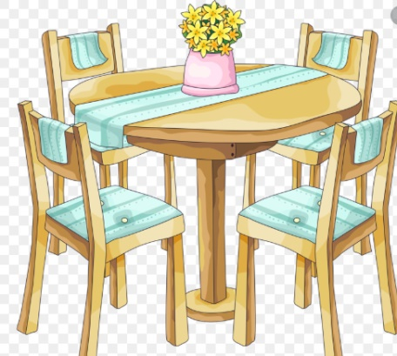
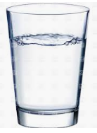
Science - Materials
A lot of the items we use at home, in school and in the yard are made from special materials.
There are four main materials that things are made from:
Wood
Metal
Plastic
Glass

Slide 11
Materials – Task 1
WE’RE GOING ON A MATERIALS HUNT!
You will need: A copy/ notebook and a pencil.
Search your house for anything made out of the four main materials (wood, metal, plastic and glass).
Make sure you write what you found in your copy. Use headings for each material and write what you find under the right heading!
For example – a drinking glass would go under the ‘glass’ heading ☺

Slide 12
SPHE – Filling Buckets
2nd class will remember their lessons on bucket filling with Ms. Tuohy.
Discuss with a grown up what you remember about bucket filling!
Have a look at this video to remind you about bucket filling and how you can fill your bucket or someone else’s bucket ☺
https://www.youtube.com/watch?v=3EuemNAo6XE

Slide 13
How can we be bucket fillers and why it is important :
Why Is It Important? – It’s important to be a bucket filler because it makes others feel good and it makes you feel good! People feel bad when their buckets are empty. However, a full bucket brings a lot of joy!

Slide 14
Be a bucket filler, not a bucket dipper!
This is a difficult time for everyone, so be kind to yourself and others ☺
Everyday this week, ask yourself; have I been a bucket filler today?

