Slide 1
2nd Class - English
Monday 20th April – Friday 24th April
Ms. N. Fox, Ms. J. Troy and Ms. C. Fox

Slide 2
Note to parents
Dear parents, we hope you and your loved ones are all well. In this PowerPoint, you will find some suggestions for helping with your child’s Literacy.
This is one weeks Literacy work and most of the activities which have been chosen are similar to work the children have previously completed in school.

Slide 3
You will need:
A copy book to record all your work
Pens, pencils, colours, rubber
An adult to help sometimes!

Slide 4
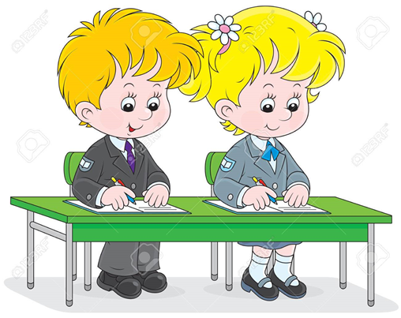
Content of Work:
News - Monday
Spellings - Everyday
Report Writing -Wednesday
Grammar - Thursday
Write a letter - Friday
Read every day

Slide 5
Reading - Everyday
Try to read for 15minutes everyday.
Read some of the books that you have at home.
Give some audio books a try on this website:
https://stories.audible.com/discovery
If you are a member of the library you can get ebooks or audio books from this website:
https://www.librariesireland.ie/news/online-services-during-coronavirus

Slide 6
Spellings
Each day put your spellings into sentences like you normally do for homework.
On Friday do your own mini spelling test at home and if you try your best you might have earned a Friday treat.

Slide 7
 | Look | Say | Cover and Write | Check
Monday | key
 | donkey
 | monkey
Tuesday | honey
 | alley
 | kidney
Wednesday | turkey
 | parsley
 | jersey
Thursday | money
 | chimney
 | journey

Slide 8
Monday
Write about your news over the Easter holidays.
Remember this is recount writing so make sure to have as much detail as possible:
Who?
What?
Where?
When?
Why?
How?

Slide 9
Tuesday: Gaeilge Guessing Game
See if you can draw a picture to match these Gaeilge words:
Coinín – I am white and fluffy and I deliver eggs to children on Easter Sunday.
Ubh Cáisce – you eat me and I taste delicious and people get lots of them at Easter.
Seacláid – I am sweet and tasty you can melt me to help make rice krispie buns.

Slide 10
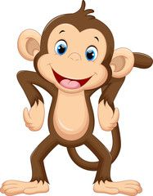
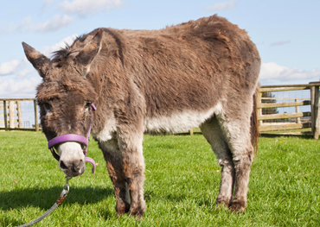
Tuesday: Spellings
This week we are looking at the ‘ey’ digraph see if you can think of any other words that are not on this list and put them into sentences.
Here are some picture clues to words with ey:

Slide 11
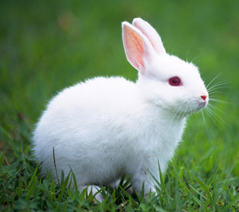
Wednesday – Report Writing
Report writing – since it was Easter we are going to be doing a report on Rabbits.
See if you can find out any information about rabbits using– www.kiddle.ie
Report structure:
Introduce it….This report is about
Say what it is…….a type of animal
Describe what it looks like……very fluffy….
Describe where it lives
Write three other interesting facts about it
Draw a picture to go with your report

Slide 12
Thursday: Plurals
Plurals mean if you have more than one thing.
To make a word plural you have to add ‘s’
For example bag - bags
However for some words we add ‘es’ only if the word ends in x, ch, sh, ss
For example witch - witches
Watch this video to help learn about plurals:
https://www.youtube.com/watch?v=lD1OaD4FBqM

Slide 13
Thursday – Plurals See if you can write the plural of these words remember add ‘s’ or ‘es’
Singular | Plural
pig
lock
fox
cross
play
tree
dish

Slide 14
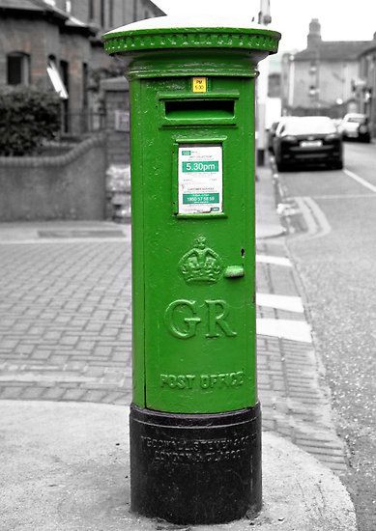
Friday – Letter Writing
Today we are going to write a letter.
You can choose whoever you would like to write to.
Remember in a letter you need to write the persons address in the top right hand corner of the page and then the date underneath.
Next you can address the letter using Dear….. Or To……

Slide 15
Friday – Letter Writing
In your letter tell the person all about your week you could include:
what your favourite bit of school work was this week
Something you did outside
Something you drew or baked
Even tell them how many Easter eggs you got
Don’t forget to sign off your letter with from, love, see you soon, bye
Why not add a picture at the back as well.
Then go and post your letter

Slide 16
Gaeilge
It is important to try keep practicing your Gaeilge.
Why not try out this website:
https://seideansi.ie/rang2.php
You can look at a picture from a story and choose the correct sentence to match it.
There are also some fun Gaeilge card games.

Slide 17
Well Done
Try do as much of the work as possible but don’t worry if you can’t get it all done.
Congratulations on getting through as much of your English work as possible
Looking forward to hopefully seeing you all back at school very soon for lots of fun, laughter and learning.

