Slide 1
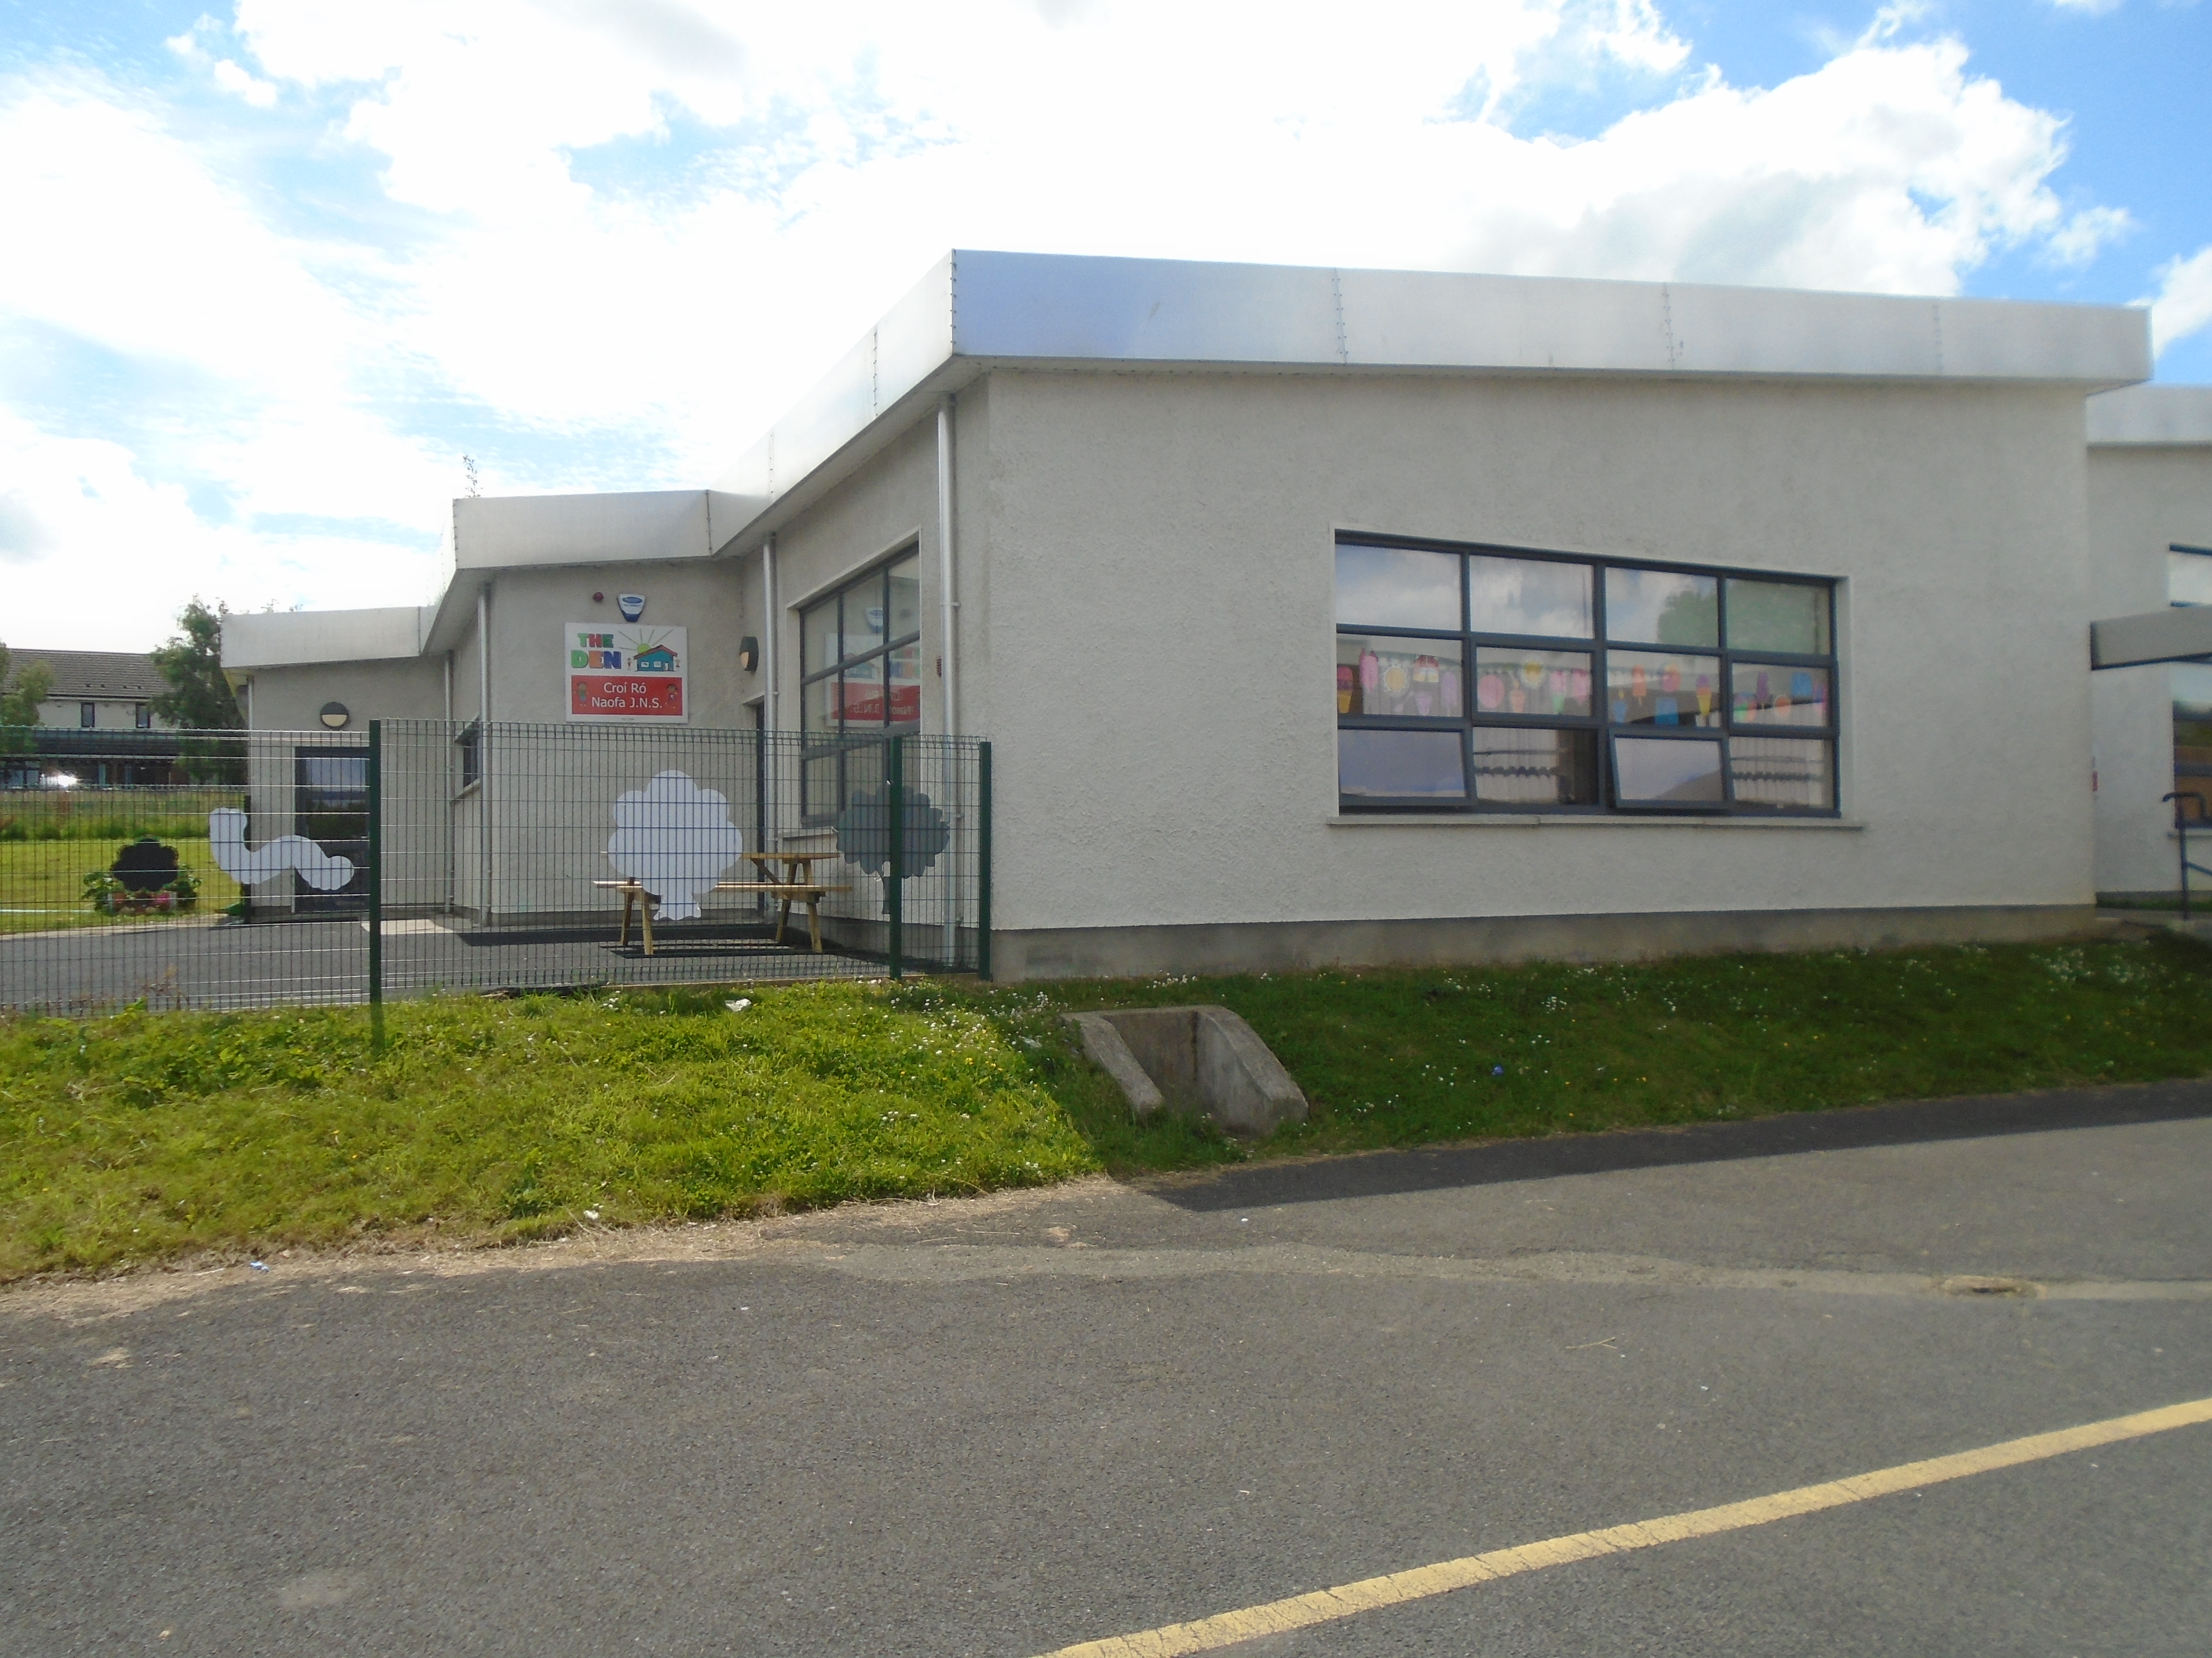
The Den
April 2020
Home-School Links

Slide 2
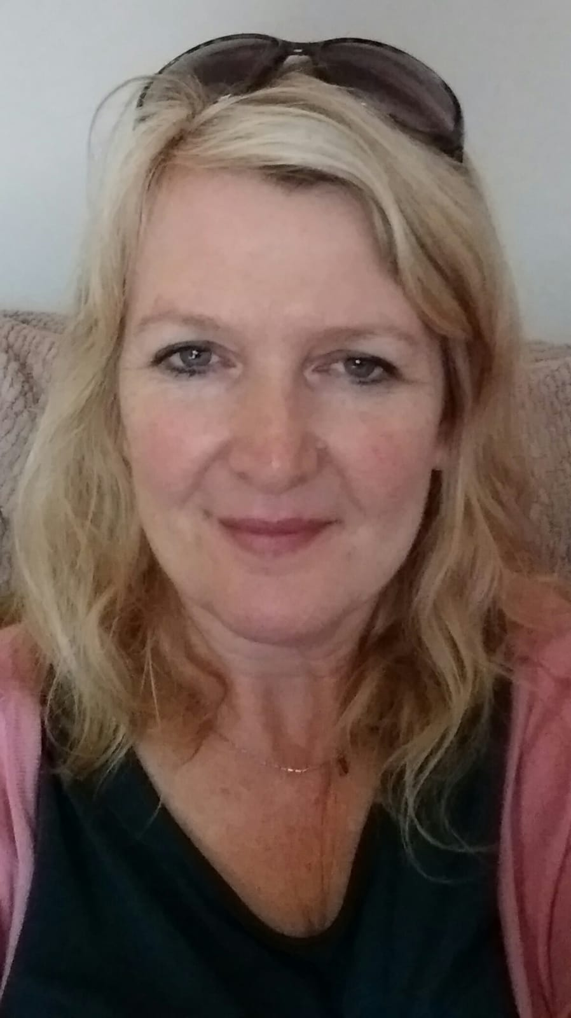
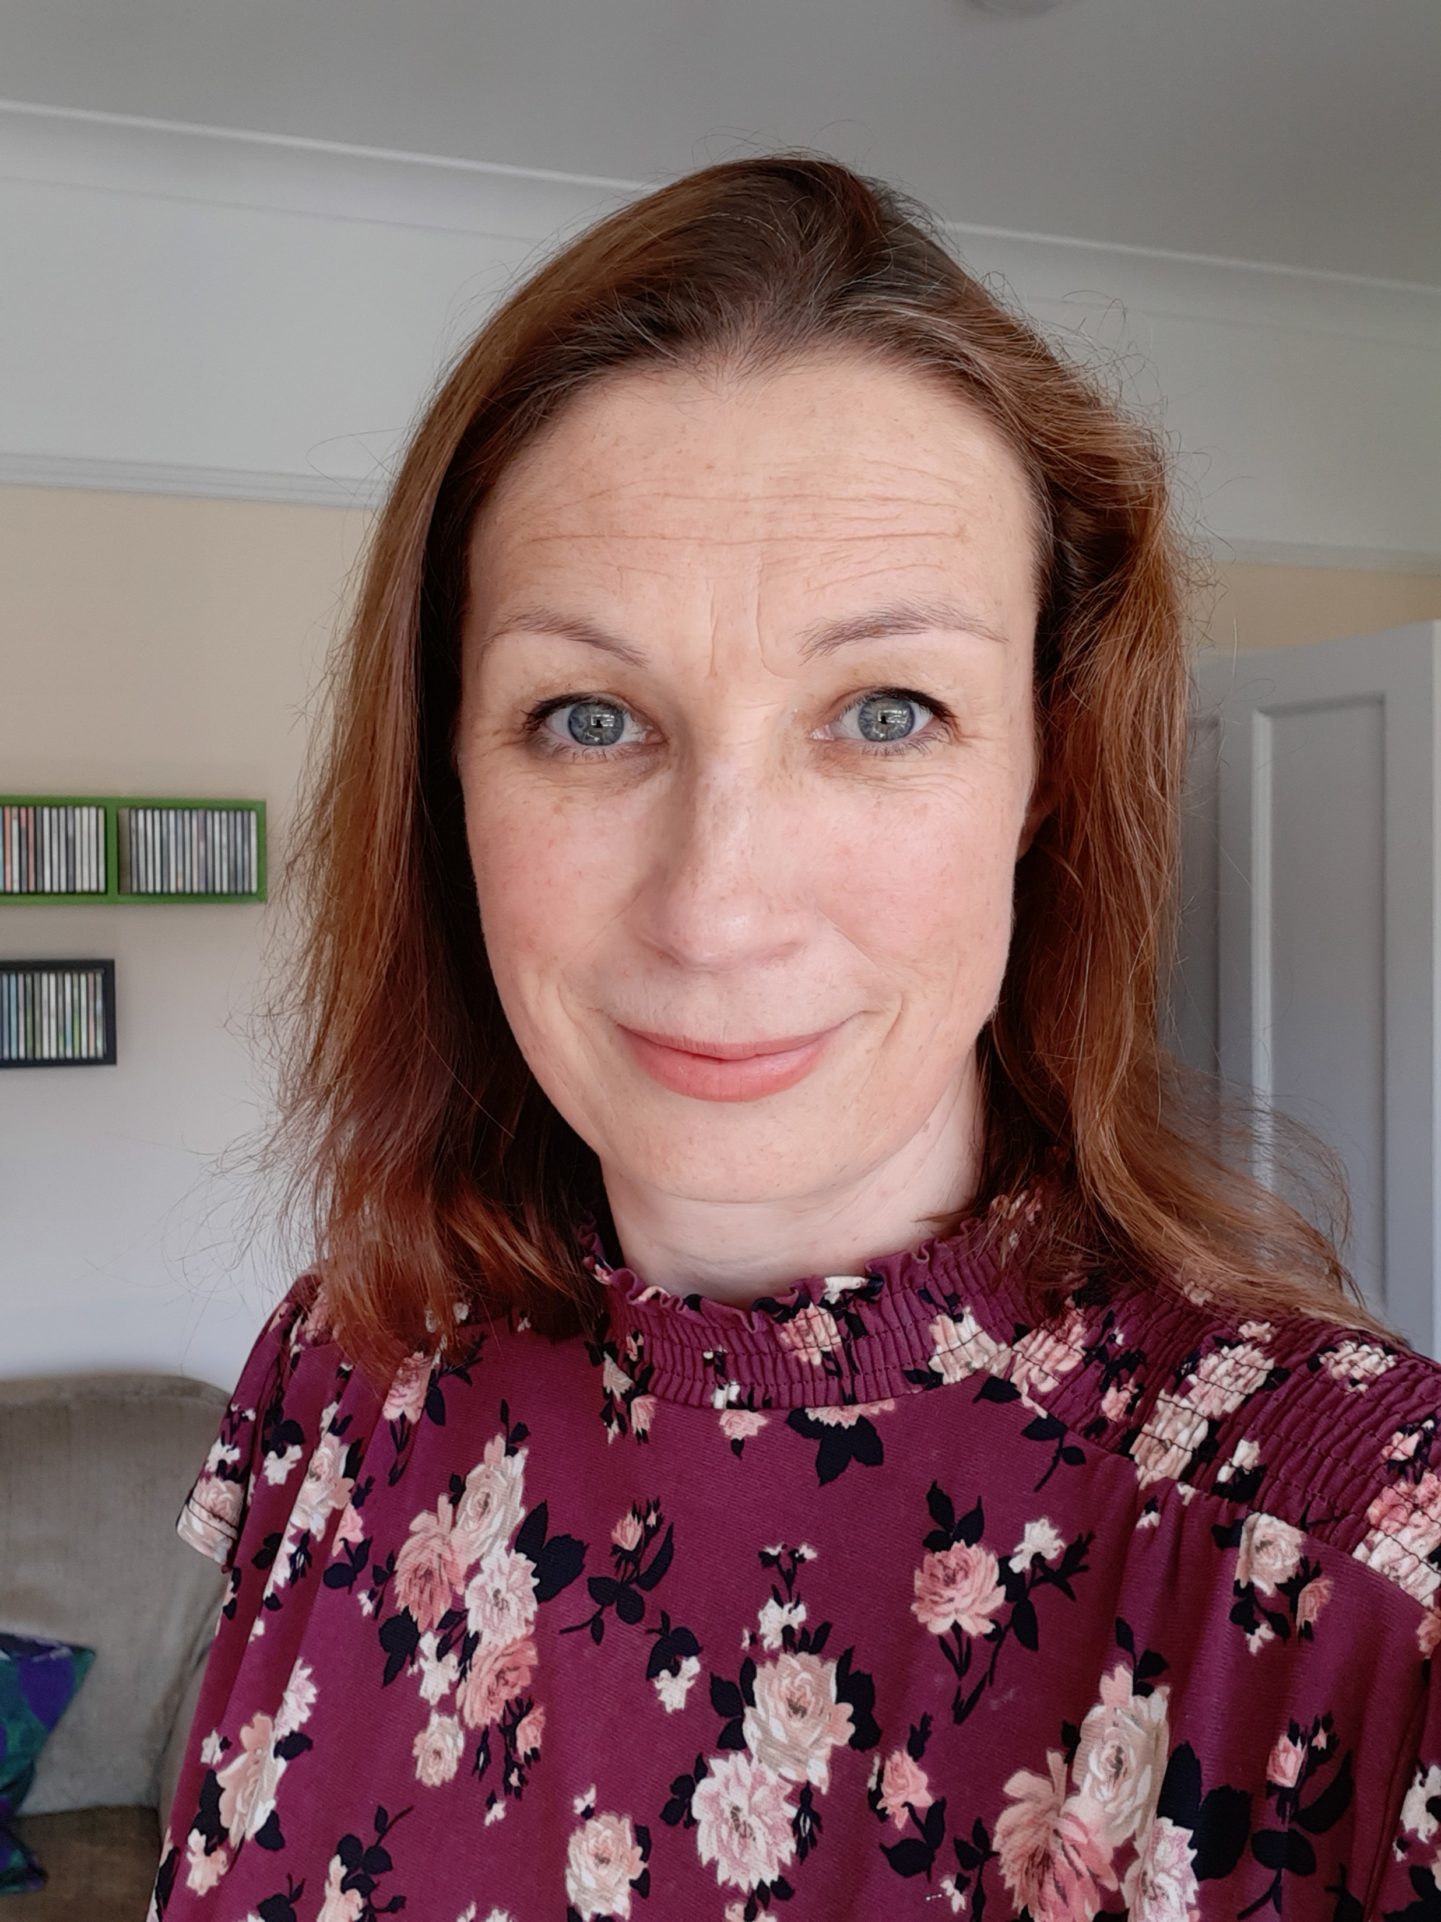
Hello boys and girls!
We miss you!

Slide 3
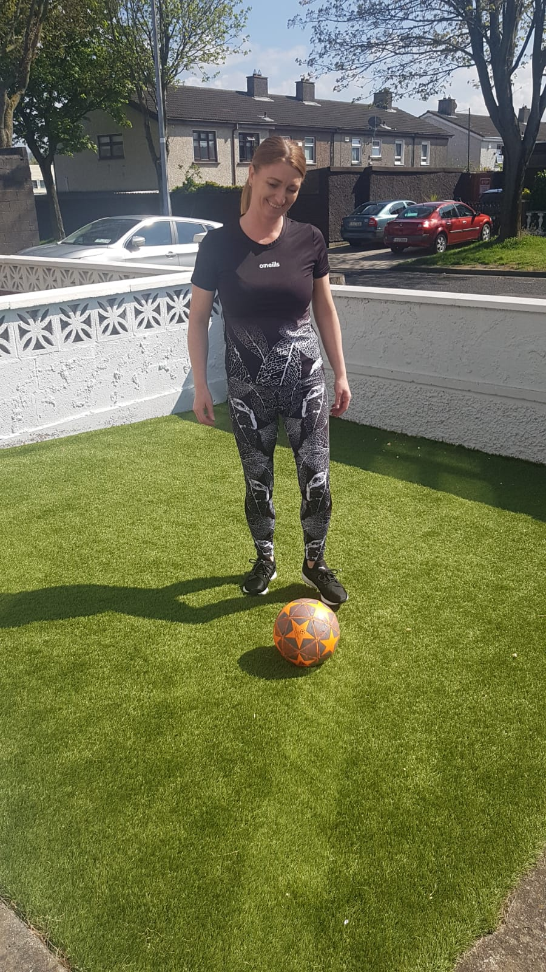
We are getting lots of exercise and fresh air!
Hope you are too?

Slide 4
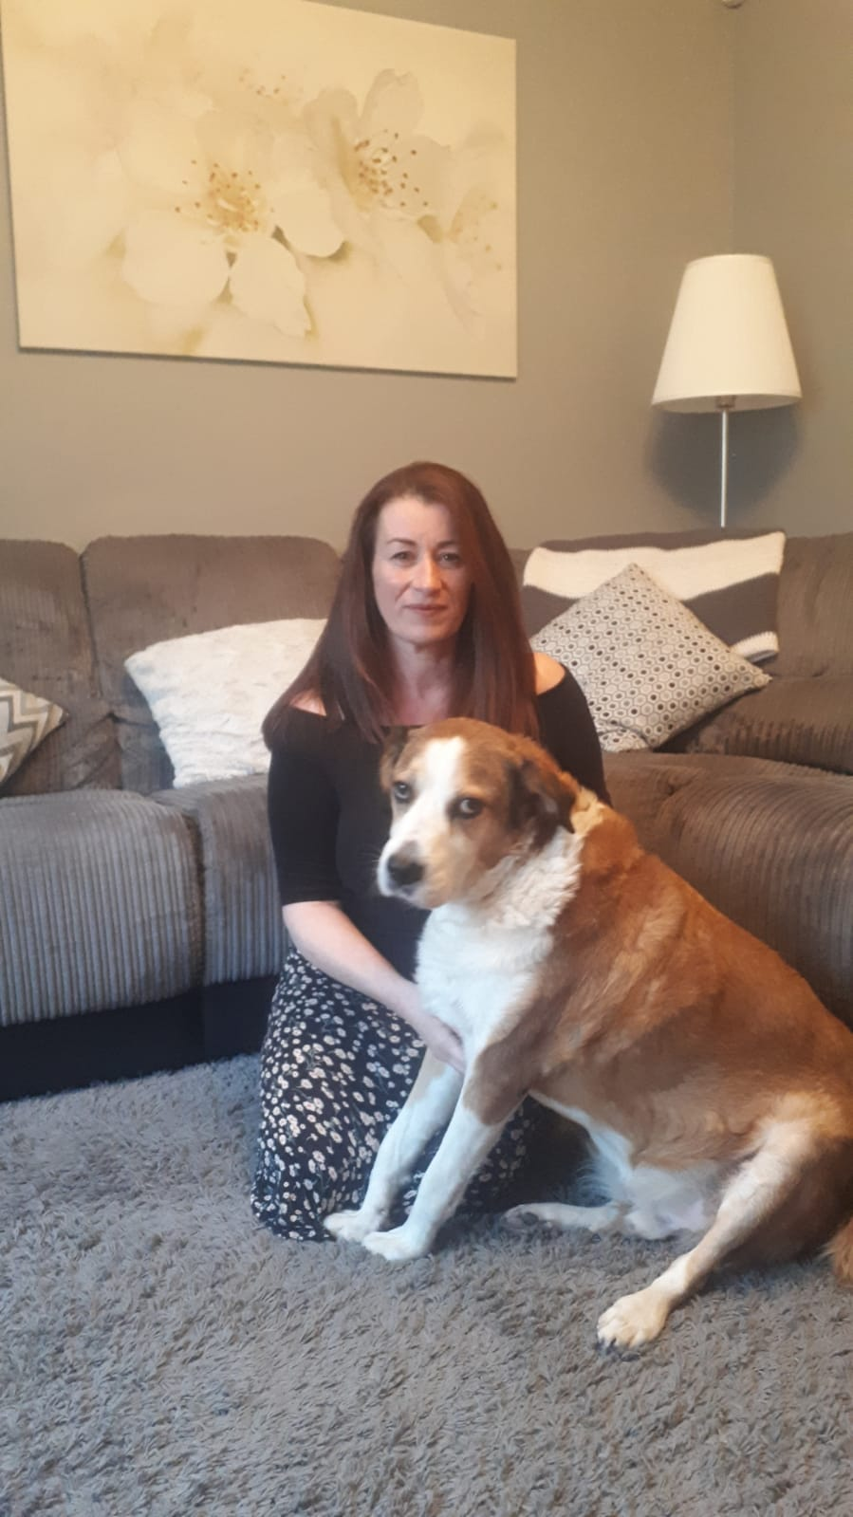
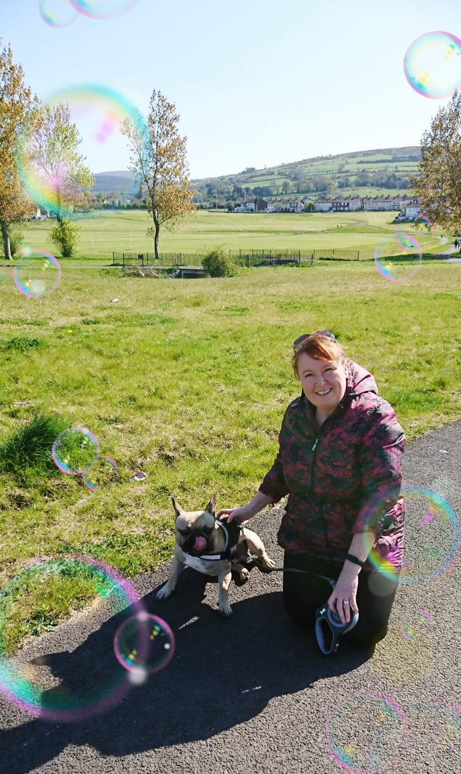
Hoping to see you soon!

Slide 5
Dear Parents/Guardians,
We hope you are all well and staying safe. We miss our wonderful Den friends.
We know that you have been trying to keep a routine going at home as much as is possible. And we are glad to hear that all children are doing well and have adapted to this ‘new normal’. However, we are all wishing, more than anything, to be back at school as soon as possible.
We have put together a few activities that you might like to try at home. There is no pressure to complete them. If some things work, that is great. If some things are not possible, that is fine too. The most important thing is the wellbeing and happiness of the children, and yourselves,
If you would like to share any photos of your child’s achievements on the school website for the Friday Gallery, you can send them to Gaye, HSCL on Whatsapp 087 7443779 or email hscl@shjkillinarden.ie
Take care of yourselves and your families,

Slide 6
CONTENTS…
Sensory Play Ideas
Gross Motor
S.E.S.E.
Cooking
Funky Fingers
Storytime
And finally…

Slide 7
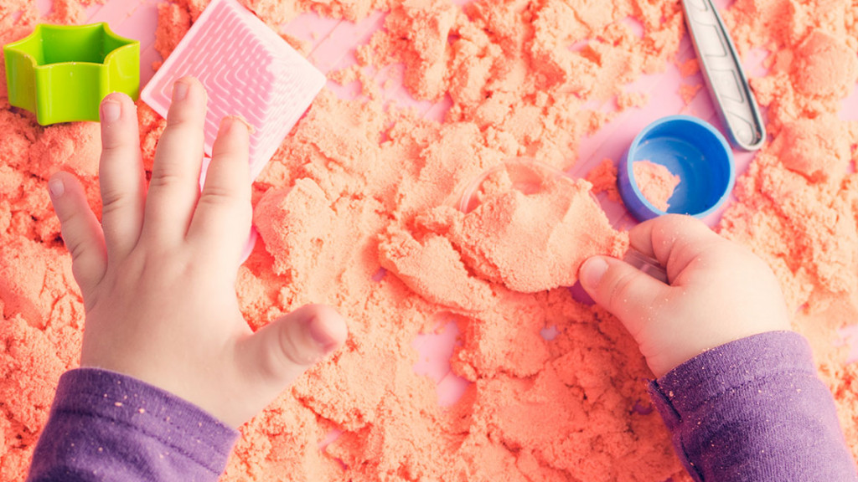
Sensory Play Ideas
Gloop – cornflour and water
Bubbles/Bubble Mountain
Shaving Foam/with food colouring
Squishy Colour Bags (paint in ziplock bags, closed with tape)
Coloured Spaghetti worms
Jelly
Wash the animals (plastic animals, nail brush)
Water or sand play (funnels, jugs, containers)
Digging for Treasure (sand/compost)
Clean Mud – flour/hot choc/water
Coloured Ice and Salt
Shaving foam colour mixing bags
Shredded paper sensory box
Coloured bubble blowing paintings
Dry porridge
Shaving foam car wash
Dinosaur swamp (grass,mud, water etc)

Slide 8
Gross Motor Activities

Slide 9
Social, Environmental & Scientific Education
FARM ANIMALS
How many farm animals can you name?
What are the animal’s babies called?
What do we get from cows?
Sheep? Hens? Pigs?

Slide 10
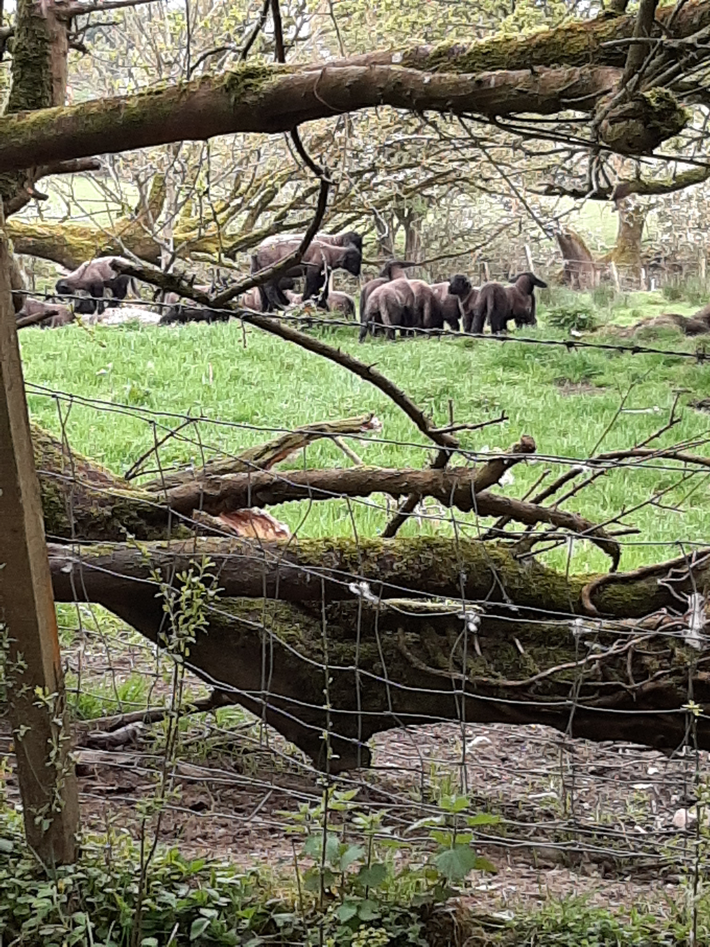
Ms. O’Meara spied some brown lambs on her walk…
What Nursery Rhymes do you know about lambs or sheep?

Slide 11
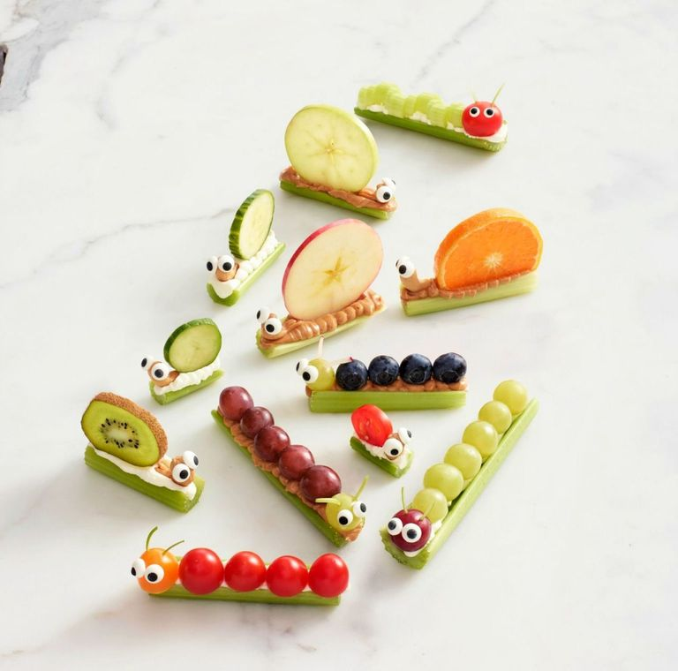
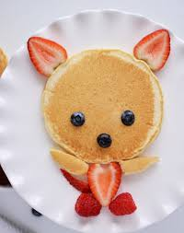
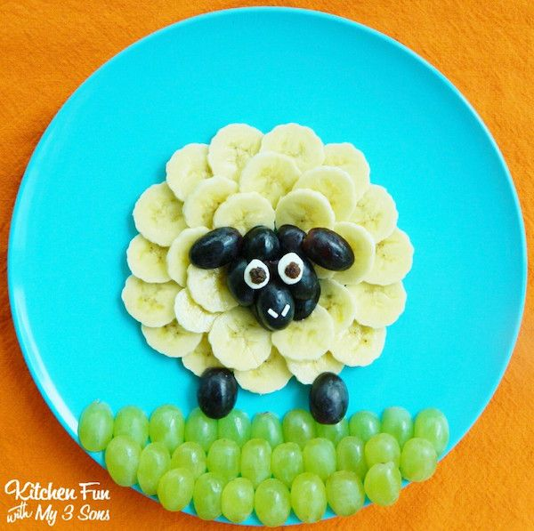
No cook food art (Inspired by Tiarnan)

Slide 12
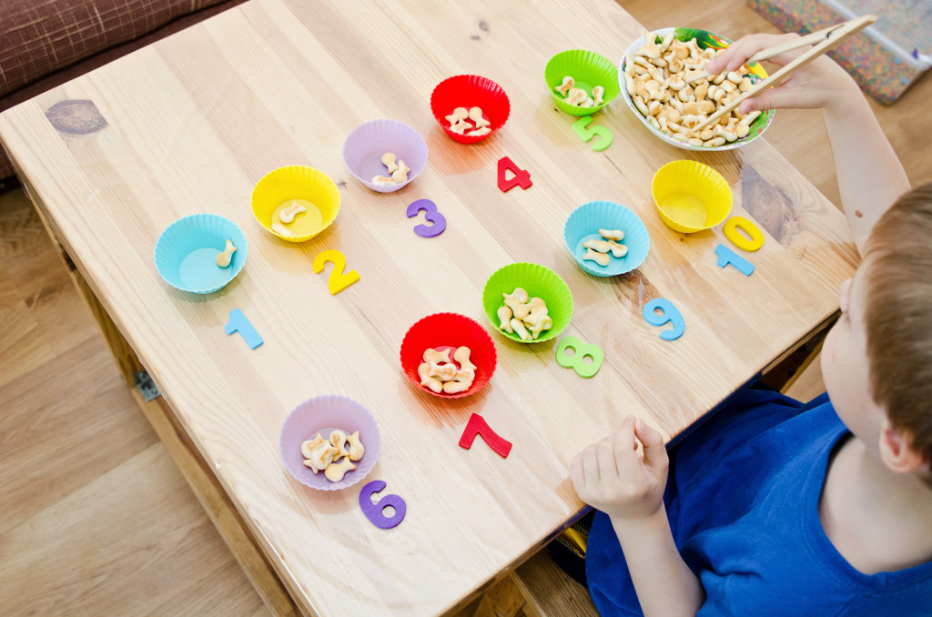
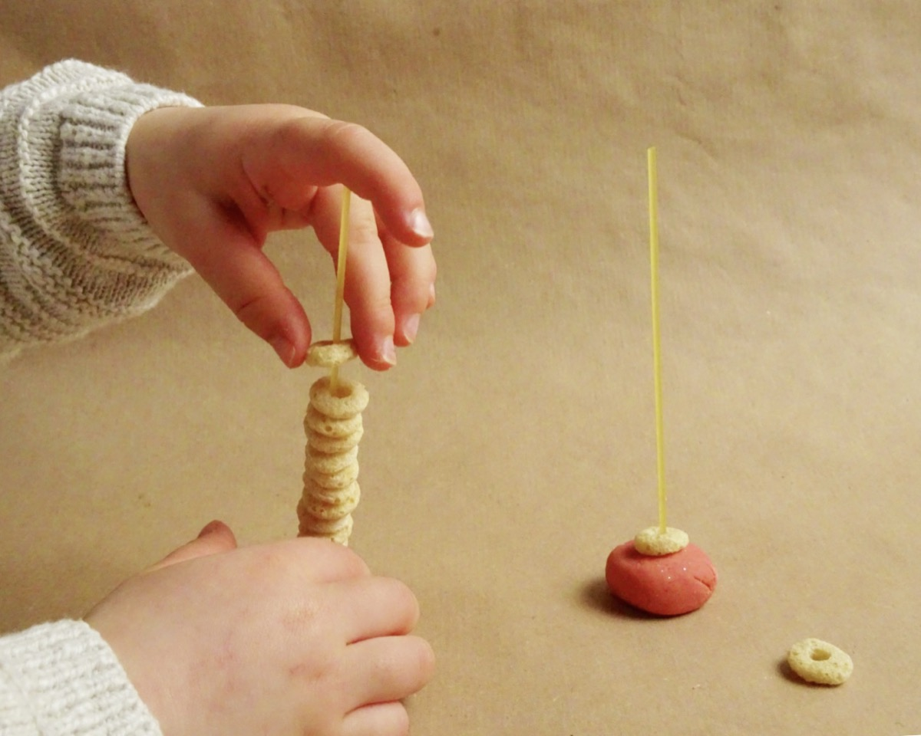
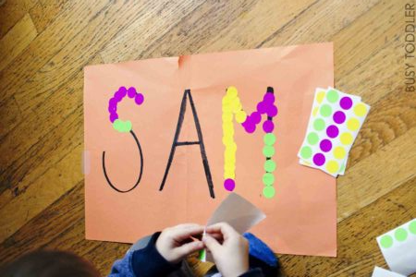
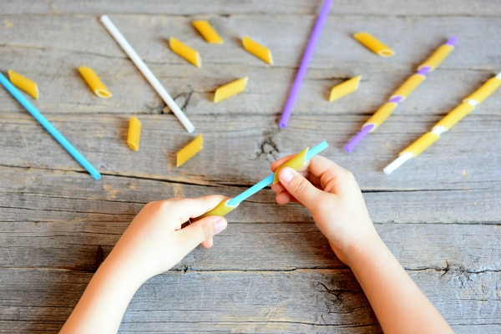
Funky Fingers (Fine Motor Skills Activities)

Slide 13
Storytime
There are a variety of websites where you can see stories animated and read aloud:
https://www.storylineonline.net
https://www.scholastic.com/teachers/teaching-tools/articles/resources/scholastic-learn-at-home--free-resources-for-school-closures.html#

Slide 14
Finally…
Children,
Keep up the great work! It is hard at the moment because you can’t do all the things you usually do but we know that you are all being very patient and we are so proud of you.
Parents, please contact us if you need anything. Take care ☺
Also on the school website, under Classes- ASD unit, you might like to check out:
Attention Autism video
Occupational Therapy games

